Slide 1
Programming – Lecture 1
Feedback from a recent conference: As a virtual participant, I followed the overall trend of disabling my webcam outside of my own talk. This makes it sooooo tempting to do other work, which of course is always detrimental to a conference. It may be a good move to motivate the virtual participants to keep their cam active in order to maintain a critical mass of visible faces.
Sooo … At lecture start time (or before) –
please show us your beautiful face, thanks!

Slide 2
Your Privacy
In the end, it’s of course up to you whether you switch on your camera or not.
However, seeing your faces allows some “class atmosphere” for you, and it would help me to judge how well things come across.
In any case, it is forbidden by law to make photos/recordings of participants.
Also, it's up to you whether you participate with your actual name or with some alias.
However, seeing your real name may help you to find buddies, and it would allow me to give you credit for contributions to the class.

Slide 3
Interaction Protocol
Per default, please have your microphone muted.
If you want to ask something/respond to a question, raise your hand – either on video, or by using “raise hand” feature in zoom.
To take your comment, I will not mention your name (to preserve anonymity), but will prompt you to unmute your microphone (a msg box will pop up on your screen)
After you made your comment, lower your hand (if you used the zoom feature), and mute your mike again.
If it's urgent or if I appear to overlook you for a longer time, you may also just switch on your mike and speak up.

Slide 4
Programming – Lecture 1
Welcome
Administrivia
Introduction (Chapter 1)
Brief history of computing
CS, Algorithms, SW Engineering, Errors
Compilation vs. Interpretation

Slide 5
We
Lecturer:
Prof. Reinhard von Hanxleden
R1117, rvh@informatik.uni-kiel.de
Staff (Mitarbeiter):
Steven Smyth (lead)
ssm@
Niklas Rentz
nre@
Alexander Schulz-Rosengarten
als@
Student Staff
(Hilfskräfte):
Liam David Boddin
Sascha Ecks
Christopher Konkel
Tim Krawczyk
Patrik Michalski
Kajus Park
Alexander Pfanne
Hendrik Sauer
Björn Schumacher

Slide 6
You?
Please visit http://pingo.upb.de/643250

Slide 7
Literature
"The Art and Science of Java,"
by Eric Roberts – our “Skript”
"Java ist auch eine Insel,"
by Christian Ullenboom
See also wiki ⤳ Begleitmaterialien

Slide 8
Code of Conduct
I:
Start and finish on time
Try to deliver high-quality lectures
Listen to your concerns
Make sure you have a fair chance of passing this class
Prepare you for what's ahead
You:
Are punctual
Do not disturb others (laptops/tablets only in last row)
Wait – we‘re in virtual space anyway, so scratch that …
Work on problems yourself (no plagiarism/code sharing)
Familiarize yourself with infprogoo.de and the linked wiki, including requirements for "Endklausurzulassung"

Slide 9
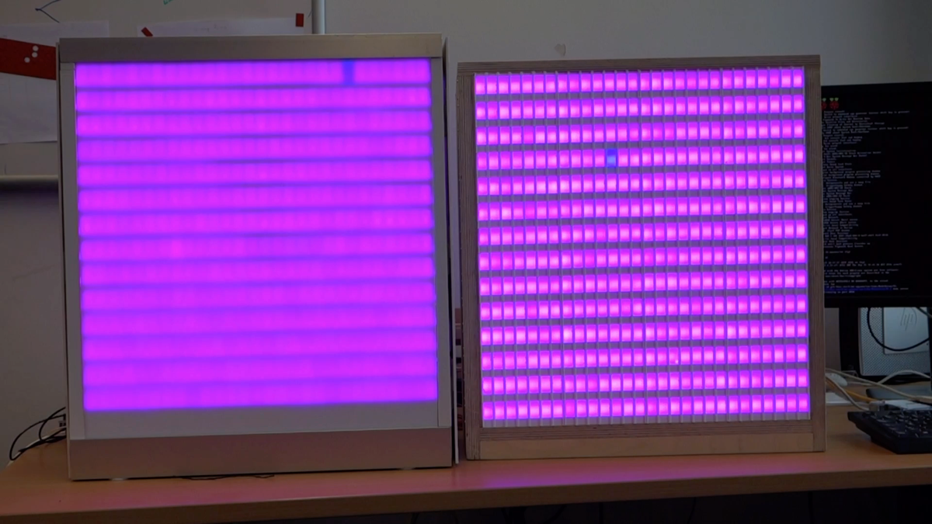
// Problem:
int color_out = 4096 / (256 / color_in);
// Solution:
int color_out = color_in << 4;

Slide 10
Programming – Lecture 1
Welcome
Administrivia
Introduction (Chapter 1)
Brief history of computing
CS, Algorithms, SW Engineering, Errors
Compilation vs. Interpretation

Slide 11
Before registering for practical class and listing your time preferences:
CHECK YOUR SCHEDULE.
It is rather irritating to get complaints of the form "I now got a time slot which conflicts with class XY, I have to change, do something", when it then turns out that you gave that very time slot as one of your top-three preferences for the practical class.
(At least you should acknowledge that it was your mistake, not ours. And yes, we will still find a solution for you ...)

Slide 12


Chapter 1—Introduction
Java
The Art and Science of
An Introduction
C H A P T E R 1
ERIC S. ROBERTS
to Computer Science
Introduction
[The Analytical Engine offers] a new, a vast, and a powerful language . . . for the purposes of mankind.
—Augusta Ada Byron, Lady Lovelace, 1843
1.1 A brief history of computing
1.2 What is computer science?
1.3 A brief tour of computer hardware
1.4 Algorithms
1.5 Stages in the programming process
1.6 Java and the object-oriented paradigm
1.7 Java and the World Wide Web

Slide 13

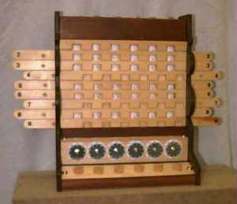
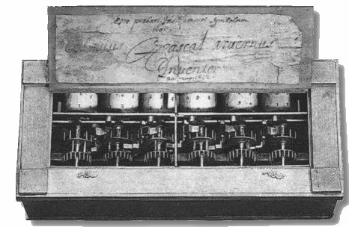
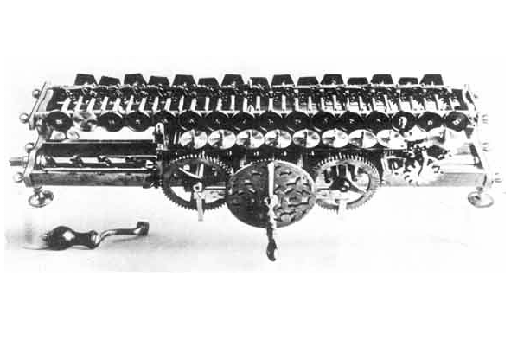
A Brief History of Computing
Although electronic computers are relatively new, mechanical computers are much older. The abacus goes back almost 4000 years.
In the 17th century, several mechanical computing devices were developed in Europe.
Reconstruction of 1623
Wilhelm Schickard machine
(Deutsches Museum, Munich)
Blaise Pascal’s 1641
“Pascaline” machine
(Musée des Arts et Metiers, Paris)
Gottfried Wilhelm von Leibniz’s
calculating wheel (ca. 1671)
(IBM)
The most important conceptual breakthroughs, however, came in the early part of the 19th century . . .

Slide 14
A Brief History of Computing
Image courtesy of Eric Roberts

Slide 15
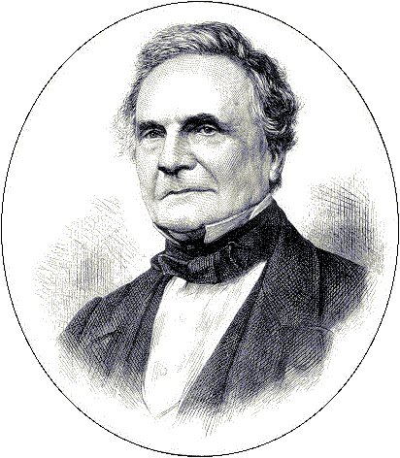
Babbage’s Machines
Charles Babbage is one of the most fascinating figures in the history of computing. Captivated by the idea that he could build a machine to produce mathematical tables, Babbage designed two machines, the Difference Engine and the Analytical Engine, that anticipated many of the features found in modern computers.
Although Babbage was unable to finish either machine during his lifetime, the Science Museum in London was able to complete a full-scale Difference Engine for the 200th anniversary of his birth.
Charles Babbage (1791-1871)

Slide 16
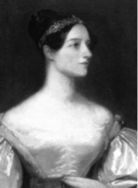
Ada Byron, The First Programmer
Augusta Ada Byron, the daughter of English poet Lord Byron, was encouraged to pursue her interests in science and mathematics at a time when few women were allowed to study those subjects. At the age of 17, Ada met Charles Babbage and became fascinated by his machines. Ada was convinced of the potential of Babbage’s Analytical Engine and wrote extensive notes on its design, along with several complex mathematical programs that have led many people to characterize her as the first programmer. In 1980, the U.S. Department of Defense named the programming language Ada in her honor.
Augusta Ada Byron,
Lady Lovelace (1815–1852)

Slide 17
The Birth of Modern Computing
The question of who invented the modern computers is not an easy one, given the competing claims for that achievement.
In 1939, John Atanasoff and Clifford Barry built a prototype computer at Iowa State and a large machine in 1942.
The first large-scale computer was the Electronic Numerical Integrator and Computer (ENIAC), completed in 1946 under the direction of J. Presper Eckert and John Mauchly at the Moore School of the University of Pennsylvania.
Conrad Zuse in Germany and the World War II cryptography team in England also built early computers.
Other important contributions during the early years include stored-programming concept generally attributed to John von Neumann and the use of switching circuits to implement binary arithmetic proposed by Claude Shannon.

Slide 18
Augusta Ada Byron,
Lady Lovelace (1815 – 1852)
Charles Babbage
(1791 – 1871)
Images courtesy of Eric Roberts

Slide 19
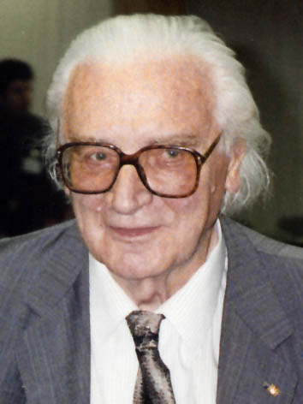
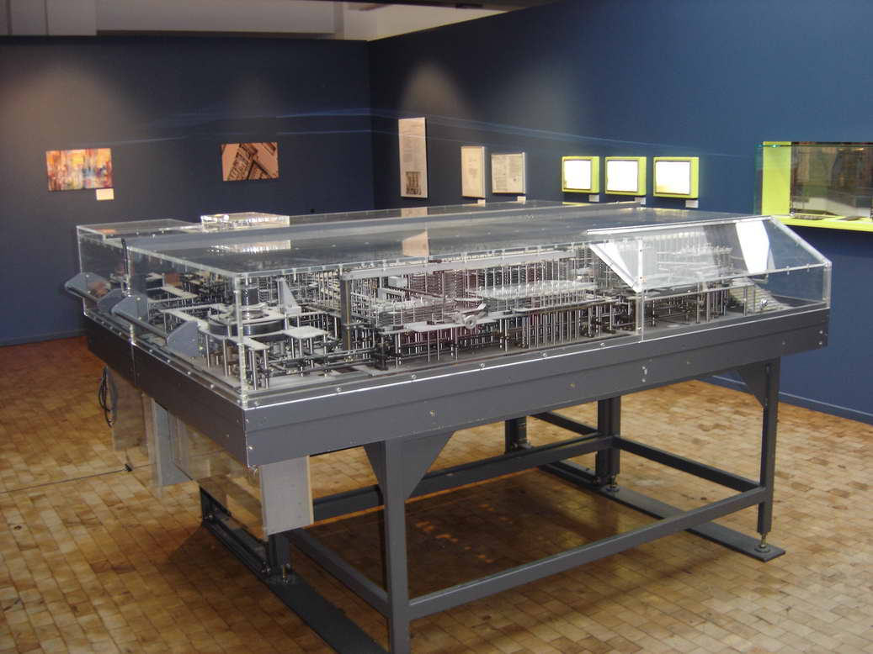
CC BY-SA 3.0
Z1
CC BY-SA 3.0
Konrad Zuse
(1910 – 1995)

Slide 20
What is Computer Science?
Many people imagine that computer science is the study of computers as artifacts and wonder how that can be a science.
Computer science has more to do with the study of problem solving in which the solutions happen to use computers.
Computer science draws on a range of intellectual traditions that includes aspects of mathematics, classical science, and engineering.
Computer science plays an increasingly important role in other disciplines:
  Biology. Computers made it possible to map the human genome.
  Economics. Computers enable the creation of better economic models.
  Psychology. Artificial intelligence helps us to understand the brain.
  Environment. Climate models require modern computing technology.
  Literature. Computerized analysis helps resolve disputed authorship.
  and most everything else . . .

Slide 21
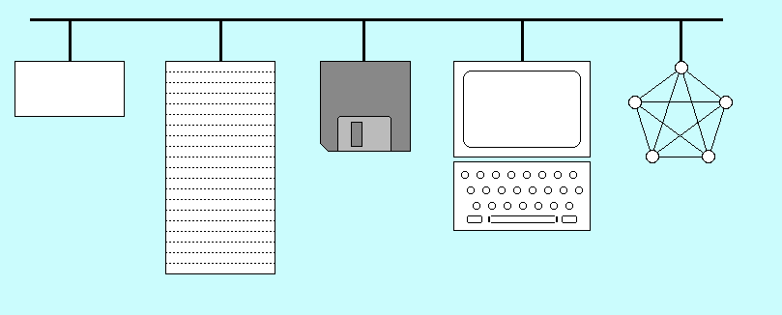
A Brief Tour of Computer Hardware
bus
CPU
secondary
network
storage
I/O
devices
memory

Slide 22
Computer Science
The science of problem solving in which the solutions happen to involve a computer
Solving a problem by computer:
Algorithmic design
Coding

Slide 23
Algorithms
Much of computer science involves the study of algorithms.
In an informal sense, you can think of an algorithm as simply a procedure for solving a problem.
To meet its more formal definition, an algorithm must be:
  Clearly and unambiguously defined.
  Effective, in the sense that its steps are executable.
  Finite, in the sense that it terminates after a bounded number of steps.

Slide 24
Algorithm
Ninth-century Persian mathematician Abu Ja‘far Mohammed ibn Mûsâ al-Khowârizmî
Properties:
Clearly and unambiguously defined
Effective
Finite

Slide 25
Software Engineering
Discipline of writing programs so that they can be understood and maintained by others

Slide 26
Stages in the Programming Process
Each computer system understands a low-level language that is specific to that type of hardware, which is called its machine language.
Programmers typically write their software in a higher-level language that is easier for humans to understand.
To execute a programs written in a higher-level language, the computer must adopt one of two strategies:
  The classical approach is to translate the higher-level language into machine language. This strategy is called compilation.
  A second approach is to simulate the program operation without actually translating it to machine language. This strategy is called interpretation.
Java uses a hybrid strategy:
  Programs are compiled into an intermediate language that serves as the machine language for the Java Virtual Machine (JVM).
  Java then interprets those programs by simulating the JVM.

Slide 27
Programming Errors
Distinguish
Syntax errors
Bugs
„The first step [in all of my inventions] is an intuition, and comes with a burst, then difficulties arise – this thing gives out and [it is] then that ‘Bugs’ – as such little faults and difficulties are called – show themselves […].“
Thomas Edison, 18 Nov 1878

Slide 28
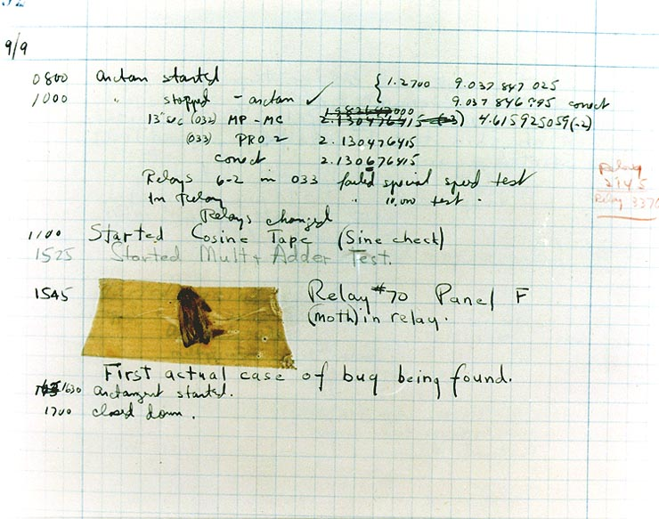
[U.S. Naval Historical Center Online Library]
Page from the Harvard Mark II electromechanical computer's log, 1947

Slide 29
Why Java in InfProgOO?
First of all: why ask that question? This class is about programming principles, not about a particular programming language.
Having said that: to really learn the principles, one should write real programs, for which a concrete language X must be chosen.
Choice of X should be guided by a few questions ...

Slide 30
Questions to Ask Concerning X
Does X illustrate imperative/object-oriented programming?
Is it reasonably easy to learn X, are there good resources available for learning X?
Does the teaching staff have good expertise on X?
Do later classes and software projects at CAU also use X?
Does knowledge of X help me after graduation?
Clear “yes” to all of these for X = Java.

Slide 31
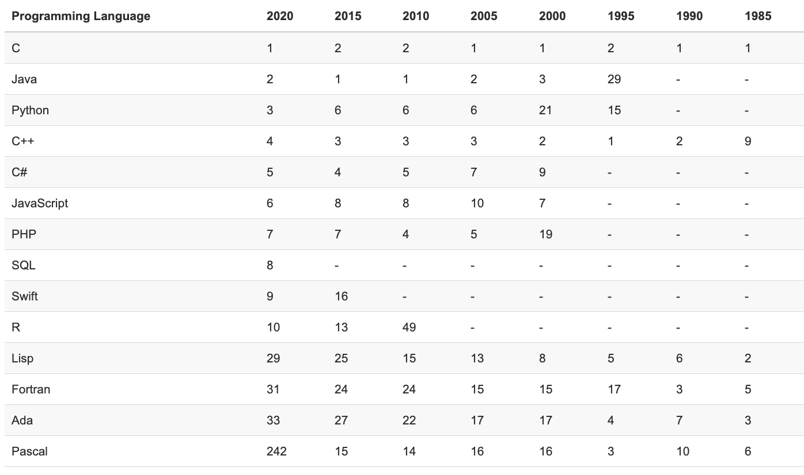
www.tiobe.com

Slide 32
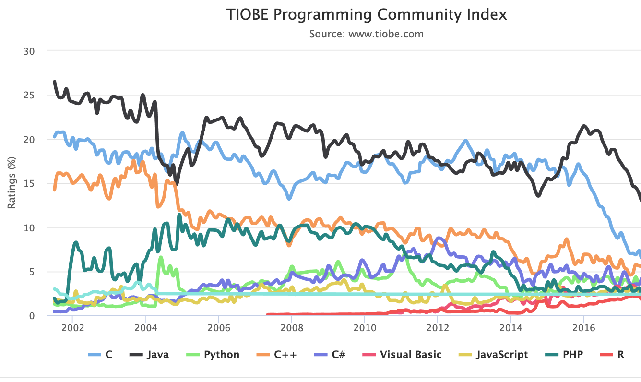
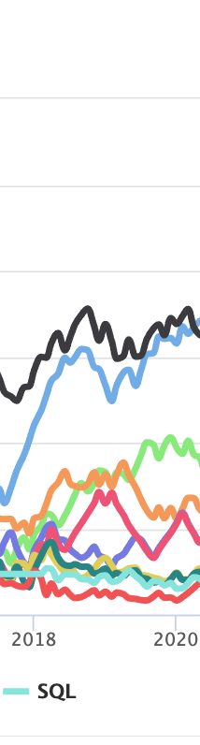
See also http://www.tiobe.com/tiobe-index/programming-languages-definition/

Slide 33
Java – the undisputed winner
Java still continues to top the most popular programming languages charts as it did a year ago. According to TIOBE’s data, Java has secured the first and second positions more than any other languages for about a couple of decades. A large number of renowned companies use Java to develop software and applications so if you happen to know Java, you definitely won’t have to struggle to find a job. The major reasons behind the popularity of Java are its portability, scalability and a large community of users.
https://fossbytes.com/most-popular-programming-languages/
June 2018

Slide 34
Java – Design Goals
Simple, object oriented, familiar
Robust, secure
Architecture neutral, portable
High performance
Interpreted, threaded, dynamic
White Paper: The Java Language Environment
James Gosling and Henry McGilton, May 1996
Notes:
OO: started in 1960s in Scandinavia with Simula, most terminology from there
Late 1970s: Smalltalk, developeed at Xerox Palo Alto Research Center (PARC)
OO adapted in variants of C, most successfully in C++
1991: Sun initiated Java, originally for embedded devices
In early 1990s WWW arose, so in 1993 Sun redesigned Java for web applications

Slide 35
Classic Compilation Process
source file
object file
gcc hello.c
#include <stdio.h>
int main() {
printf("hello\n");
}
0100100101011001000
1000010100011101011
0110100111010101100
a.out
compiler
executable file
0100100101011001000
1000010100011101011
0110100111010101100
1001011010110001011
0100100101001011011
0101101011010100101
linker
other object files
and libraries
1001011010110001011
0100100101001011011
0101101011010100101
Graphic courtesy of Eric Roberts

Slide 36
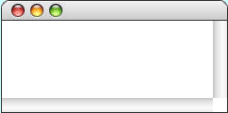
The Java Interpreter
javac Hello.java
Hello.class
source file
class file
JAR archive
public class Hello {
public static void
main(String[] args)
{
System.out.
println("hello");
}
}
CA FE BA BE 00 03 00
00 16 07 00 1A 07 00
00 04 00 07 0C 00 13
01 00 16 2B 4C 6A 61
CA FE BA BE 00 03 00
00 16 07 00 1A 07 00
00 04 00 07 0C 00 13
01 00 16 2B 4C 6A 61
47 72 61 70 68 69 63
2D 00 1F 08 00 0F 07
14 0A 00 02 00 08 0A
00 18 0C 00 17 00 1C
compiler
archive
other class files
JVM
47 72 61 70 68 69 63
2D 00 1F 08 00 0F 07
14 0A 00 02 00 08 0A
00 18 0C 00 17 00 1C
java Hello
Hello
hello
Graphic courtesy of Eric Roberts

Slide 37
Java and the Object-Oriented Paradigm
Programming languages typically support a particular style of use, which is called its programming paradigm.
Traditional languages like FORTRAN, Pascal, and C use the procedural paradigm, in which the programmer defines the algorithmic operations and data structures independently.
Modern languages like Java tend to favor the object-oriented paradigm in which the programmer defines the algorithmic and data structure of a program in a more integrated way.
In Java, programs are written as collections of classes, which serve as templates for individual objects. Each object is an instance of a particular class; a single class can serve as a pattern for many different objects.

Slide 38
Java and the World-Wide Web
Part of Java’s success comes from the fact that it is the first language specifically designed to take advantage of the power of the World-Wide Web, which came into prominence shortly before Java’s release in 1995.
In addition to more traditional application programs, Java makes it possible to write small interactive programs called applets that run under the control of a web browser.
The programs that you will learn to write in this book run as either applications or applets, which means that you can easily share them on the web.

Slide 39
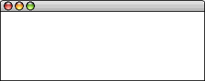
Running a Java Applet
Steps taken by the applet author
Steps taken by the applet user
1.
The author of the web page writes the code for a program to run as an applet.
4.
The user enters the URL for the applet page into a web browser.
HelloProgram.java
/* File: HelloProgram.java */
import acm.graphics.*;
import acm.program.*;
public class HelloProgram extends GraphicsProgram {
public void run() {
add(new GLabel("hello, world", 75, 100));
}
}
5.
The browser reads and interprets the HTML source for the web page.
6.
The appearance of an applet tag in the HTML source file causes the browser to download the compiled applet over the network.
2.
The applet author then uses a Java compiler to generate a file containing the intermediate code for the applet.
7.
A verifier program in the browser checks the applet intermediate code to ensure that it does not violate the security of the user’s system.
HelloProgram.jar
CA FE BA BE 00 03 00 2D 00 1F 08 00 0F 07 C8 00
00 16 07 00 1A 07 00 14 0A 00 02 00 08 0A 00 5F
00 04 00 07 0C 00 13 00 18 0C 00 17 00 1C 72 A4
01 00 16 28 4C 6A 61 76 61 2F 61 77 74 2F 00 FF
3.
8.
The Java interpreter in the browser program runs the compiled applet, which generates the desired display on the user’s console.
The applet author publishes an HTML web page that includes a reference to the compiled applet.
HelloProgram.html
HelloProgram
<html>
<title>HelloProgram</title>
<applet archive="HelloProgram.jar"
code="HelloProgram.class"
width=300 height=150>
</applet>
</html>
hello, world

Slide 40
Summary
Long history of computing, recent acceleration
Defined “CS”, “Algorithm”, “SW Engineering”
Syntax errors vs. Bugs
Discussed Java design goals
Compilation vs. Interpretation

