Slide 1
Five-Minute Review
What is a class hierarchy?
Which graphical coordinate system is used by Java (and most other languages)?
Why is a collage a good methapher for GObjects?
What is a CFG? What is it useful for?
What is the language defined by a CFG?
Notes:
Classes form hierarchies; each class can have one (in Java) superclass and an arbitrary number of subclasses.
Origin is top left, coordinates given in pixels, x-coordinates increase to the right, y-coordinates increase downwards
At a given coordinate you always see what is placed there last; objects become visible again when other things on top of them get removed
A context free grammar (CFG) consists of a set of nonterminal characters/variables (V), an alphabet/set of terminals (Σ), a set of rewrite rules/productions (R), and a start symbol (S). It is useful for precisely defining the syntax of a language, including programming languages (or at least significant parts thereof) such as Java.
The language of a CFG is the set of strings over Σ* that can be derived from S via an arbitrary number of derivations using R.

Slide 2
Five-Minute Review
What is an abstract data type?
What is an expression? A term?
What is an assignment?
What is precedence? Associativity?
How are expressions evaluated?
Notes:
Set of variables + set of operations + (formal or informal) specification; ADT abstracts from implementation
Expression: terms joined by operators. Term: literal/unnamed constant, variable name, method call, or expression in parentheses.
Assignment changes value of a variable
Precedence and associativity determine what operands belong to which operators. Precedence relates different operators, associativity relates the same operators.
Operands are recursively evaluated left-to-right, according to operator/operand-bindings established by paren's, precedence and associativity.
Extra questions:
What do you know about Booleans?
Primitive data type, can be true or false, can apply logical operations (and, not, or, xor)
What is a variable declaration?
Declaration establishes name and type of variable, perhaps also initial value.

Slide 3
Programming – Lecture 4
Statement Forms (Chapter 4)
Repeat N-Times Pattern
Repeat-Until-Sentinel Pattern
if/else
? :
switch
while, do while
Loop-and-a-Half Pattern
for
Animation

Slide 4

Chapter 4—Statement Forms
Java
The Art and Science of
An Introduction
C H A P T E R 4
ERIC S. ROBERTS
to Computer Science
Statement Forms
The statements was interesting but tough.
—Mark Twain, The Adventures of Huckleberry Finn, 1884
4.1 Statement types in Java
4.2 Control statements and problem solving
4.3 The if statement
4.4 The switch statement
4.5 The while statement
4.6 The for statement

Slide 5
Statement Types
Recall: Expressions, have type, are interested in value
Recall: Classes, Methods, Statements
Statements: units of run-time execution,
are interested in side effect
Distinguish
Expression statements
Declaration statements
Control flow statements
Compound statements (blocks)

Slide 6
Expression Statements
The following expressions, terminated with semicolon, form expression statements
Assignment expressions
aValue = 8933.234;
Any use of ++ or --
aValue++;
Method invocations
System.out.println("Hello!");
Math.signum(42);
Object creation expressions
new Bicycle();
Note: the book lists simple statements, defined as “expression;”, instead of listing expression/declaration statements.
However, declarations are not expressions, and not all expressions (such as “17”) lead to valid statements.
Notes:
Expression statements are statements that result from terminating expression with a semicolon.
See also https://docs.oracle.com/javase/tutorial/java/nutsandbolts/expressions.html
http://docs.oracle.com/javase/specs/jls/se9/html/jls-14.html#jls-14.8
When an expression in a program is evaluated (executed), the result denotes one of three things: [...] - Nothing (the expression is said to be void)
https://docs.oracle.com/javase/specs/jls/se8/html/jls-15.html

Slide 7
Statement Types in Java
Programs in Java consist of a set of classes. Those classes contain methods, and each of those methods consists of a sequence of statements.
Statements in Java fall into three basic types:
  Simple statements (expression statements or declaration statements)
  Compound statements
  Control statements
Compound statements (also called blocks) consist of a sequence of statements enclosed in curly braces.
Control statements fall into two categories:
  Conditional statements that specify some kind of test
  Iterative statements that specify repetition

Slide 8
if Statement
if (condition) {
statements to be executed if the condition is true
}
if (condition) {
statements to be executed if the condition is true
} else {
statements to be executed if the condition is false
}
Notes:
The simplest of the control statements is the if statement, which occurs in two forms. You use the first form whenever you need to perform an operation only if a particular condition is true:
You use the second form whenever you want to choose between two alternative paths, one for cases in which a condition is true and a second for cases in which that condition is false:

Slide 9
Cascading if Statement
if (condition₁) {
statements₁
} else if (condition₂) {
statements₂
. . . more else/if conditions . . .
} else {
statements_{else}
}
Notes:
The simplest of the control statements is the if statement, which occurs in two forms. You use the first form whenever you need to perform an operation only if a particular condition is true:
You use the second form whenever you want to choose between two alternative paths, one for cases in which a condition is true and a second for cases in which that condition is false:

Slide 10

Dangling Else
if (x > 0)
if (doprint)
println(“x positive”);
else
if (doprint)
println(“x not positive”);
Notes:
Dangling else problem. Ambiguity of matching an else to one of the preceding if statements.

Slide 11
Coding Advice – Conditionals
To avoid "dangling else":
If an if has an else clause,
always make if clause a block (add braces)
In general, it is a good idea to use blocks with conditionals
Possible exception: single statements, on same line (at least in C/C++ this is still common, in Java less so)
Bad: if (x > 0)
x++;
Ok: if (x > 0) x++;
Good: if (x > 0) {
x++;
}
Notes:
Dangling else problem. Ambiguity of matching an else to one of the preceding if statements.

Slide 12
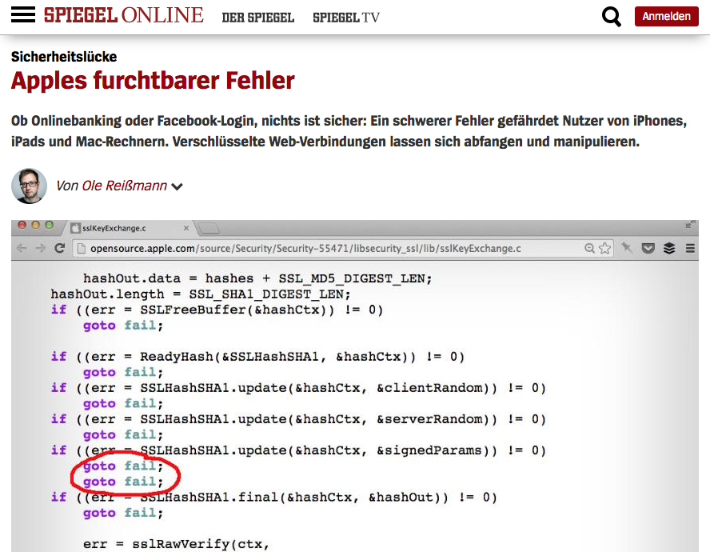

Slide 13
Choosing between if and if/else
As is true with most programming constructs, there is no hard-and-fast rule that will tell you whether you need the basic if statement or the if/else form.
As is true with most programming constructs, there is no hard-and-fast rule that will tell you whether you need the basic if statement or the if/else form.
public void run() {
println("This program averages a list of numbers.");
println("Enter values, one per line, using " + SENTINEL);
println("to signal the end of the list.");
int total = 0;
int count = 0;
while (true) {
int value = readInt(" ? ");
if (value == SENTINEL) break;
total += value;
count++;
}
double average = (double) total / count;
println("The average is " + average + ".");
}
if (value != 0) {
}
The best general guideline is to think about the English description of the problem you are trying to solve. If that description contains the words else or otherwise, there is a good chance that the solution will use the else keyword.
The best general guideline is to think about the English description of the problem you are trying to solve. If that description contains the words else or otherwise, there is a good chance that the solution will use the else keyword.
total += value;
count++;
total += value;
count++;
total += value;
count++;
As an example, suppose that you wanted to change the AverageList program so that it didn’t include any zero values in the average. Here, you need a simple if statement that makes sure that the score is not equal to 0.
As an example, suppose that you wanted to change the AverageList program so that it didn’t include any zero values in the average. Here, you need a simple if statement that makes sure that the score is not equal to 0.
total += value;
count++;
total += value;
count++;
total += value;
count++;
total += value;
count++;
total += value;
count++;
}
double average = (double) total / count;
println("The average is " + average + ".");
}
}
double average = (double) total / count;
println("The average is " + average + ".");
}
}
double average = (double) total / count;
println("The average is " + average + ".");
}
}
double average = (double) total / count;
println("The average is " + average + ".");
}
}
double average = (double) total / count;
println("The average is " + average + ".");
}
}
double average = (double) total / count;
println("The average is " + average + ".");
}
}
double average = (double) total / count;
println("The average is " + average + ".");
}
}
double average = (double) total / count;
println("The average is " + average + ".");
}
If you also wanted to count the nonzero scores, you would need to add an else clause to increment a counter variable in the case that value was equal to 0.
nonzero

Slide 14
Common Forms of the if Statement
The examples in the book use the if statement in the following forms:
Single line if statement
Multiline if statement with curly braces
if (condition) statement
if (condition) {
statement
. . . more statements . . .
}
if/else statement with curly braces
Cascading if statement
if (condition) {
statements_{true}
} else {
statements_{false}
}
if (condition₁) {
statements₁
} else if (condition₂) {
statements₂
. . . more else/if conditions . . .
} else {
statements_{else}
}

Slide 15
switch Statement
switch ( expression ) {
case v₁:
statements to be executed if expression = v₁
break;
case v₂:
statements to be executed if expression = v₂
break;
. . . more case clauses if needed . . .
default:
statements to be executed if no values match
break;
}
Notes:
The switch statement provides a convenient syntax for choosing among a set of possible paths:
If none of the values in the case clauses match the expression, Java evaluates the statements in the default clause.
Java evaluates the statements in a case clause until it reaches the break statement, which should appear at the end of each clause.
Java then looks for a case clause that matches expression. If expression was equal to v₂, Java would choose the second clause.
When Java executes a switch statement, it begins by evaluating expression, which must produce an integer-like value.

Slide 16
public void run() {
println("This program shows the number of days in a month.");
int month = readInt("Enter numeric month (Jan=1): ");
switch (month) {
case 2:
println("28 days (29 in leap years)");
break;
case 4: case 6: case 9: case 11:
println("30 days");
break;
case 1: case 3: case 5: case 7: case 8: case 10: case 12:
println("31 days");
break;
default:
println("Illegal month number");
break;
}
}
Note: the Eclipse default format looks different:
Cases not indented
New line for each case
Notes:
The switch statement is useful when the program must choose among several cases, as in the following example:

Slide 17
Coding Advice – Switch Statement
A popular programming mistake:
forgetting the break statement.
If you really want a "non-trivial" fall-through case, indicate so with comment
Always include default
switch (var) {
// Trivial fall-through from 1 to 2
case 1: case 2:
println("var is 1 or 2");
break;
case 3:
println("var is 3");
// no break here
case 4:
println("var is 3 or 4");
break;
default:
println("var is not 1 ... 4");
break;
}

Slide 18
Control Statements and Problem Solving
Before looking at the individual control statement forms in detail, it helps to look more holistically at a couple of programs that make use of common control patterns.
The next few slides extend the Add2Integers program from Chapter 2 to create programs that add longer lists of integers. These slides illustrate three different strategies:
  Adding new code to process each input value
  Repeating the input cycle a predetermined number of times
  Repeating the input cycle until the user enters a special sentinel value

Slide 19
The Add4Integers Program
If you don’t have access to control statements, the only way you can increase the number of input values is to add a new statement for each one, as in the following example:
public class Add4Integers extends ConsoleProgram {
public void run() {
println("This program adds four numbers.");
int n1 = readInt("Enter n1: ");
int n2 = readInt("Enter n2: ");
int n3 = readInt("Enter n3: ");
int n4 = readInt("Enter n4: ");
int total = n1 + n2 + n3 + n4;
println("The total is " + total + ".");
}
}
This strategy, however, is difficult to generalize and would clearly be cumbersome if you needed to add 100 values.

Slide 20
Add4Integers
public class Add4Integers extends ConsoleProgram {
public void run() {
println("This program adds four numbers.");
int n1 = readInt("Enter n1: ");
int n2 = readInt("Enter n2: ");
int n3 = readInt("Enter n3: ");
int n4 = readInt("Enter n4: ");
int total = n1 + n2 + n3 + n4;
println("The total is " + total + ".");
}
}

Slide 21
The Repeat-N-Times Idiom
One strategy for generalizing the addition program is to use the Repeat-N-Times idiom, which executes a set of statements a specified number of times. The general form of the idiom is
for (int i = 0; i < repetitions; i++) {
statements to be repeated
}
for (int i = 0; i < repetitions; i++) {
statements to be repeated
}
As is true for all idiomatic patterns in this book, the italicized words indicate the parts of the pattern you need to change for each application. To use this pattern, for example, you need to replace repetitions with an expression giving the number of repetitions and include the statements to be repeated inside the curly braces.

Slide 22
The Repeat-N-Times Idiom
One strategy for generalizing the addition program is to use the Repeat-N-Times idiom, which executes a set of statements a specified number of times. The general form of the idiom is
for (int i = 0; i < repetitions; i++) {
statements to be repeated
}
for (int i = 0; i < repetitions; i++) {
statements to be repeated
}
The information about the number of repetitions is specified by the first line in the pattern, which is called the header line.
As is true for all idiomatic patterns in this book, the italicized words indicate the parts of the pattern you need to change for each application. To use this pattern, for example, you need to replace repetitions with an expression giving the number of repetitions and include the statements to be repeated inside the curly braces.
The statements to be repeated are called the body of the for statement and are indented with respect to the header line.
A control statement that repeats a section of code is called a loop.
Each execution of the body of a loop is called a cycle.

Slide 23
Repeat-N-Times Idiom
for (int i = 0; i < repetitions; i++) {
statements to be repeated
}

Slide 24
AddNIntegers
public class AddNIntegers extends ConsoleProgram {
private static final int N = 100;
public void run() {
println("This program adds " + N +
" numbers.");
int total = 0;
for (int i = 0; i < N; i++) {
int value = readInt(" ? ");
total += value;
}
println("The total is " + total + ".");
}
}
Notes:
This program uses the Repeat-N-Times idiom to compute the sum of a predetermined number of integer values, specified by the named constant N.
This body of the loop consists of two statements. The first reads an integer from the user into the variable value, and the second adds that value to the variable total.
The for loop in this example works correctly only if the variable total is initialized to 0 before executing the loop.

Slide 25
Repeat-Until-Sentinel Idiom
while (true) {
prompt user and read in a value
if (value == sentinel) {
break;
}
rest of loop body
}
Note: some (including the author of our book) consider the braces around the break unnecessary, and in C/C++ they are commonly omitted, as in–for conciseness–most of our slide examples. However, most Java coding styles do recommend braces.

Slide 26
The Repeat-Until-Sentinel Idiom
A better approach for the addition program that works for any number of values is to use the Repeat-Until-Sentinel idiom, which executes a set of statements until the user enters a specific value called a sentinel to signal the end of the list:
while (true) {
prompt user and read in a value
if (value == sentinel) break;
rest of loop body
}
You should choose a sentinel value that is not likely to occur in the input data. It also makes sense to define the sentinel as a named constant to make the sentinel value easy to change.

Slide 27
AddIntegerList
public class AddIntegerList extends ConsoleProgram {
private static final int SENTINEL = 0;
public void run() {
println("This program adds a list of integers.");
println("Enter values, one per line, using " +
SENTINEL);
println("to signal the end of the list.");
int total = 0;
while (true) {
int value = readInt(" ? ");
if (value == SENTINEL) break;
total += value;
}
println("The total is " + total + ".");
}
}
Notes:
This program uses the Repeat-Until-Sentinel idiom to add a list of integers, stopping when the user enters a value that matches the named constant SENTINEL.

Slide 28
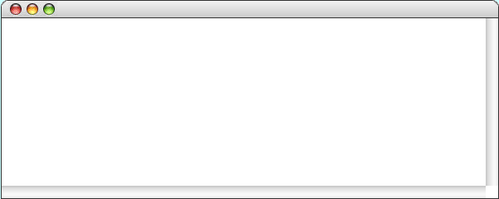
AddIntegerList
public void run() {
println("This program adds a list of integers.");
println("Enter values, one per line, using " + SENTINEL);
println("to signal the end of the list.");
int total = 0;
while (true) {
int value = readInt(" ? ");
if (value == SENTINEL) break;
total += value;
}
println("The total is " + total + ".");
}
public void run() {
println("This program adds a list of integers.");
println("Enter values, one per line, using " + SENTINEL);
println("to signal the end of the list.");
int total = 0;
while (true) {
int value = readInt(" ? ");
if (value == SENTINEL) break;
total += value;
}
println("The total is " + total + ".");
}
value
value
total
total
1
2
3
0
0
0
1
3
6
6
AddIntegerList
This program adds a list of integers.
Enter values, one per line, using 0
to signal the end of the list.
?
1
?
2
?
3
?
0
The total is 6.
skip simulation

Slide 29
Exercise: Control Patterns
Using the AddIntegerList program as a model, write a new AverageList program that reads a set of integers from the user and displays their average. Because 0 values might well appear, for example, in an average of exam scores, change the sentinel value so that the input stops when the user enters -1. It is important to keep in mind that the average of a set of integers is not necessarily an integer.
The AverageList program will require the following changes:
  Convert the variable total to a double before computing the average
  Change the definition of the SENTINEL constant
  Keep a count of the number of input values along with the sum
  Update the user messages and program documentation

Slide 30
The AverageList Program
public class AverageList extends ConsoleProgram {
public void run() {
println("This program averages a list of numbers.");
println("Enter values, one per line, using " + SENTINEL);
println("to signal the end of the list.");
int total = 0;
int count = 0;
while (true) {
int value = readInt(" ? ");
if (value == SENTINEL) break;
total += value;
count++;
}
double average = (double) total / count;
println("The average is " + average + ".");
}
private static final int SENTINEL = -1;
}

Slide 31
The while Statement
The while statement is the simplest of Java’s iterative control statements and has the following form:
while ( condition ) {
statements to be repeated
}
while ( condition ) {
statements to be repeated
}
When Java encounters a while statement, it begins by evaluating the condition in parentheses, which must have a boolean value.
If the value of condition is true, Java executes the statements in the body of the loop.
At the end of each cycle, Java reevaluates condition to see whether its value has changed. If condition evaluates to false, Java exits from the loop and continues with the statement following the closing brace at the end of the while body.

Slide 32
while, do while Statements
while ( condition ) {
statements to be repeated
}
do {
statements to be repeated
} while ( condition )

Slide 33
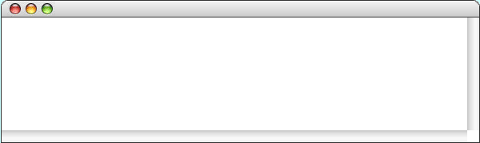
DigitSum
public void run() {
println("This program sums the digits in an integer.");
int n = readInt("Enter a positive integer: ");
int dsum = 0;
while ( n > 0 ) {
dsum += n % 10;
n /= 10;
}
println("The sum of the digits is " + dsum);
}
public void run() {
println("This program sums the digits in an integer.");
int n = readInt("Enter a positive integer: ");
int dsum = 0;
while ( n > 0 ) {
dsum += n % 10;
n /= 10;
}
println("The sum of the digits is " + dsum);
}
public void run() {
println("This program sums the digits in an integer.");
int n = readInt("Enter a positive integer: ");
int dsum = 0;
while ( n > 0 ) {
dsum += n % 10;
n /= 10;
}
println("The sum of the digits is " + dsum);
}
n
n
dsum
dsum
0
1
0
1729
172
17
19
18
19
0
9
11
This program sums the digits in an integer.
1729
Enter a positive integer:
The sum of the digits is 19.
skip simulation

Slide 34
The Loop-and-a-Half Pattern
The while statement in Java always tests the condition at the beginning of each cycle of the loop. Sometimes, however, you need to perform some computation before you can make the test. In those situations, the loop-and-a-half pattern is very useful:
while (true) {
computation necessary to make the test
if (test for completion) break;
computation for the rest of the loop cycle
}
Because the condition in the while statement itself is always true, this loop would continue forever without some other strategy to indicate completion. The loop-and-a-half pattern uses the if and break statements to exit the loop. When the test for completion becomes true, Java executes the break statement, which causes the loop to exit, skipping the rest of the cycle.

Slide 35
Loop-and-a-Half Pattern
while (true) {
computation necessary to make the test
if (test for completion) break;
computation for the rest of the loop cycle
}

Slide 36
Repeat-Until-Sentinel Revisited
The repeat-until-sentinel pattern presented at the beginning of the chapter is an example of the loop-and-a-half pattern.
while (true) {
prompt user and read in a value
if (value == sentinel) break;
rest of loop body
}
while (true) {
computation necessary to make the test
if (test for completion) break;
computation for the rest of the loop cycle
}
Although it might at first seem as if this pattern is more complex than the more basic form of the while statement, it turns out to be considerably easier for most students to use. Several studies have demonstrated that students who use the loop-and-a-half pattern are far more likely to write correct code than those who don’t.

Slide 37
Repeat-Until-Sentinel Revisited
while (true) {
computation necessary to make the test
if (test for completion) break;
computation for the rest of the loop cycle
}
while (true) {
prompt user and read in a value
if (value == sentinel) break;
rest of loop body
}

Slide 38
Break Considered Harmful?
break is disciplined cousin of C’s goto
Most seem to agree that goto should be avoided
  Dijkstra, “Go To Statement Considered Harmful”, CACM 11(3), 1968
  Moore et al., ““’ GOTO Considered Harmful’ Considered Harmful” Considered Harmful?””, CACM 30(5), 1987
Most seem to agree that break (and patterns that use it) are ok, but even that has its criticisms, e.g., difficult formalization

Slide 39
for Statement
for ( init ; test ; step ) {
statements to be repeated
}
for ( init ; test ; step ) {
statements to be repeated
}
Java evaluates a for statement by executing the following steps:
1.
Evaluate init, which typically declares a control variable.
2.
Evaluate test and exit from the loop if the value is false.
3.
Execute the statements in the body of the loop.
4.
Evaluate step, which usually updates the control variable.
5.
Return to step 2 to begin the next loop cycle.
Notes:
The for statement in Java is a particularly powerful tool for specifying the control structure of a loop independently from the operations the loop body performs. The syntax looks like this:

Slide 40
The for Statement
The for statement in Java is a particularly powerful tool for specifying the control structure of a loop independently from the operations the loop body performs. The syntax looks like this:
for ( init ; test ; step ) {
statements to be repeated
}
for ( init ; test ; step ) {
statements to be repeated
}
Java evaluates a for statement by executing the following steps:
1.
Evaluate init, which typically declares a control variable.
2.
Evaluate test and exit from the loop if the value is false.
3.
Execute the statements in the body of the loop.
4.
Evaluate step, which usually updates the control variable.
5.
Return to step 2 to begin the next loop cycle.

Slide 41
Comparing for and while
The for statement
for ( init ; test ; step ) {
statements to be repeated
}
is functionally equivalent to the following code using while:
init;
while ( test ) {
statements to be repeated
step;
}
The advantage of the for statement is that everything you need to know to understand how many times the loop will run is explicitly included in the header line.

Slide 42
for Statement
for ( init ; test ; step ) {
statements to be repeated
}
Equivalent to:
{
init;
while ( test ) {
statements to be repeated
step;
}
}
Notes:
The extra braces in the while-equivalent serve to delineate the scope of a loop variable

Slide 43
Exercise: Reading for Statements
Describe the effect of each of the following for statements:
1.
for (int i = 1; i <= 10; i++)
This statement executes the loop body ten times, with the control variable i taking on each successive value between 1 and 10.
2.
for (int i = 0; i < N; i++)
This statement executes the loop body N times, with i counting from 0 to N - 1. This version is the standard Repeat-N-Times idiom.
3.
for (int n = 99; n >= 1; n -= 2)
This statement counts backward from 99 to 1 by twos.
4.
for (int x = 1; x <= 1024; x *= 2)
This statement executes the loop body with the variable x taking on successive powers of two from 1 up to 1024.

Slide 44
Please visit pingo.upb.de/
643250
https://xkcd.com/2070

Slide 45
Exercise
for (int i = 1; i <= 10; i++)
for (int i = 0; i < N; i++)
for (int n = 99; n >= 1; n -= 2)
for (int x = 1; x <= 1024; x *= 2)
Notes:
Number of iterations_
10
N
50
11

Slide 46
Fence-Post Problem
In the araeostylos [style of temple] it is only necessary to preserve, in a peripteral building, twice the number of intercolumniations on the flanks that there are in front, so that the length may be twice the breadth. Those who use twice the number of columns for the length, appear to err, because they thus make one intercolumniation more than should be used.
Vitruvius, On Architecture
If you build a straight fence 30 meters long with posts spaced 3 meters apart, how many posts do you need?
Coding Advice: Beware of the Off-By-One Error
http://www.dsm.fordham.edu/~moniot/Opinions/fencepost-error-history.shtml
https://en.wikipedia.org/wiki/Off-by-one_error

Slide 47
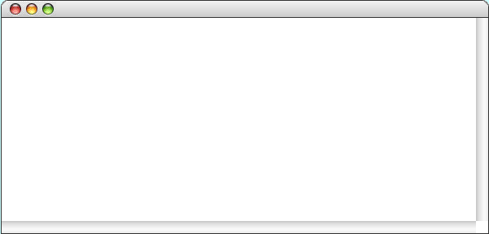
Countdown
public void run() {
for ( int t = 10 ; t >= 0 ; t-- ) {
println(t);
}
println("Liftoff!");
}
public void run() {
for ( int t = 10 ; t >= 0 ; t-- ) {
println(t);
}
println("Liftoff!");
}
public void run() {
for ( int t = 10 ; t >= 0 ; t-- ) {
println(t);
}
println("Liftoff!");
}
t
t
10
9
8
7
6
5
4
3
2
1
0
–1
–1
10
9
8
7
6
5
4
3
2
1
0
Liftoff!
skip simulation

Slide 49
Nested for Statements
The body of a control statement can contain other statements. Such statements are said to be nested.
Many applications require nested for statements. The next slide, for example, shows a program to display a standard checkerboard in which the number of rows and number of columns are given by the constants N_ROWS and N_COLUMNS.
The for loops in the Checkerboard program look like this:
for (int i = 0; i < N_ROWS; i++) {
for (int j = 0; j < N_COLUMNS; j++) {
Display the square at row i and column j.
}
}
Because the entire inner loop runs for each cycle of the outer loop, the program displays N_ROWS ^{x} N_COLUMNS squares.

Slide 50
Nested for
for (int i = 0; i < N_ROWS; i++) {
for (int j = 0; j < N_COLUMNS; j++) {
Display the square at row i and column j.
}
}

Slide 51
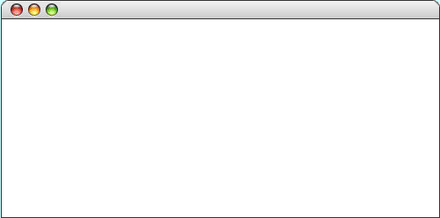
Checkerboard
public void run() {
double sqSize = (double) getHeight() / N_ROWS;
for (int i = 0; i < N_ROWS; i++) {
for (int j = 0; j < N_COLUMNS; j++) {
double x = j * sqSize;
double y = i * sqSize;
GRect sq = new GRect(x, y, sqSize, sqSize);
sq.setFilled((i + j) % 2 != 0);
add(sq);
}
}
}
public void run() {
double sqSize = (double) getHeight() / N_ROWS;
for (int i = 0; i < N_ROWS; i++) {
for (int j = 0; j < N_COLUMNS; j++) {
double x = j * sqSize;
double y = i * sqSize;
GRect sq = new GRect(x, y, sqSize, sqSize);
sq.setFilled((i + j) % 2 != 0);
add(sq);
}
}
}
Execute the inner loop seven times to complete the checkerboard.
Execute these statements six more times to complete the row.
sqSize
sqSize
i
i
j
j
x
x
y
y
sq
sq
30.0
30.0
0
1
8
0
1
2
8
8
0.0
30.0
60.0
210.0
210.0
0.0
210.0
8
210.0
skip simulation

Slide 52
Exercise: Triangle Number Table
Write a program that duplicates the sample run shown at the bottom on this slide, which displays the sum of the first N integers for each value of N from 1 to 10. As the output suggests, these numbers can be arranged to form a triangle and are therefore called triangle numbers.
TriangleTable
1 = 1
1 + 2 = 3
1 + 2 + 3 = 6
1 + 2 + 3 + 4 = 10
1 + 2 + 3 + 4 + 5 = 15
1 + 2 + 3 + 4 + 5 + 6 = 21
1 + 2 + 3 + 4 + 5 + 6 + 7 = 28
1 + 2 + 3 + 4 + 5 + 6 + 7 + 8 = 36
1 + 2 + 3 + 4 + 5 + 6 + 7 + 8 + 9 = 45
1 + 2 + 3 + 4 + 5 + 6 + 7 + 8 + 9 + 10 = 55

Slide 53
Exercise: Triangle Number Table
1 = 1
1 + 2 = 3
1 + 2 + 3 = 6
1 + 2 + 3 + 4 = 10
1 + 2 + 3 + 4 + 5 = 15
1 + 2 + 3 + 4 + 5 + 6 = 21
1 + 2 + 3 + 4 + 5 + 6 + 7 = 28
1 + 2 + 3 + 4 + 5 + 6 + 7 + 8 = 36
1 + 2 + 3 + 4 + 5 + 6 + 7 + 8 + 9 = 45
1 + 2 + 3 + 4 + 5 + 6 + 7 + 8 + 9 + 10 = 55

Slide 54
Design Issues: Triangle Number Table
As you think about the design of the TriangleTable program, it will help to keep the following thoughts in mind:
The program involves two nested loops. The outer loop runs through each of the values of N from 1 to the maximum; the inner loop prints a series of values on each output line.
The individual elements of each output line are easier to display if you call print instead of println. The print method is similar to println but doesn’t return the cursor position to the beginning of the next line in the way that println does. Using print therefore makes it possible to string several output values together on the same line.
The n^{th} output line contains n values before the equal sign but only n – 1 plus signs. Your program therefore cannot print a plus sign on each cycle of the inner loop but must instead skip one cycle.

Slide 55
TriangleTable
public class TriangleTable extends ConsoleProgram {
private static final int MAX_VALUE = 10;
public void run() {
for (int n = 1; n <= MAX_VALUE; n++) {
int total = 0;
for (int i = 1; i <= n; i++) {
if (i > 1) print(" + ");
print(i);
total += i;
}
println(" = " + total);
}
}
}

Slide 56
Simple Graphical Animation
The while and for statements make it possible to implement simple graphical animation. The basic strategy is to create a set of graphical objects and then execute the following loop:
for (int i = 0; i < N_STEPS; i++) {
update the graphical objects by a small amount
pause(PAUSE_TIME);
}
for (int i = 0; i < N_STEPS; i++) {
update the graphical objects by a small amount
pause(PAUSE_TIME);
}
On each cycle of the loop, this pattern updates each animated object by moving it slightly or changing some other property of the object, such as its color. Each cycle is called a time step.
After each time step, the animation pattern calls pause, which delays the program for some number of milliseconds (expressed here as the constant PAUSE_TIME). Without the call to pause, the program would finish faster than the human eye can follow.

Slide 57
Simple Graphical Animation
for (int i = 0; i < N_STEPS; i++) {
update the graphical objects by a small amount
pause(PAUSE_TIME);
}

Slide 58

AnimatedSquare
public void run() {
GRect square = new GRect(0, 0, SQUARE_SIZE, SQUARE_SIZE);
square.setFilled(true);
square.setFillColor(Color.RED);
add(square);
double dx = (getWidth() - SQUARE_SIZE) / N_STEPS;
double dy = (getHeight() - SQUARE_SIZE) / N_STEPS;
for (int i = 0; i < N_STEPS; i++) {
square.move(dx, dy);
pause(PAUSE_TIME);
}
}
public void run() {
GRect square = new GRect(0, 0, SQUARE_SIZE, SQUARE_SIZE);
square.setFilled(true);
square.setFillColor(Color.RED);
add(square);
double dx = (getWidth() - SQUARE_SIZE) / N_STEPS;
double dy = (getHeight() - SQUARE_SIZE) / N_STEPS;
for (int i = 0; i < N_STEPS; i++) {
square.move(dx, dy);
pause(PAUSE_TIME);
}
}
i
i
dx
dx
dy
dy
square
square
100
3.0
3.0
1.7
1.7
AnimatedSquare
AnimatedSquare
skip simulation

Slide 59
Summary
Expressions (“Ausdrücke”) primarily yield a value, statements (“Befehle”) primarily yield a side effect
However, most expressions (assignments, ++/--, method invocations, object creation expressions) can also be turned into expression statements by adding a semicolon
Conversely, some statements (such as assignments) can also be used as expressions

Slide 60
Summary
Compound statements (blocks) provide structure and scoping
Java control statements include if/else, switch, while, for
Common idioms are Repeat N-Times, Repeat-Until-Sentinel, and Loop-and-a-Half
Beware of missing breaks
Beware of the off-by-one error

