Slide 1
Five-Minute Review
How do we construct a GPolygon object?
How does GCompound support decomposition for graphical objects?
What does algorithmic complexity mean?
Which operations does a HashMap support?
What is an efficient way to implement it?
Notes:
Start with initial point (addVertex), then add points/edges
Allows to break down complex graphical objects into smaller objects/classes
How operation count depends on problem size N, for large N; use O-Notation
map.put(key, value) and get(key)
Bucket hashing; map (key,value) pairs to buckets, based on hash code, have linked list in each bucket

Slide 2
Programming – Lecture 12
Files, Exception handling (Chapter 12.4)
Text files vs. strings
Opening a file
Reading characters/lines
Exception handling
Selecting files interactively
Scanner class
Writing files
Notes:
Randomness in games

Slide 3
Using Data Files
Applications that involve searching and sorting typically work with data collections that are too large to enter by hand. For this reason, section 12.4 includes a brief discussion of data files, which make it possible to work with stored data.
A file is the generic name for any named collection of data maintained on the various types of permanent storage media attached to a computer. In most cases, a file is stored on a hard disk, but it can also be stored on removable medium, such as a CD or flash memory drive.
Files can contain information of many different types. When you compile a Java program, for example, the compiler stores its output in a set of class files, each of which contains the binary data associated with a class. The most common type of file, however, is a text file, which contains character data of the sort you find in a string.

Slide 4
Text Files vs. Strings
Although text files and strings both contain character data, it is important to keep in mind the following important differences between text files and strings:
1.
The information stored in a file is permanent. The value of a string variable persists only as long as the variable does. Local variables disappear when the method returns, and instance variables disappear when the object goes away, which typically does not occur until the program exits. Information stored in a file exists until the file is deleted.
2.
Files are usually read sequentially. When you read data from a file, you usually start at the beginning and read the characters in order, either individually or in groups that are most commonly individual lines. Once you have read one set of characters, you then move on to the next set of characters until you reach the end of the file.

Slide 5
Text Files vs. Strings
Both contain character data
Permanent storage vs. temporary existence
Sequential vs. random access

Slide 6
Text Files
Contain plain character data, encoded in ASCII or Unicode
Typically have file extension .txt
Can be edited with notepad, emacs, vi, …
Not to be confused with e.g. files produced by Word etc. (file extension .doc, .docx)
On console (a.k.a. shell, terminal), can dump text file with cat command
And can read/write text files with your Java program!

Slide 7
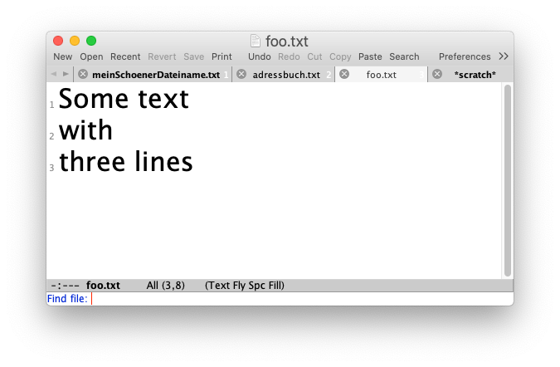
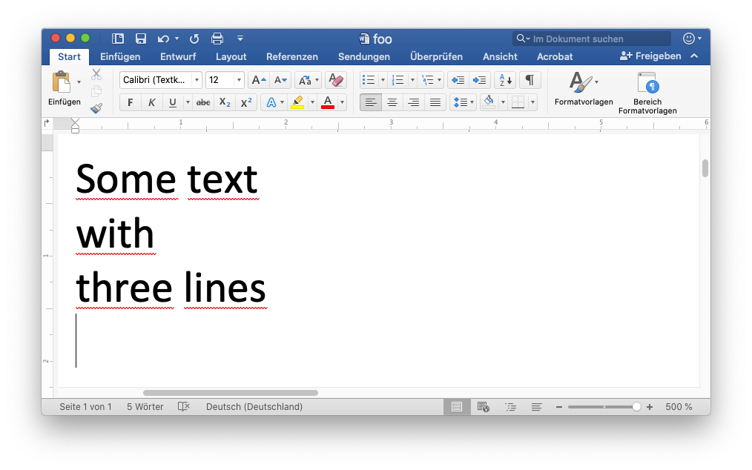
$ ls -l
-rw-r--r--@ 1 rvh staff 11833 15 Jan 13:28 foo.docx
-rw-r--r-- 1 rvh staff 27 15 Jan 13:25 foo.txt
$ cat foo.txt
Some text
with
three lines
$ cat foo.docx
P!ߤ?lZ[Content_Types].xml ?(????n?0E?????Ub袪*?>?-R?{V??Ǽ??QU?
l"%3??3Vƃ?ښl ?w%?=???^i7+???-d&?0?A?6?l4??L60#?Ò?S
...
Prompt
File sizes
User command
Sample dialog on console

Slide 8
Directory Structure
Each file resides in some directory (“Verzeichnis”)
Directory is specified by path
  Absolute path: begins with root directory (“/”)
  or home directory (“~”)
  Relative path: starts at working directory,
  i.e., does not begin with “/” or “~”
Usually, when referring to name of file, we may or may not prefix file name with path
If no path is specified, look for file in working directory

Slide 9
Sample Directory Structure
Root directory
/
Users
System
…
Home directory (“~”)
rvh
guest
…
Working directory (“.”)
tmp
Desktop
…
foo.txt
foo.docx
…
Equivalent alternatives for filename:
/Users/rvh/tmp/foo.txt // With absolute path
~/tmp/foo.txt // With absolute path
./foo.txt // With relative path
../tmp/foo.txt // “..” goes one level up
foo.txt // Without path

Slide 10
Opening a File
import java.io.*;
BufferedReader rd =
new BufferedReader(
new FileReader( filename));
filename may or may not include a path.
Alternatives for finding the file:
Specify path (may use pwd to find out)
Put file into default working directory; see Run → Run Configurations → Arguments → Working directory
Note: workspace_loc is location of work space; for a project, see Properties → Resource → Linked Resources → Path Variables
Change working directory to directory of file

Slide 11
Reading Text Files
When you want to read data from a text file as part of a Java program, you need to take the following steps:
1.
Construct a new BufferedReader object that is tied to the data in the file. This phase of the process is called opening the file.
2.
Call the methods provided by the BufferedReader class to read data from the file in sequential order.
3.
Break the association between the reader and the file by calling the reader’s close method, which is called closing the file.
Java’s BufferedReader class make it possible to read data from files in several different ways.
  You can read individual characters by calling the read method.
  You can read complete lines by calling the readLine method.
  You can read individual tokens by using the Scanner class.
Each of these strategies is described in a subsequent slide.

Slide 12
Standard Reader Subclasses
The java.io package defines several different subclasses of the generic Reader class that are useful in different contexts. To read text files, you need to use the following subclasses:
  The FileReader class, which allows you to create a simple reader by supplying the name of the file.
  The BufferedReader class, which makes all operations more efficient and enables the strategy of reading individual lines.
The standard idiom for opening a text file is to call the constructors for each of these classes in a single statement:
BufferedReader rd = new BufferedReader(
new FileReader( filename));
The FileReader constructor takes the file name and creates a simple reader. That reader is then passed along to the BufferedReader constructor.

Slide 13
Reading Characters from a File
Once you have created the BufferedReader object as shown on the preceding slide, you can then read individual characters from the file by calling the read method.
The read method conceptually returns the next character in a file, although it does so as an int. If there are any characters remaining in the file, calling read returns the Unicode value of the next one. If all the characters have been exhausted, read returns -1.
The following code fragment, for example, counts the number of letters in a BufferedReader named rd:
int nLetters = 0;
while (true) {
int ch = rd.read();
if (ch == -1) break;
if (Character.isLetter(ch)) nLetters++;
}

Slide 14
Reading Characters
int nLetters = 0;
while (true) {
int ch = rd.read();
if (ch == -1) break;
if (Character.isLetter(ch))
nLetters++;
}

Slide 15
Reading Lines from a File
You can also read entire lines from a text file by calling the readLine method, which returns the next line of data from the file as a string after discarding any end-of-line characters. If no lines remain in the file, readLine returns null.
The following code fragment uses the readLine method to determine the length of the longest line in the reader rd:
int maxLength = 0;
while (true) {
String line = rd.readLine();
if (line == null) break;
maxLength = Math.max(maxLength, line.length());
}
Using the readLine method makes programs more portable because it eliminates the need to think about the end-of-line characters, which differ from system to system.

Slide 16
Reading Lines
int maxLength = 0;
while (true) {
String line = rd.readLine();
if (line == null) break;
maxLength =
Math.max(maxLength,
line.length());
}

Slide 17
Exception Handling
Unfortunately, the process of reading data from a file is not quite as simple as the previous slides suggest. When you work with the classes in the java.io package, you must ordinarily indicate what happens if an operation fails. In the case of opening a file, for example, you need to specify what the program should do if the requested file does not exist.
Java’s library classes often respond to such conditions by throwing an exception, which is one of the strategies Java methods can use to report an unexpected condition. If the FileReader constructor, for example, cannot find the requested file, it throws an IOException to signal that fact.
When Java throws an exception, it stops whatever it is doing and looks back through its execution history to see if any method has indicated an interest in “catching” that exception by including a try statement as described on the next slide.

Slide 18
The try Statement
Java uses the try statement to indicate an interest in catching an exception. In its simplest form, the try statement syntax is
try {
code in which an exception might occur
} catch (type identifier) {
code to respond to the exception
}
where type is the name of some exception class and identifier is the name of a variable used to hold the exception itself.
The range of statements in which the exception can be caught includes not only the statements explicitly enclosed in the try body but also any methods those statements call. If the exception occurs inside some other method, any subsequent stack frames are removed until control returns to the try statement itself.

Slide 19
Exception Handling
try {
code in which an exception might occur
} catch (type identifier) {
code to respond to the exception
}

Slide 20
private void checkExpression(String prefixExp) {
try {
String infixExp = new PNParser(prefixExp).toString();
println(prefixExp + " => " + infixExp);
} catch (IllegalArgumentException ex) {
println("\"" + prefixExp + "\" caused " + ex);
}
}
public void run() {
checkExpression("1");
checkExpression("+");
checkExpression("1 + 2");
checkExpression("+ 1 2");
}
1 => 1
"+" caused java.lang.IllegalArgumentException: Premature
end of tokens!
"1 + 2" caused java.lang.IllegalArgumentException: Too
many tokens!
+ 1 2 => 1 + 2

Slide 21
Object
Throwable
Error
Exception
OutOfMemoryError
IOException
Thrown by e.g. java.io !
RuntimeException
IndexOutOfBoundsException
FileNotFoundException
IllegalArgumentException
Checked exceptions
Must catch (try-catch) or propagate (throws) !
Unchecked exceptions
See also https://docs.oracle.com/javase/tutorial/essential/exceptions/runtime.html
Notes:
From https://docs.oracle.com/javase/tutorial/essential/exceptions/runtime.html:
Unchecked Exceptions — The Controversy
Because the Java programming language does not require methods to catch or to specify unchecked exceptions (RuntimeException, Error, and their subclasses), programmers may be tempted to write code that throws only unchecked exceptions or to make all their exception subclasses inherit from RuntimeException. Both of these shortcuts allow programmers to write code without bothering with compiler errors and without bothering to specify or to catch any exceptions. Although this may seem convenient to the programmer, it sidesteps the intent of the catch or specify requirement and can cause problems for others using your classes.
Why did the designers decide to force a method to specify all uncaught checked exceptions that can be thrown within its scope? Any Exception that can be thrown by a method is part of the method's public programming interface. Those who call a method must know about the exceptions that a method can throw so that they can decide what to do about them. These exceptions are as much a part of that method's programming interface as its parameters and return value.
The next question might be: "If it's so good to document a method's API, including the exceptions it can throw, why not specify runtime exceptions too?" Runtime exceptions represent problems that are the result of a programming problem, and as such, the API client code cannot reasonably be expected to recover from them or to handle them in any way. Such problems include arithmetic exceptions, such as dividing by zero; pointer exceptions, such as trying to access an object through a null reference; and indexing exceptions, such as attempting to access an array element through an index that is too large or too small.
Runtime exceptions can occur anywhere in a program, and in a typical one they can be very numerous. Having to add runtime exceptions in every method declaration would reduce a program's clarity. Thus, the compiler does not require that you catch or specify runtime exceptions (although you can).
One case where it is common practice to throw a RuntimeException is when the user calls a method incorrectly. For example, a method can check if one of its arguments is incorrectly null. If an argument is null, the method might throw a NullPointerException, which is an unchecked exception.
Generally speaking, do not throw a RuntimeException or create a subclass of RuntimeException simply because you don't want to be bothered with specifying the exceptions your methods can throw.
Here's the bottom line guideline: If a client can reasonably be expected to recover from an exception, make it a checked exception. If a client cannot do anything to recover from the exception, make it an unchecked exception.

Slide 22
The try Statement
The design of the java.io package forces you to use try statements to catch any exceptions that might occur. For example, if you open a file without checking for exceptions, the Java compiler will report an error in the program.
To take account of these conditions, you need to enclose calls to constructors and methods in the various java.io classes inside try statements that check for IOExceptions.
The ReverseFile program on the next few slides illustrates the use of the try statement in two different contexts:
  Inside the openFileReader method, the program uses a try statement to detect whether the file exists. If it doesn’t, the catch clause prints a message to the user explaining the failure and then asks the user for a new file name.
  Inside the readLineArray method, the code uses a try statement to detect whether an I/O error has occurred.

Slide 23
ReverseFile
import acm.program.*;
import acm.util.*;
import java.io.*;
import java.util.*;
/** This program prints the lines from a file in reverse order */
public class ReverseFile extends ConsoleProgram {
public void run() {
println("This program reverses the lines in a file.");
BufferedReader rd = openFileReader("Enter input file: ");
String[] lines = readLineArray(rd);
for (int i = lines.length - 1; i >= 0; i--) {
println(lines[i]);
}
}
/*
* Implementation note: The readLineArray method on the next slide
* uses an ArrayList internally because doing so makes it possible
* for the list of lines to grow dynamically. The code converts
* the ArrayList to an array before returning it to the client.
*/
page 1 of 3
skip code

Slide 24
ReverseFile
/*
* Reads all available lines from the specified reader and returns
* an array containing those lines. This method closes the reader
* at the end of the file.
*/
private String[] readLineArray(BufferedReader rd) {
ArrayList<String> lineList = new ArrayList<String>();
try {
while (true) {
String line = rd.readLine();
if (line == null) break;
lineList.add(line);
}
rd.close();
} catch (IOException ex) {
throw new ErrorException(ex);
}
String[] result = new String[lineList.size()];
for (int i = 0; i < result.length; i++) {
result[i] = lineList.get(i);
}
return result;
}
import acm.program.*;
import acm.util.*;
import java.io.*;
import java.util.*;
/** This program prints the lines from a file in reverse order */
public class ReverseFile extends ConsoleProgram {
public void run() {
println("This program reverses the lines in a file.");
BufferedReader rd = openFileReader("Enter input file: ");
String[] lines = readLineArray(rd);
for (int i = lines.length - 1; i >= 0; i--) {
println(lines[i]);
}
}
/*
* Implementation note: The readLineArray method on the next slide
* uses an ArrayList internally because doing so makes it possible
* for the list of lines to grow dynamically. The code converts
* the ArrayList to an array before returning it to the client.
*/
page 2 of 3
skip code

Slide 25
ReverseFile
/*
* Requests the name of an input file from the user and then opens
* that file to obtain a BufferedReader. If the file does not
* exist, the user is given a chance to reenter the file name.
*/
private BufferedReader openFileReader(String prompt) {
BufferedReader rd = null;
while (rd == null) {
try {
String name = readLine(prompt);
rd = new BufferedReader(new FileReader(name));
} catch (IOException ex) {
println("Can't open that file.");
}
}
return rd;
}
}
/*
* Reads all available lines from the specified reader and returns
* an array containing those lines. This method closes the reader
* at the end of the file.
*/
private String[] readLineArray(BufferedReader rd) {
ArrayList<String> lineList = new ArrayList<String>();
try {
while (true) {
String line = rd.readLine();
if (line == null) break;
lineList.add(line);
}
rd.close();
} catch (IOException ex) {
throw new ErrorException(ex);
}
String[] result = new String[lineList.size()];
for (int i = 0; i < result.length; i++) {
result[i] = lineList.get(i);
}
return result;
}
page 3 of 3

Slide 26
Selecting Files Interactively
The Java libraries also make it possible to select an input file interactively using a dialog box. To do so, you need to use the JFileChooser class from the javax.swing package.
The JFileChooser constructor is usually called like this:
JFileChooser chooser = new JFileChooser();
You can then ask the user to select a file by calling
int result = chooser.showOpenDialog(this);
where this indicates the program issuing this call. The return value will be JFileChooser.APPROVE_OPTION or JFileChooser.CANCEL_OPTION depending on whether the user clicks the Open or Cancel button. The caller can obtain the selected file by calling chooser.getSelectedFile().

Slide 27
Selecting Files Interactively
import javax.swing.*;
int result;
JFileChooser chooser;
do {
chooser = new JFileChooser();
result = chooser.
showOpenDialog(this);
} while (result !=
JFileChooser.APPROVE_OPTION);

Slide 28
Selecting Files Interactively
try {
BufferedReader rd = new
BufferedReader(new FileReader(
chooser.getSelectedFile()));
} catch (IOException ex) {
println("Can't open that file.");
}

Slide 29
Scanner
new Scanner(reader)
Creates a new Scanner object from the reader.
next()
Returns the next whitespace-delimited token as a string.
nextLine()
Returns rest of line as string.
nextInt()
Reads the next integer and returns it as an int.
nextDouble()
Reads the next number and returns it as a double.
nextBoolean()
Reads the next Boolean value (true or false).
hasNext()
Returns true if the scanner has any more tokens.
hasNextInt()
Returns true if the next token scans as an integer.
hasNextDouble()
Returns true if the next token scans as a number.
hasNextBoolean()
Returns true if the next token is either true or false.
close()
Closes the scanner and the underlying reader.
Notes:
Although it is not used in the examples in the text, it is also possible to divide a text file into individual tokens by using the Scanner class from the java.util package. The most useful methods in the Scanner class are shown in the following table:

Slide 30
Scanning Input
// ACM Java
String name = readLine(”What’s your name? ");
println("Hello, " + name);
// "Standard" Java
Scanner in = new Scanner(System.in);
System.out.print("What’s your name? ");
name = in.nextLine();
in.close();
System.out.println("Way to go, " + name);

Slide 31
Using Files for Output
The java.io package also makes it possible to create new text files by using the appropriate subclasses of the generic Writer class.
When you write data to a file, the most common approach is to create a PrintWriter like this:
PrintWriter wr = new PrintWriter(
new FileWriter( filename));
As in the reader example, this nested constructor first creates a FileWriter for the specified file name and then passes the result along to the PrintWriter constructor.
Once you have a PrintWriter object, you can write data to that writer using the println and print methods you have used all along with console programs.

Slide 32
Writing Files
PrintWriter wr =
new PrintWriter(
new FileWriter( filename));
wr.println("My first line");
wr.close();

Slide 33
Summary
There are different types of files, we are particularly interested in text files
Files are permanently stored, accessed sequentially
A file must first be opened, and later be closed
The Scanner class facilitates to read in data
Exceptions are caught and handled with try/catch
Thrown exceptions are propagated up the call stack until the next enclosing handler
Exceptions outside of the RuntimeException hierarchy, such as IOException, must be caught by the application
Notes:
Randomness in games

