Slide 1
Programming – Lecture 15
Going Beyond ACM
Lectures Beyond Inf-ProgOO
IDEs Beyond Eclipse
Projects Beyond Homework
Java Beyond ACM
Programming Beyond Inf-ProgOO

Slide 2
Programming – Lecture 15
Going Beyond ACM
Lectures Beyond Inf-ProgOO
IDEs Beyond Eclipse
Projects Beyond Homework
Java Beyond ACM
Programming Beyond Inf-ProgOO

Slide 3
Implementing Languages
Context-free grammars
Parsing source code
Building compilers
Prof. Dr. Hanus
Übersetzerbau
Wahlpflicht

Slide 4
Efficiency and Data Structures
Defining “performance”
Efficiency of algorithms
Efficiency of data structures
Prof. Dr. Jansen
ADS
2. Semester
Prof. Dr. Jansen
Effiziente Algorithmen
Wahlpflicht

Slide 5
Graphics Programming
Image data streams
Feature extraction
Modeling 3D objects
Rendering
Prof. Dr. Koch
Einführung in die
Bildverarbeitung
Wahlpflicht
Prof. Dr. Koch
Computer
Graphik
Wahlpflicht

Slide 6
Memory Management
Stack and Heap
Virtual memory
Paging and memory hierarchy
Prof. Dr. Landsiedel
Betriebs- und Kommunikationssysteme
2. Semester

Slide 7
Concurrency
Race conditions and synchronization
Distributed systems
Patterns for parallel and distributed systems
PD Dr. Huch
Concurrent and
Distributed Progr.
Wahlpflicht
Prof. Dr. Hasselbring
[…] parallele und
verteilte Systeme
Wahlpflicht

Slide 8
Real-Time Programming
Control flow and data flow languages
Model-based design
Concurrency and scheduling
Worst-case execution times
Prof. Dr. von. Hanxleden
Synchrone
Sprachen
Wahlpflicht
Prof. Dr. von Hanxleden
Embedded real-
time systems
Wahlpflicht

Slide 9
Programming Patterns
Requirements analysis
Specification tools
Design patterns
Prof. Dr. Hasselbring
Softwaretechnik
4. Semester
Prof. Dr. Hasselbring
Softwareprojekt
4. Semester

Slide 10
Programming Languages
Well…

Slide 11
Programming – Lecture 15
Going Beyond ACM
Lectures Beyond Inf-ProgOO
IDEs Beyond Eclipse
Projects Beyond Homework
Java Beyond ACM
Programming Beyond Inf-ProgOO

Slide 12
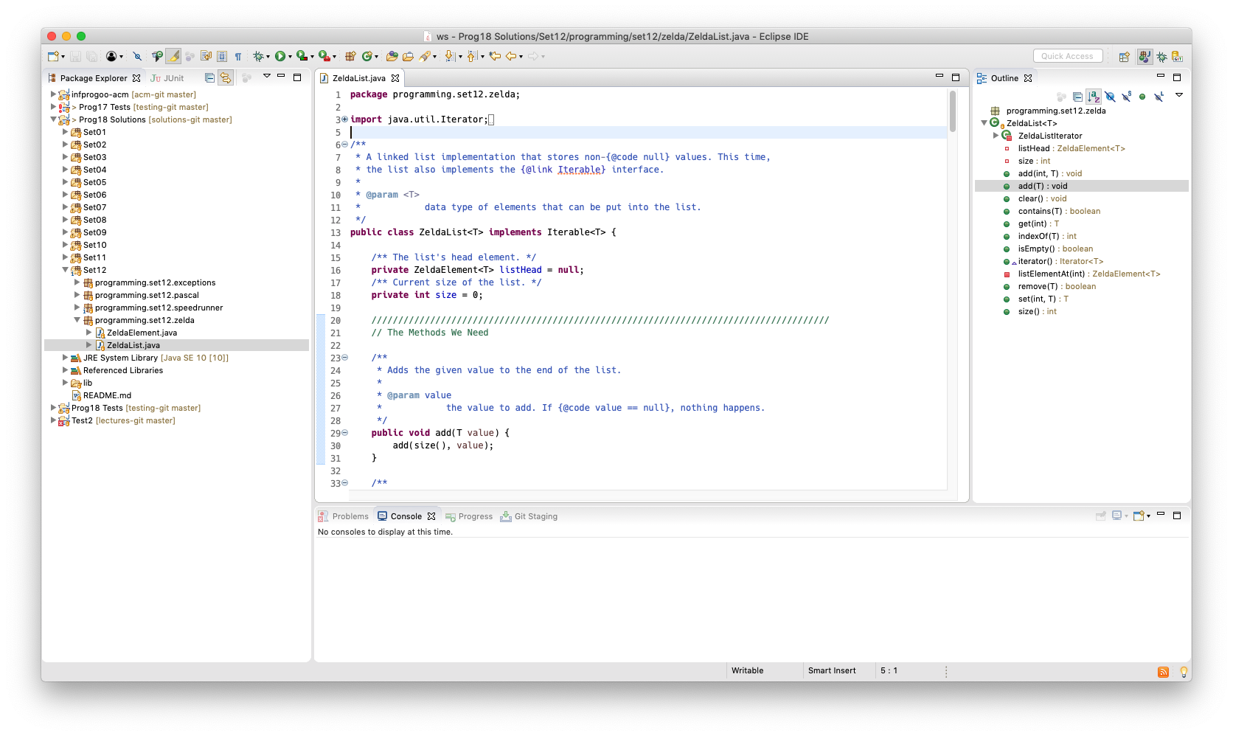
More Eclipse

Slide 13
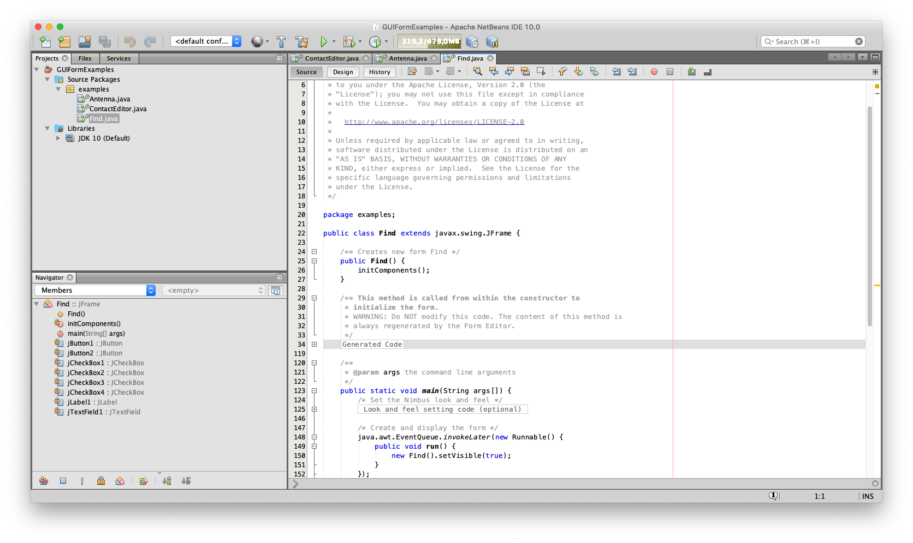
NetBeans

Slide 14
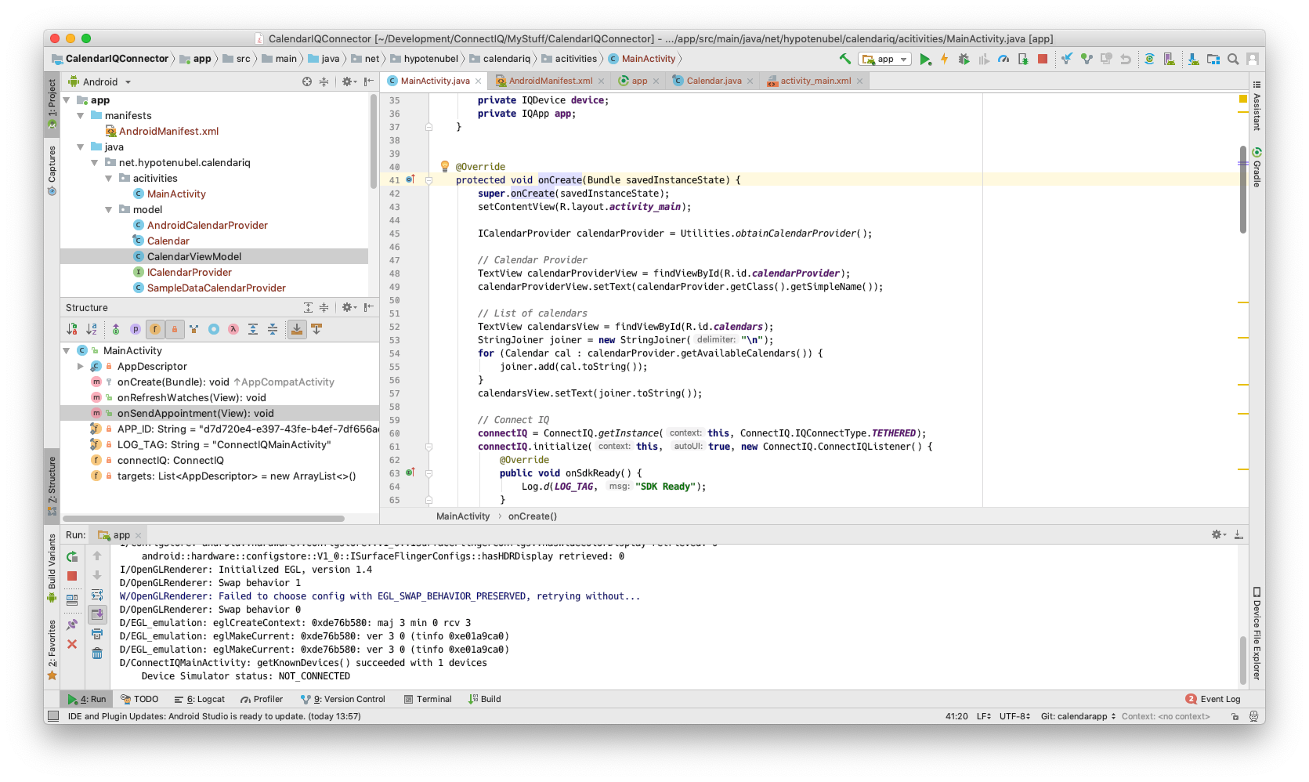
IntelliJ IDEA

Slide 15
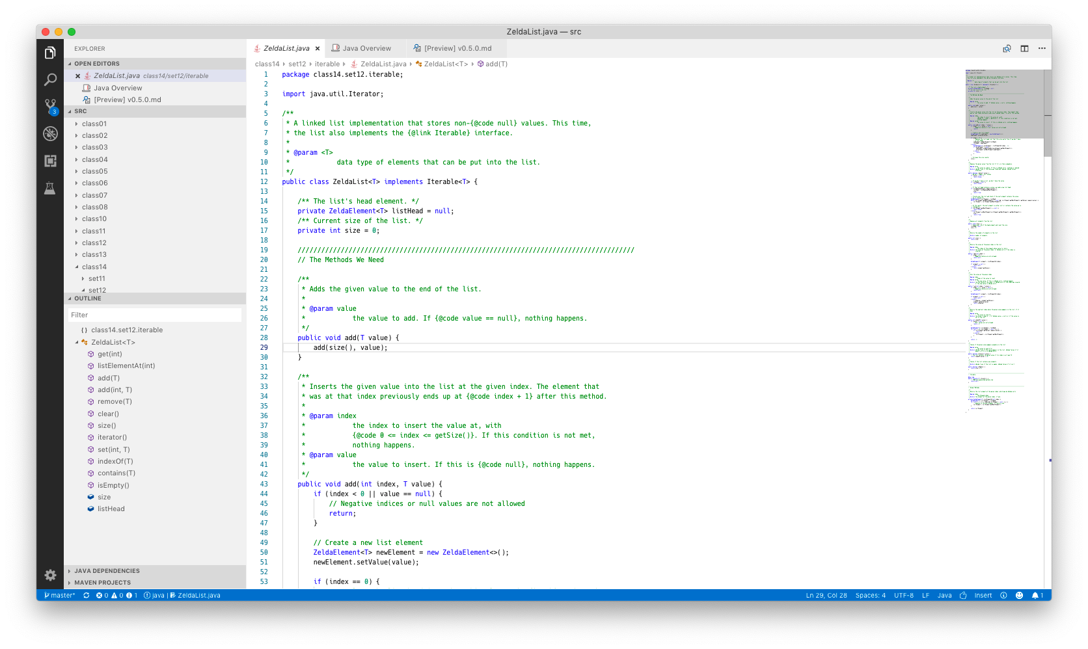
Visual Studio Code

Slide 16
Remember
IDEs are monsters
and each works differently,
so give them time
before forming an opinion!

Slide 17
Programming – Lecture 15
Going Beyond ACM
Lectures Beyond Inf-ProgOO
IDEs Beyond Eclipse
Projects Beyond Homework
Java Beyond ACM
Programming Beyond Inf-ProgOO

Slide 18
The ACM Library
So far, we have used the ACM library to write our programs.
Most of our programs were instances of one of these classes:
ConsoleProgram
Text-based
DialogProgram
Graphics-based
GraphicsProgram

Slide 19
Alternatives
ConsoleProgram
DialogProgram
GraphicsProgram

Slide 20
Alternatives: Text-Based
Simple Java programs are text-based by default. Remember Lecture 2:
public class HelloWorld {
public static void main (String[] args) {
System.out.println("Hello World!");
}
}

Slide 21
Class Definition
ACM:
public class Wubbel
extends ConsoleProgram {
//...
}
Java:
No restrictions. Every class can have a main method.

Slide 22
Program Entry Point
ACM:
public void run() {
//...
}
Java:
public static void main(String[] args) {
//...
}

Slide 23
Console Output
ACM:
println(...);
Java:
System.out.println(...);
In Eclipse, just type "syso<ctrl><space>"

Slide 24
Console Input
ACM:
String s = readLine();
int i = readInt();
Java:
Scanner scanner = new Scanner(System.in);
String s = scanner.next();
int i = scanner.nextInt();

Slide 25
Command-Line Arguments
public static void main(String[] args) {
//...
}
Array of Arguments

Slide 26
Command-Line Arguments
Entry Point:
public static void main(String[] args) {
for (String arg : args)
System.out.println(arg);
}
Invocation:
java MyClass Glorious test
Output:
Glorious
test

Slide 27
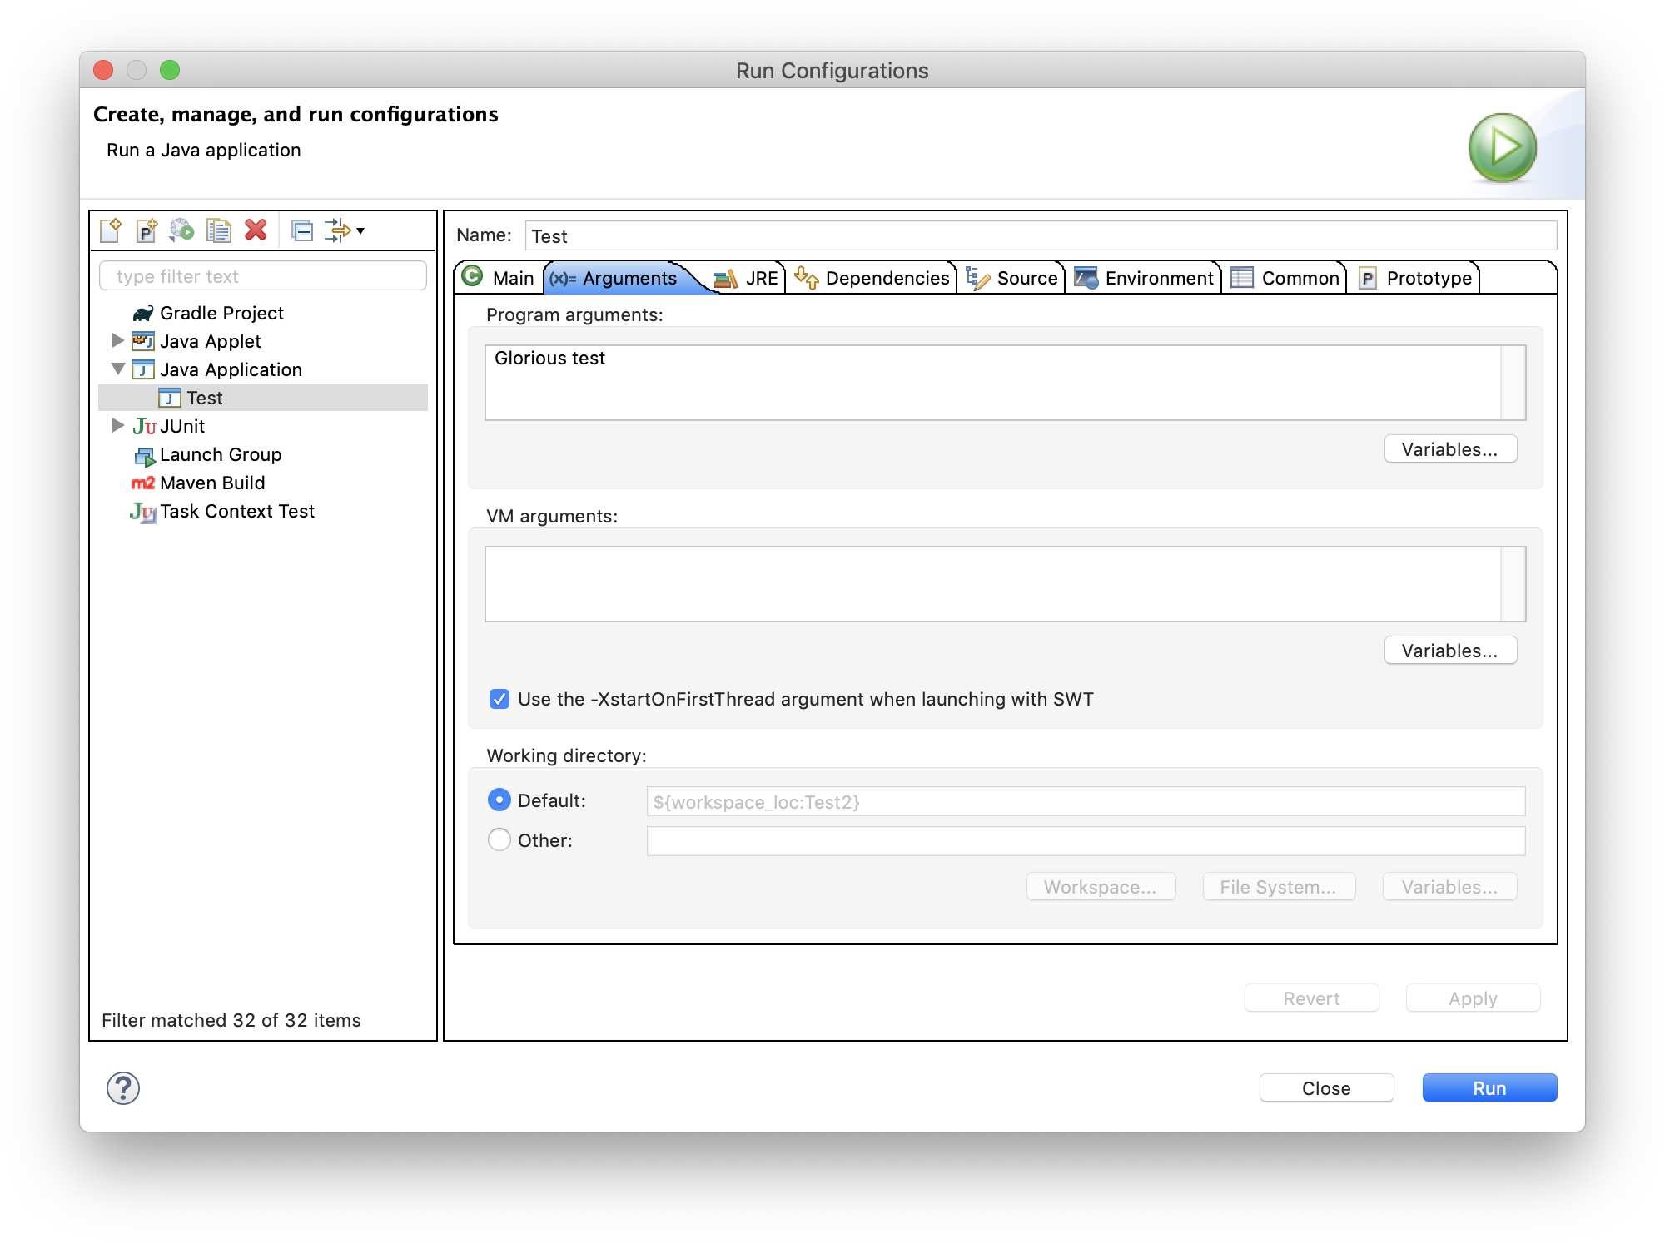
Command-Line Arguments

Slide 28
Common Code Patterns
Static Code:
public static void main(String[] args) {
// Call only other static methods
}
Only use for small, single-class programs.

Slide 29
Common Code Patterns
Slim Main Method:
public static void main(String[] args) {
MyClass mc = new MyClass(args);
mc.startDoingStuff();
}
Standard pattern. Only uses main to instantiate your main class and have it start doing stuff.

Slide 30
Alternatives
ConsoleProgram
DialogProgram
GraphicsProgram

Slide 31
Alternatives: Graphics-Based
Java GUI land
has become a sad place…

Slide 32
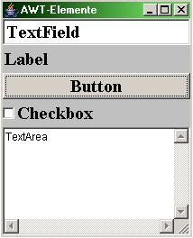
Java AWT
Wikipedia Example

Slide 33
Java AWT
The original Java GUI library.
Can look plain and outdated.
Not rich in features.
Verdict
Don’t use directly.

Slide 34
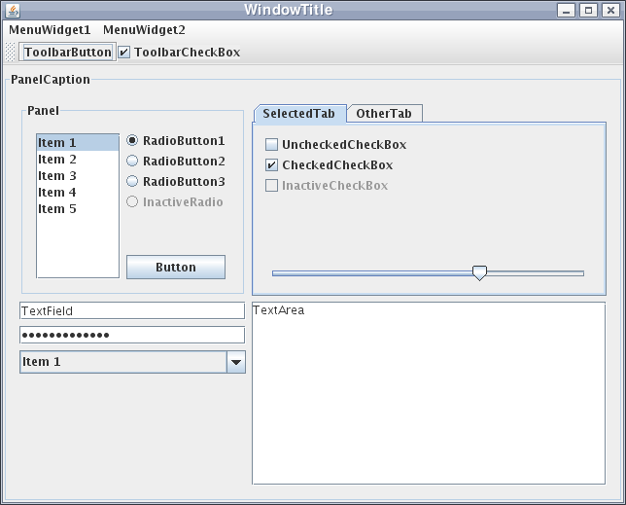
Java Swing
Wikipedia Example

Slide 35
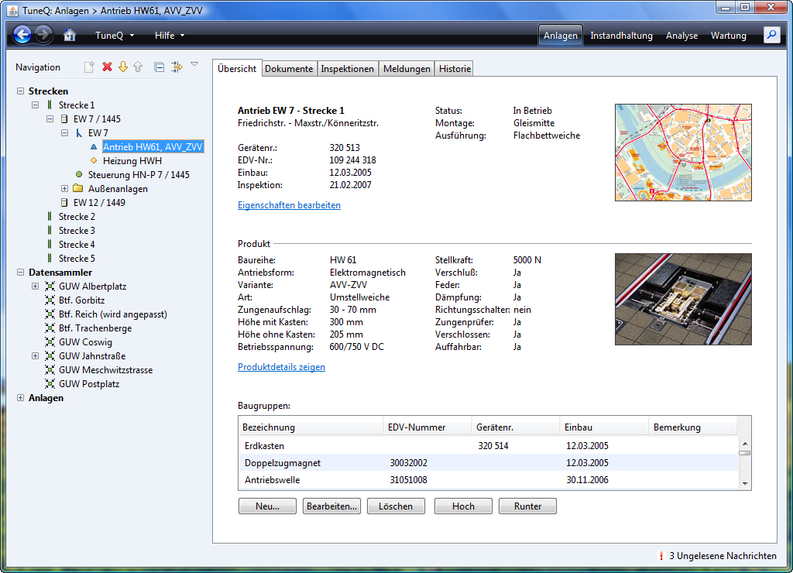
Java Swing
JGoodies

Slide 36
Java Swing
IntelliJ IDEA

Slide 37
Java Swing
Successor to AWT.
Rich in features and 3rd party support.
Work required to make it look really good.
Verdict
The simplest choice for Java GUIs.

Slide 38
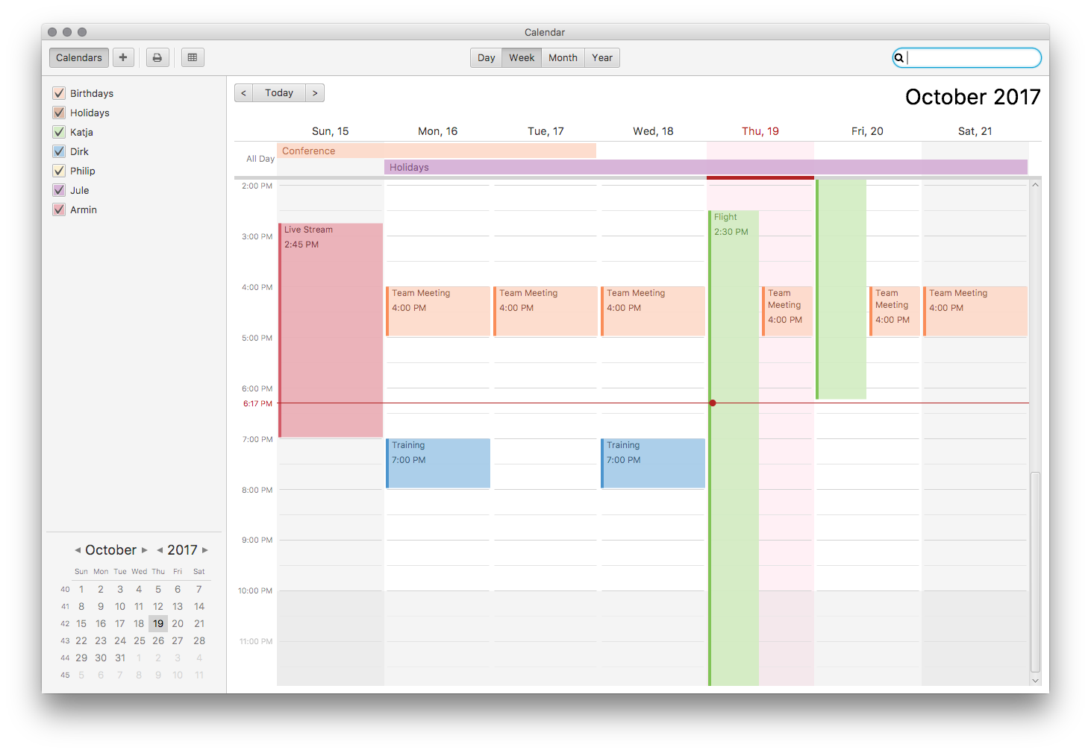
JavaFX
CalendarFX

Slide 39
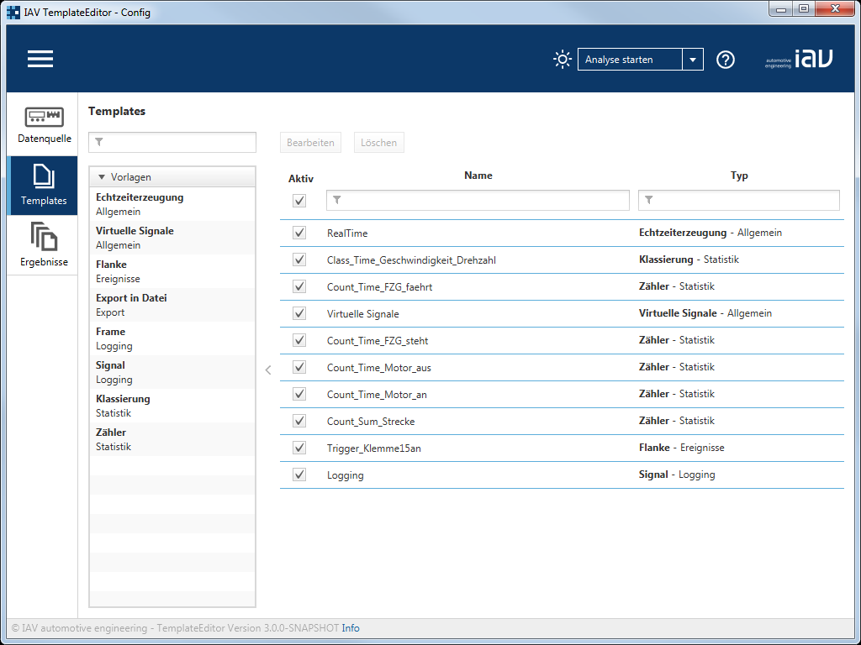
JavaFX
IAV TemplateEditor

Slide 40
JavaFX
Modern, beautiful GUIs.
Easier to work with than Swing.
Since removed from JDK,
but still exists as OpenJFX.
Verdict
Nicer GUIs, harder to setup.

Slide 41
SWT
Eclipse

Slide 42
SWT
Platform-specific controls.
Feels fast and integrates well with the OS.
Perhaps a bit more difficult to use.
Verdict
Native feeling, harder to setup.

Slide 43
Programming – Lecture 15
Going Beyond ACM
Lectures Beyond Inf-ProgOO
IDEs Beyond Eclipse
Projects Beyond Homework
Java Beyond ACM
Programming Beyond Inf-ProgOO

Slide 44
Small Console Programs
CSV
CSV
Program
CSV
Some kind
of transformation
DAT

Slide 45
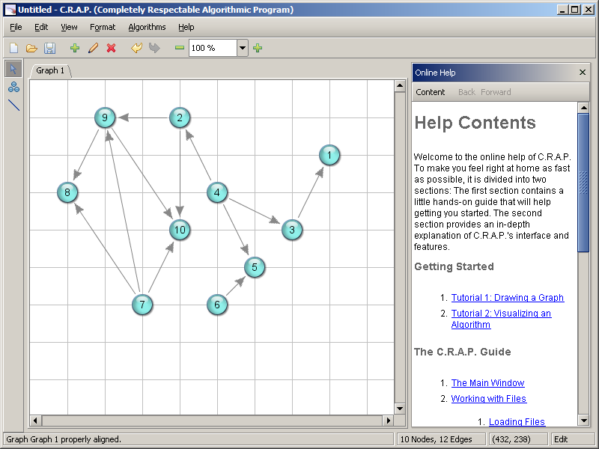
Something You’re Missing
CSV

Slide 46
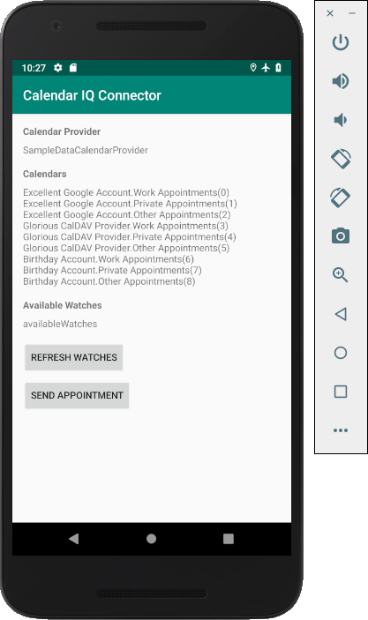

An Android App

Slide 47
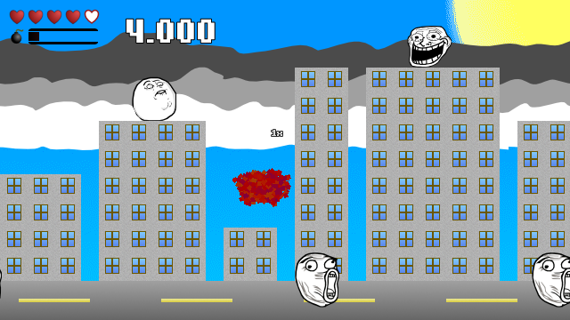
A Game

Slide 48
I’m Fresh Out Of Ideas ☹
Thou shalt be helped!

Slide 49
Open Campus
Coworking space
Fablab
Waterkant

Slide 50
Toppoint
Mit Leuten und Werkzeugen
Dinge tun!

Slide 51

Raceyard

Slide 52
Programming – Lecture 15
Going Beyond ACM
Lectures Beyond Inf-ProgOO
IDEs Beyond Eclipse
Projects Beyond Homework
Java Beyond ACM
Programming Beyond Inf-ProgOO

Slide 53
Don’t Be Afraid
We have tried to teach you concepts
using Java as our example language.
Now go forth
and learn new languages!

Slide 54



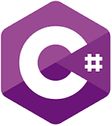









Which Language to Learn?

Slide 55
The Two Main Questions
1
What do I want to build?
2
Where should it run?

Slide 56
Android Development
Kotlin
Java

Slide 57
iOS and Mac Development
Swift

Slide 58
Web Development
JavaScript
Ruby
PHP

Slide 59
Web Development
Visual Studio Code

Slide 60
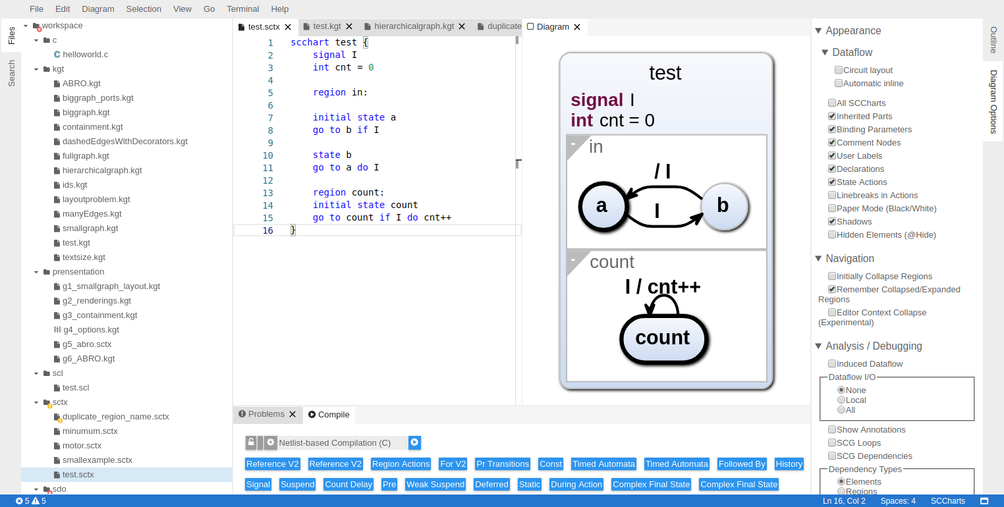
Web Development
Theia

Slide 61
Command-Line Tools
Python
Perl
Ruby

Slide 62
Tinkering With Hardware
C / C++

Slide 63
Visual Languages
LabVIEW
SCCharts

Slide 64
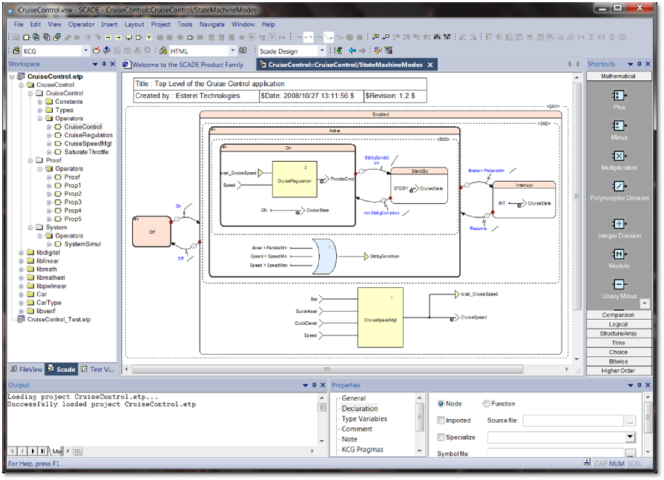
Visual Languages
SCADE

Slide 65
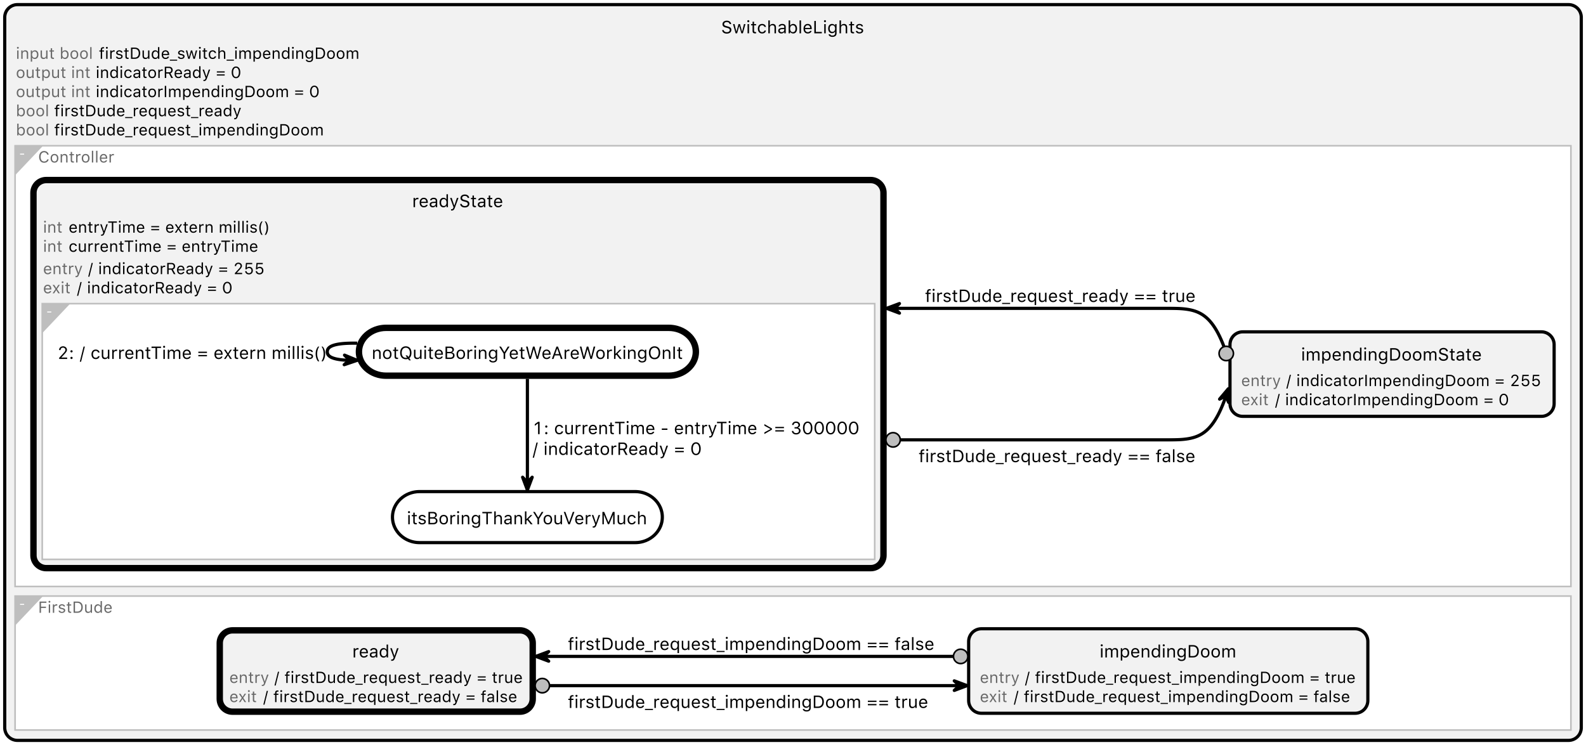
Visual Languages
SCCharts

Slide 66
Games
Godot
Unity

Slide 67
You’re just at the start
of your journey.
Now go and enjoy
being programmers!

