Slide 1
Sequential Constructiveness, SCL and SCCharts
Incorporating synchrony in conventional languages
Reinhard von Hanxleden (U Kiel)
14 March 2018, Collège de France

Slide 2
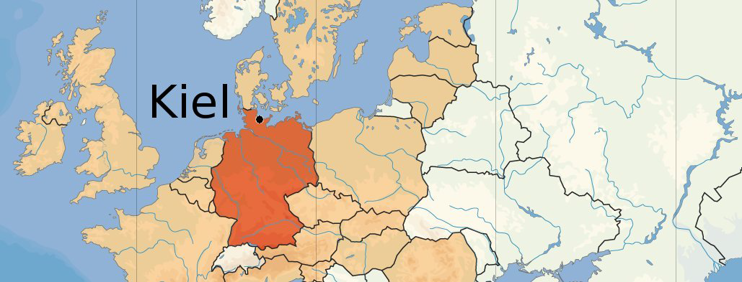


Slide 3
Speaker Bio
1985 - 88: Undergraduate studies CS/Physics in Kiel
1989: M. Sc. in CS, Penn State
1994/95: Ph. D., Rice University
1995 - 2001: DaimlerBenz/DaimlerChrysler Responsive Systems group, Berlin
2000/2001: Airbus project in Toulouse/Hamburg
Since 2001: Full professor at CAU Kiel, head of Real-Time and Embedded Systems (RTSYS) group
2007/2012/2017: Sabbaticals at UC Berkeley, U Auckland, INRIA Sophia Antipolis
2016: Guest Professor at École Normal Supérieure

Slide 4
input I
Reactive Systems
pause
output O

Slide 5
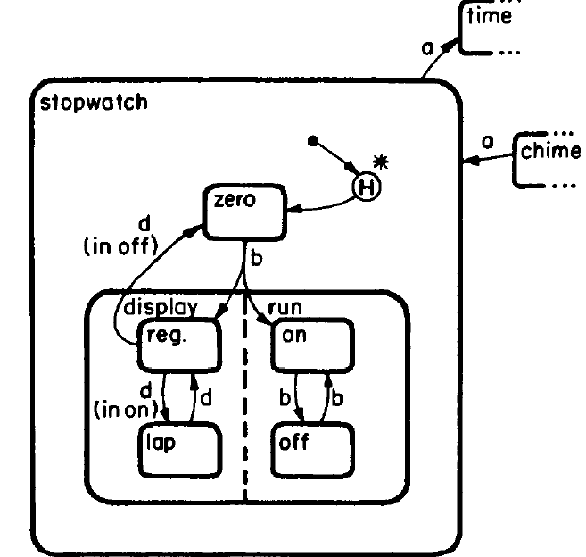
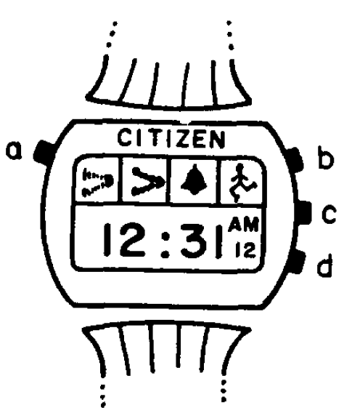
1980s: Statecharts
[David Harel,
Statecharts: A Visual Formalism for Complex Systems,
Science of Computer Programming‚ 1987]

Slide 6
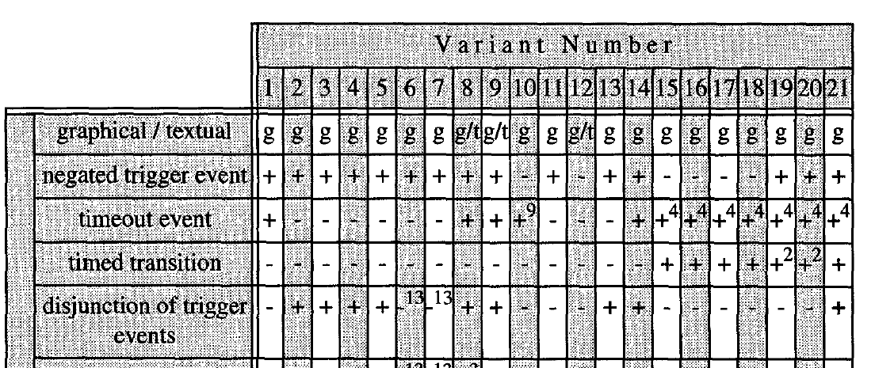
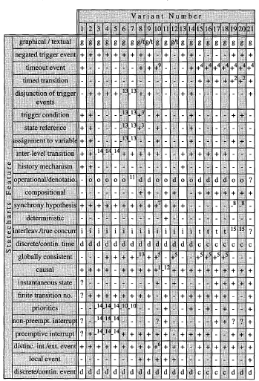
1990s: Many Statecharts
[Michael von der Beeck,
A Comparison of Statecharts Variants,
Formal Techniques in Real-Time and Fault-Tolerant Systems, LNCS 863, 1994]

Slide 7
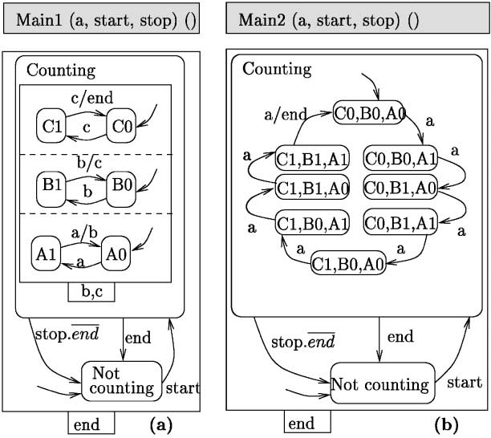
1991:
Argos
[Florence Maraninchi,
The Argos language: Graphical Representation of Automata and Description of Reactive Systems, IEEE Workshop on Visual Languages, Kobe, Japan, 1991]

Slide 8
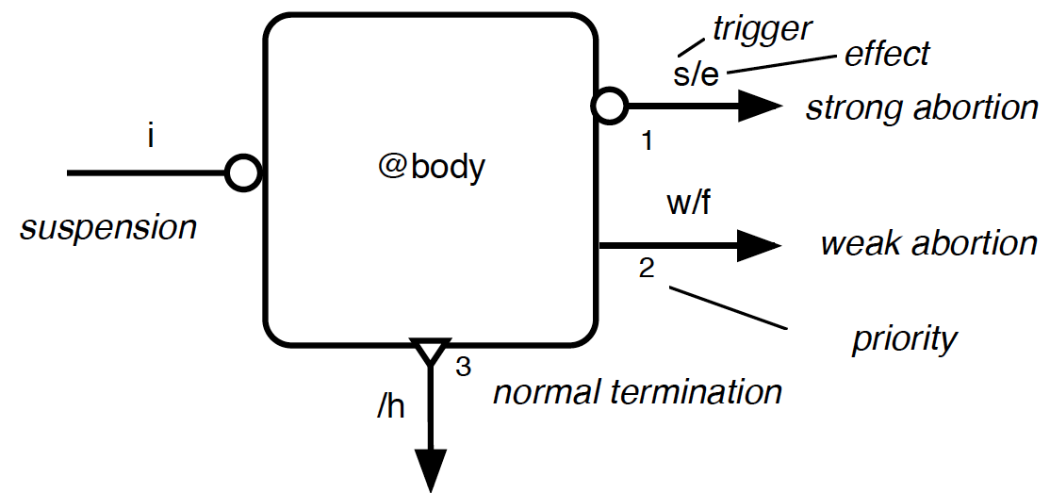
1995: SyncCharts, a.k.a. Safe State Machines
[Charles André,
SyncCharts: A Visual Representation of Reactive Behaviors,
Research Report 95-52, I3S, Sophia Antipolis, 1995]

Slide 9
SCCharts – Motivation

Slide 10
Limitations of Strict Synchrony
if (!x) {
x = true;
}
Good C

Slide 11
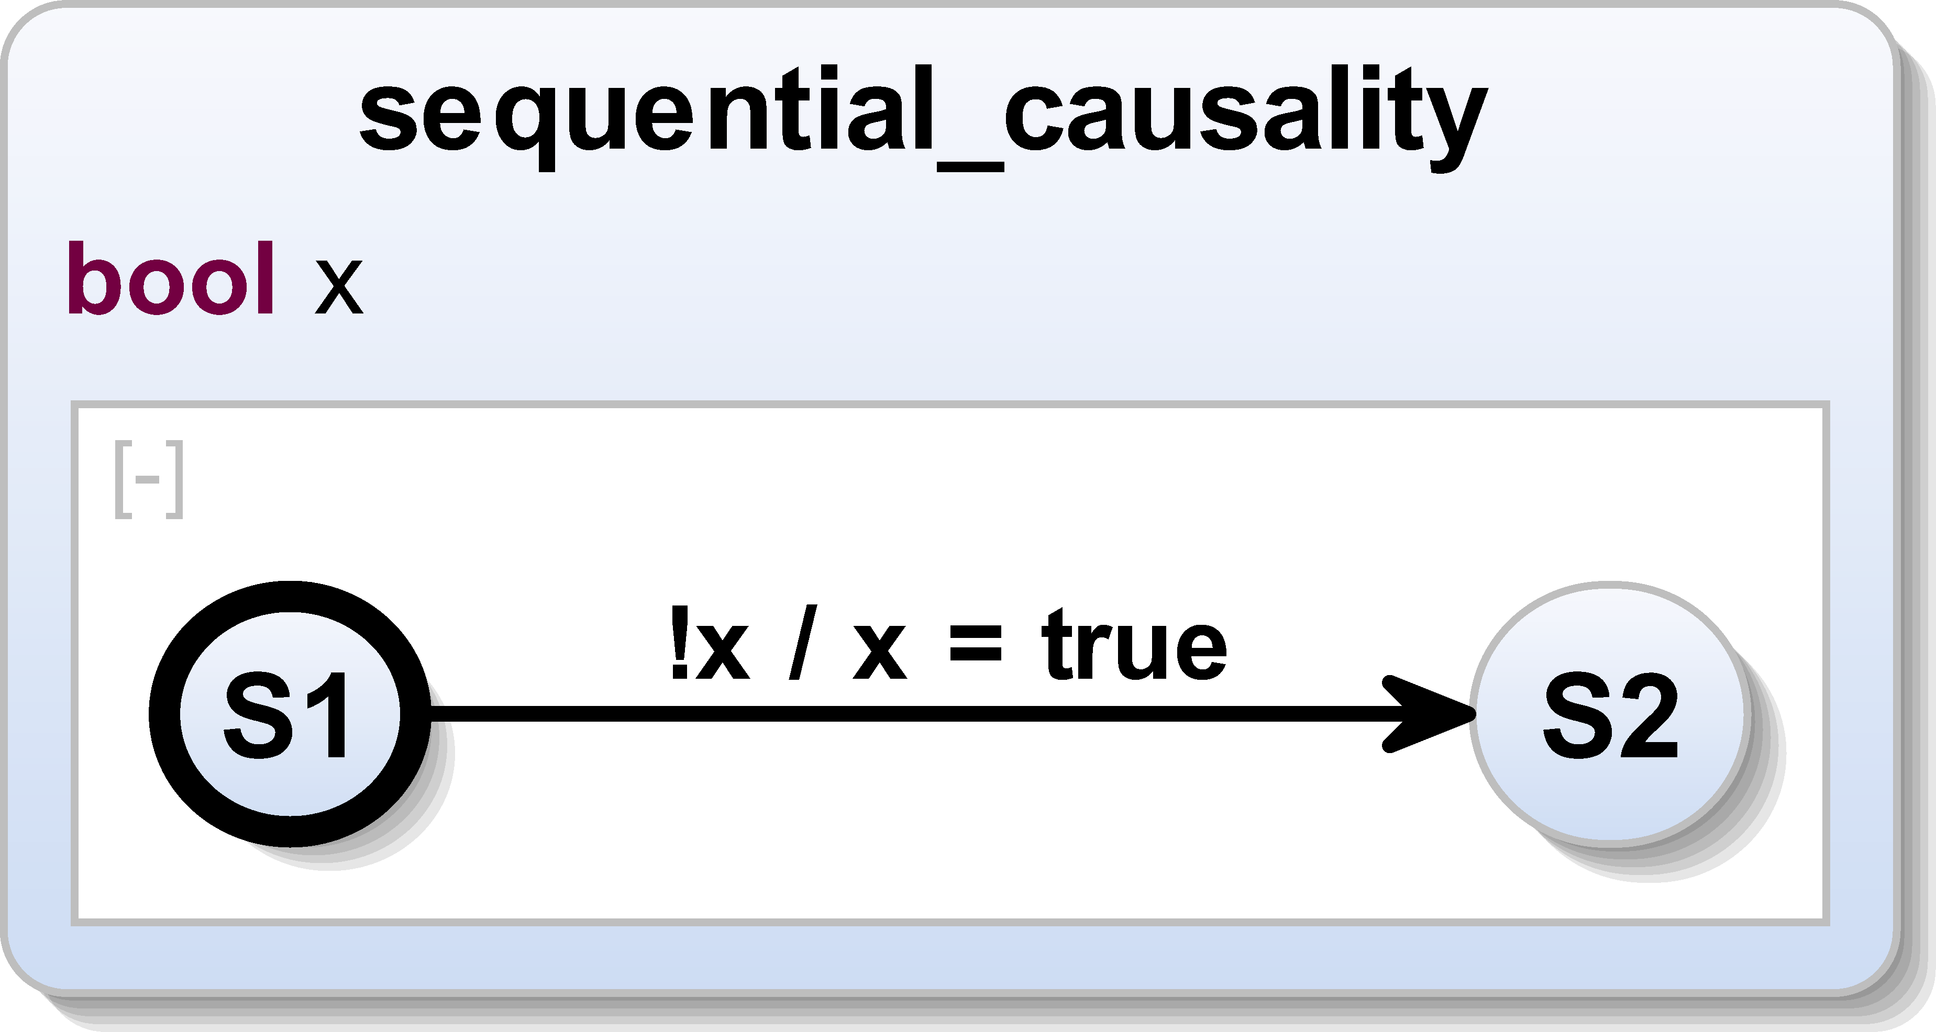
Limitations of Strict Synchrony
Bad SyncChart
Good SCChart

Slide 12
Limitations of Strict Synchrony
present x else
emit x
end
Bad Esterel
Good SCEst

Slide 13
SCCharts – Motivation
Preserve nice properties of synchronous programming
Determinacy
Sound semantic basis
Efficient synthesis
Reduce the pain
Make it easy to adapt for mainstream programmer
Reject only models where determinacy is compromised

Slide 14
Model of Computation

Slide 15
Sequential Constructiveness
Sequential control flow overrides „write before read“
Writes visible only to reads that are
sequential successors or
concurrent
[v. Hanxleden, Mendler, et al.,
Sequentially Constructive Concurrency—A Conservative Extension of the Synchronous Model of Computation,
ACM TECS ’14]

Slide 16
SCCharts – MoC
It’s all about scheduling variable accesses within reaction …
Sequential accesses to x: unconstrained
Concurrent accesses to x („iur protocol“):
init
x = 1 …
Concurrent accesses may lead to causality cycles – compiler must reject those
⇒ updates
x += 2 … x += 5 …
⇒ reads
y = x … z = x

Slide 17
SCCharts – MoC
SCChart / SCEst program is …
… SC, „is sequentially constructive,“ if
  there exist runs obeying iur protocol
  all such runs produce same result
… SCC, „corresponds to sequentially constructive circuit,“ if it is SC and does not „speculate“

Slide 18
Program Classes
module XYpresent:
[
emit X
||
present X then emit Y end
]
module ABBA:
[
present A and I
then emit B end
||
present B and not I
then emit A end
||
present A or B
then emit O end
]
BC
module XYelse:
[
present X then emit Y end
||
present Y else emit X end
]
Acyclic BC
Acyclic
module OffOn:
present S then emit T end;
emit S;
present S then emit U end
SCC
SC
module Dynamic:
loop
emit S;
present I then pause end;
present S then emit T end;
present I else pause end
end
module XY:
[
present X then emit Y end
||
present Y then emit X end
]
18

Slide 19
 | Variables |  |  | Pure Signals |  | Signal Values
 | C | Esterel | SCEst | Esterel | SCEst | Esterel | SCEst
Syntax | x = y if (x) | x := y if x | x = y if (x) | emit x present x | emit x unemit x present x if (x) | emit x(v) ?x | emit x(v) ?x set x(v) unemit x
Type | arbitrary | arbitrary | arbitrary | present/ absent | present/absent | arbitrary | arbitrary
Initialized each tick | no | no | no | yes (absent) | yes (absent) | no | no
Persistence across ticks | yes | yes | yes | no | no | yes | yes
Allow multiple values / tick | yes | yes | yes | no | yes | no | yes
Sequential scheduling constraints | none | none | none | first emit ➛ reads | none | emits ➛ reads | none
Concurrent scheduling constraints | none | read only | inits ➛ updates ➛ reads | first emit ➛ reads | unemits ➛ first emit ➛ reads | emits ➛ reads | unemits ➛ sets ➛ emits ➛ reads
I/O determinacy guaranteed | no | yes | yes | yes | yes | yes | yes

Slide 20
SCCharts – The Language(s)

Slide 21
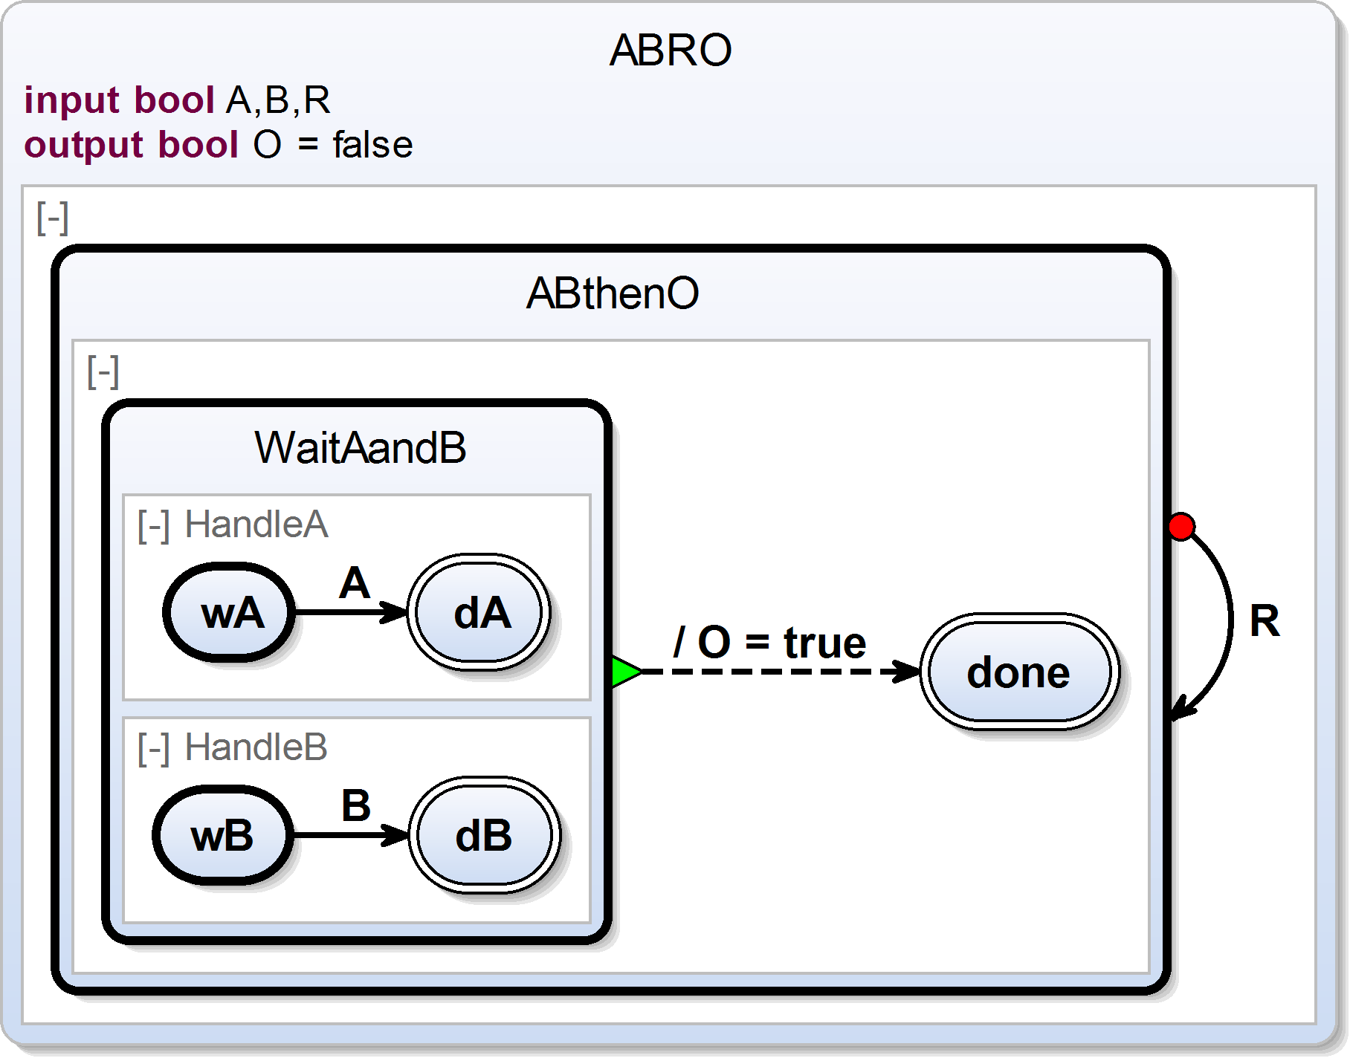
Interface declaration
Initialization

Slide 22
Interface declaration
Initialization
Superstate

Slide 23
Interface declaration
Initialization
Superstate
Region

Slide 24
Interface declaration
Initialization
Superstate
Region
Initial state

Slide 25
Interface declaration
Initialization
Superstate
Region
Initial state
Final state

Slide 26
Interface declaration
Delayed
Transition
(+ Trigger)
Initialization
Superstate
Region
Initial state
Final state

Slide 27
Interface declaration
Delayed
Transition
(+ Trigger)
Initialization
Immediate transition
(+ Effect)
Superstate
Region
Initial state
Final state

Slide 28
Interface declaration
Delayed
Transition
(+ Trigger)
Initialization
Immediate transition
(+ Effect)
Superstate
Region
Strong abort
Initial state
Final state

Slide 29
Interface declaration
Delayed
Transition
(+ Trigger)
Initialization
Immediate transition
(+ Effect)
Superstate
Region
Strong abort
Initial state
Termination
Final state

Slide 30
Interface declaration
Delayed
Transition
(+ Trigger)
Initialization
Immediate transition
(+ Effect)
Superstate
Region
Strong abort
Initial state
Termination
Final state

Slide 31
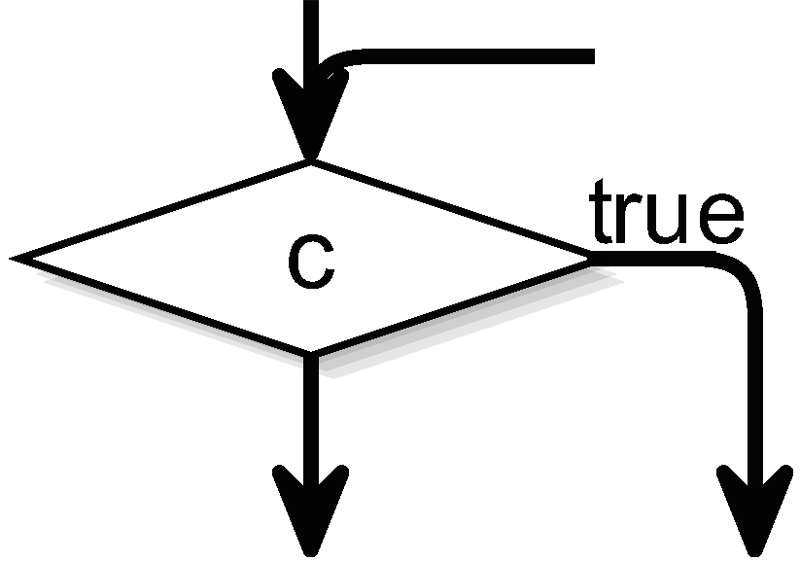
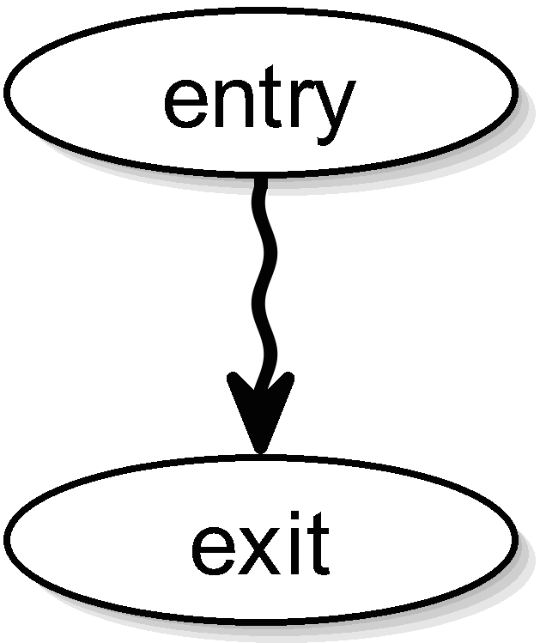
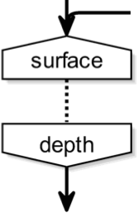
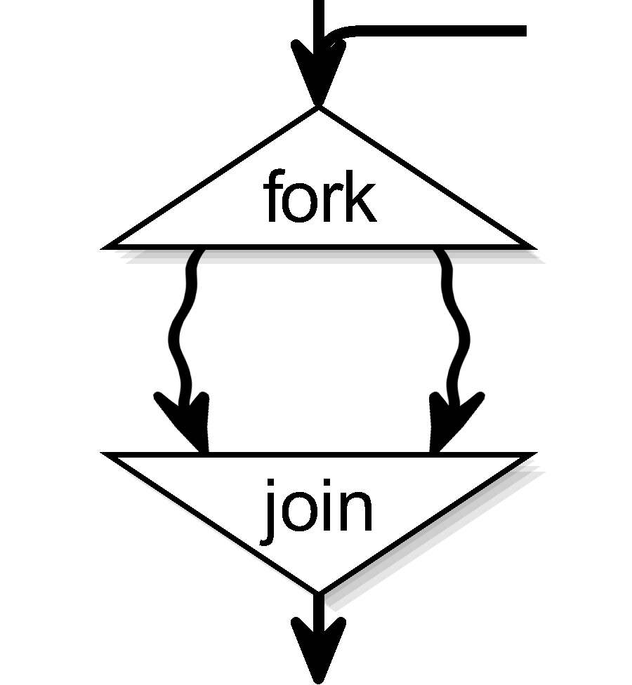
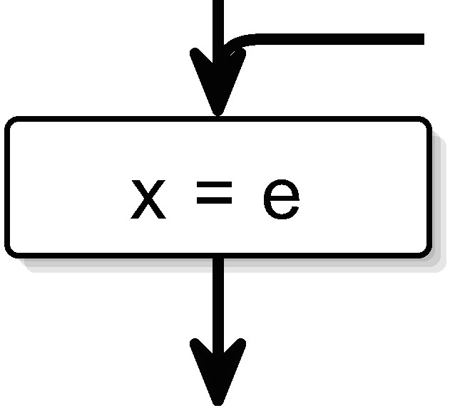
SC MoC Building Blocks
 | Thread | Conditional | Assignment | Concurrency | Delay
SCL | t | if (c) s1 else s2 | x = e | fork t1 par t2 join | pause
SCG

Slide 32
SCChart Building Blocks

Slide 33
M2M Mappings
 | Thread | Conditional | Assignment | Concurrency | Delay
SCL | t | if (c) s1 else s2 | x = e | fork t1 par t2 join | pause
SCG

Slide 34
Some Syntactic Sugar:
Core SCCharts

Slide 35
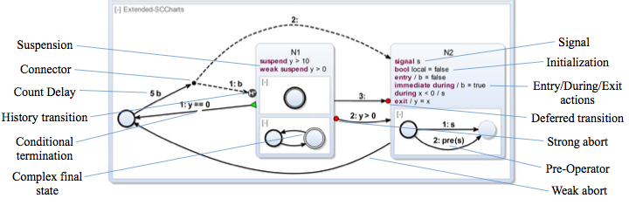
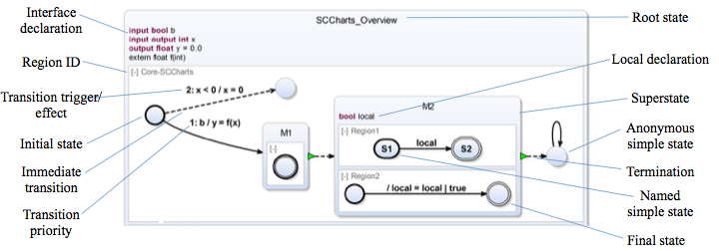
More Syntactic Sugar:
Extended SCCharts

Slide 36
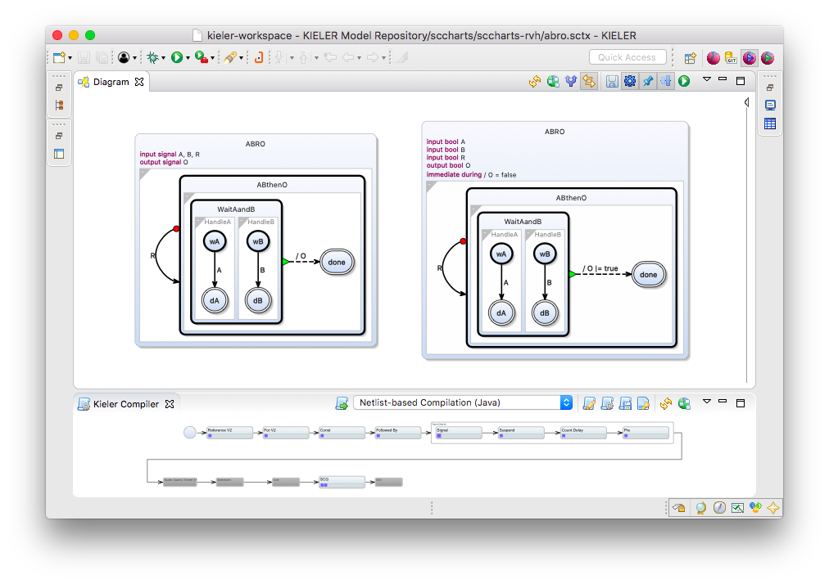
Compilation: Expand Signals

Slide 37
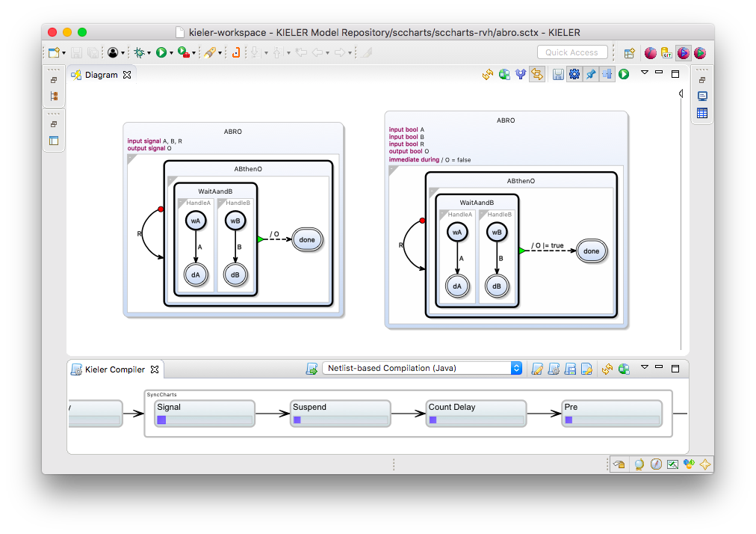
Compilation: Expand Signals

Slide 38
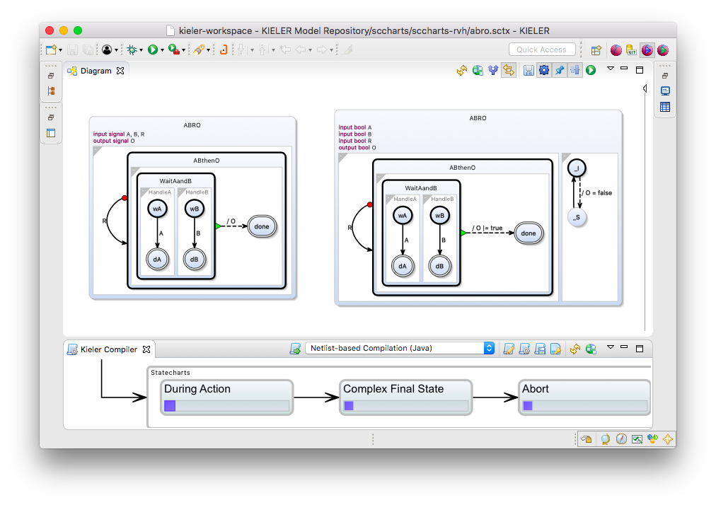
Expand During Action

Slide 39
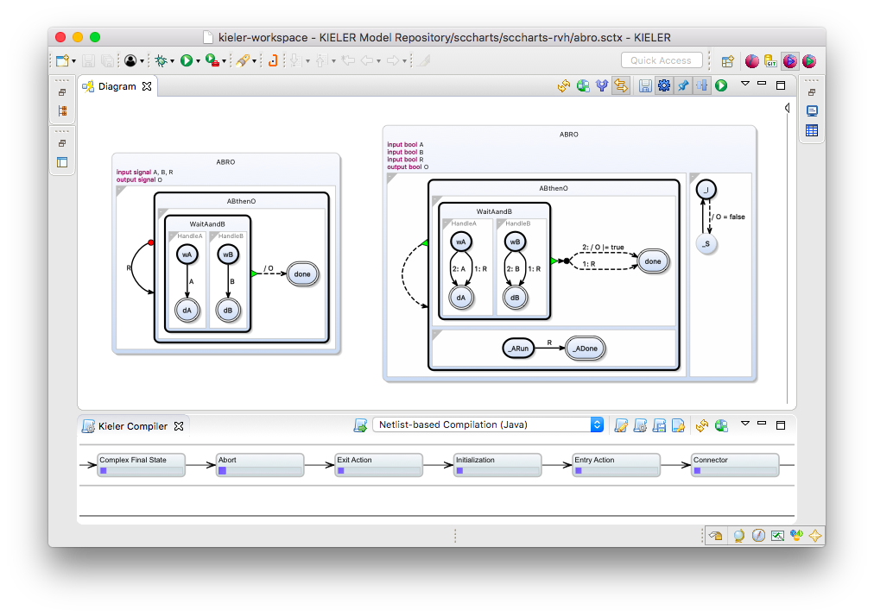
Expand Abort

Slide 40
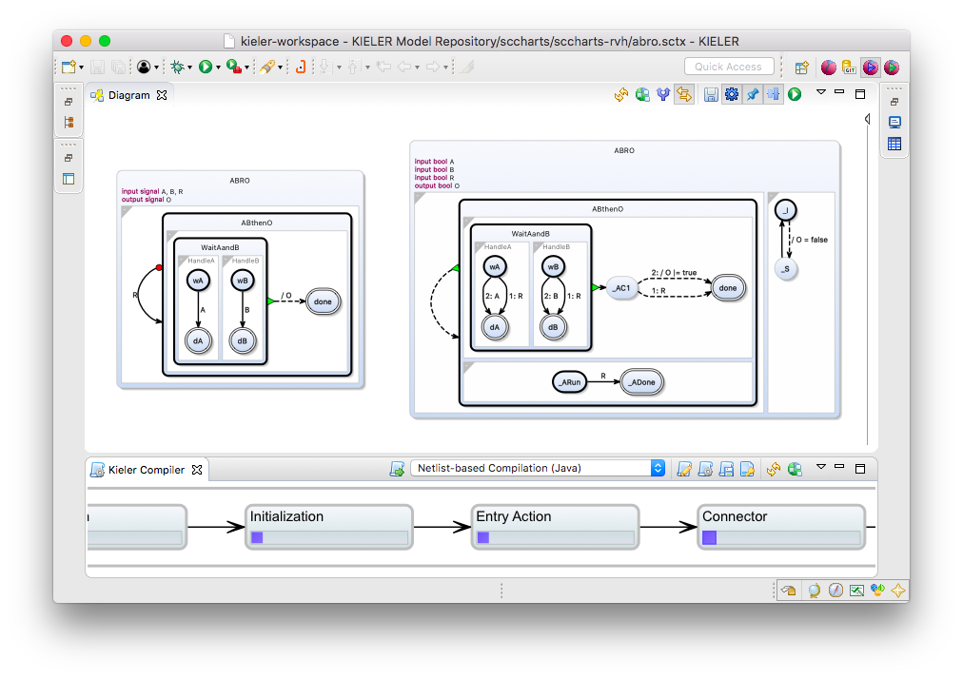
Core SCChart

Slide 41
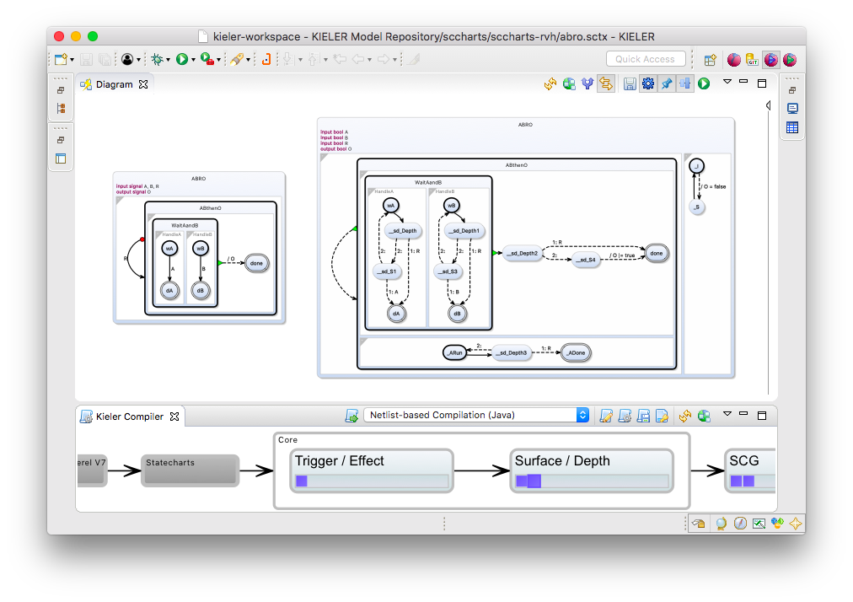
Normalized Core SCChart

Slide 42
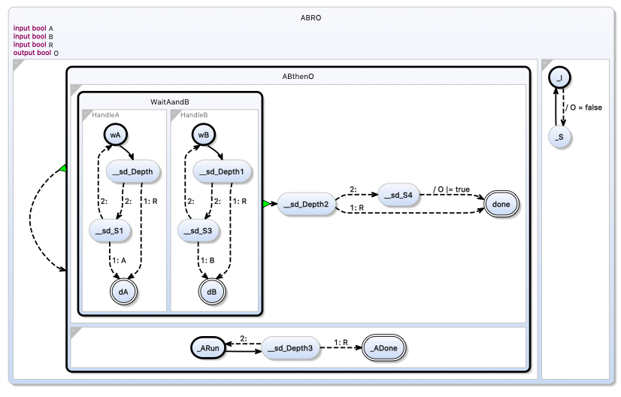
Normalized Core SCChart

Slide 43
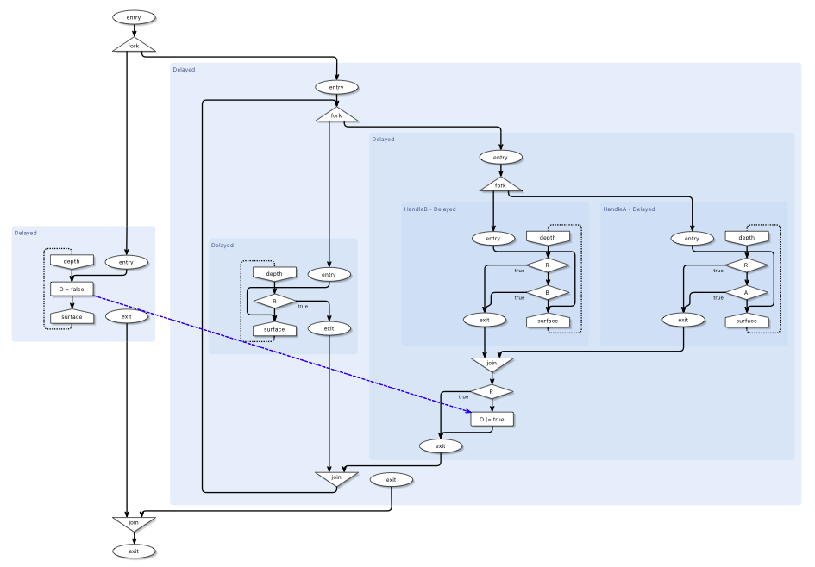
Corresponding SCG

Slide 44
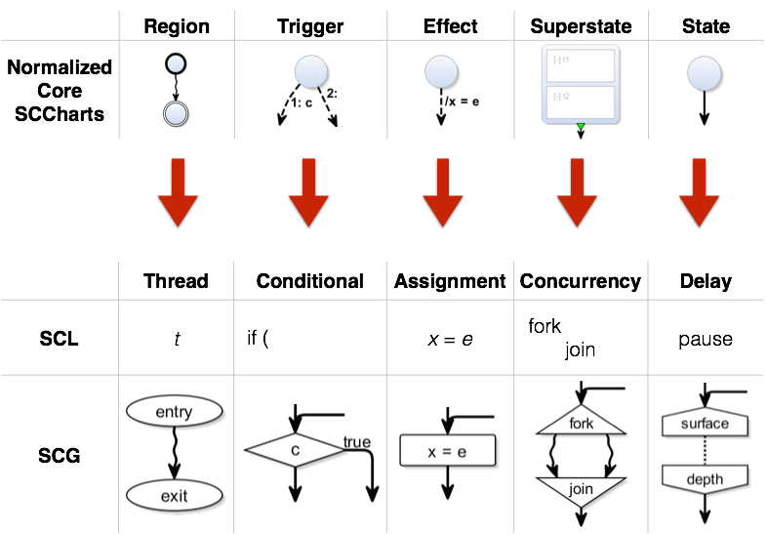
Taking Stock
SCCharts defined by M2M Transformations
Extended SCCharts
Core SCCharts
Normalized Core SCCharts
SCL/SCG

Slide 45
 | Thread | Conditional | Assignment | Concurrency | Delay
SCL | t | if (c) s1 else s2 | x = e | fork t1 par t2 join | pause
SCG

Slide 46
Priority-Based Compilation
More software-like
Don't emulate control flow with guards/basic blocks, but with program counters/threads
Priority-based thread dispatching
SCLP: SCL + PrioIDs
Implemented as C macros

Slide 51
SCCharts – Pragmatics

Slide 52
Key to Pragmatics: MVC
A model represents knowledge
A view is a (visual) representation of its model.
It would ordinarily highlight certain attributes of the model and suppress others.
It is thus acting as a presentation filter.
A controller is the link between a user and the system.
It provides the user with input by arranging for relevant views to present themselves in appropriate places on the screen.
[Trygve Reenskaug,
Models – Views – Controllers,
Xerox PARC technical note, 1979]

Slide 53
Textual Modeling
scchart ABRO {
input signal A, B, R
output signal O
initial state ABthenO {
initial state WaitAandB {
region "HandleA" {
initial state wA
if A go to dA
final state dA
}
region "HandleB" {
initial state wB
if B go to dB
final state dB
}
}
join to done do O
final state done
}
if R abort to ABthenO
}
SCChart model specified in .sctx
Efficient editing
Facilitates model comparison
Easy revision control
Graphical view automatically synthesized with KIELER (controller)
Customizable view
Saves developer time

Slide 54
Eclipse Layout Kernel
SCCharts
http://www.sccharts.com/
http://www.rtsys.informatik.uni-kiel.de/en/research/kieler
https://www.eclipse.org/elk/
All open source, under EPL license

Slide 55
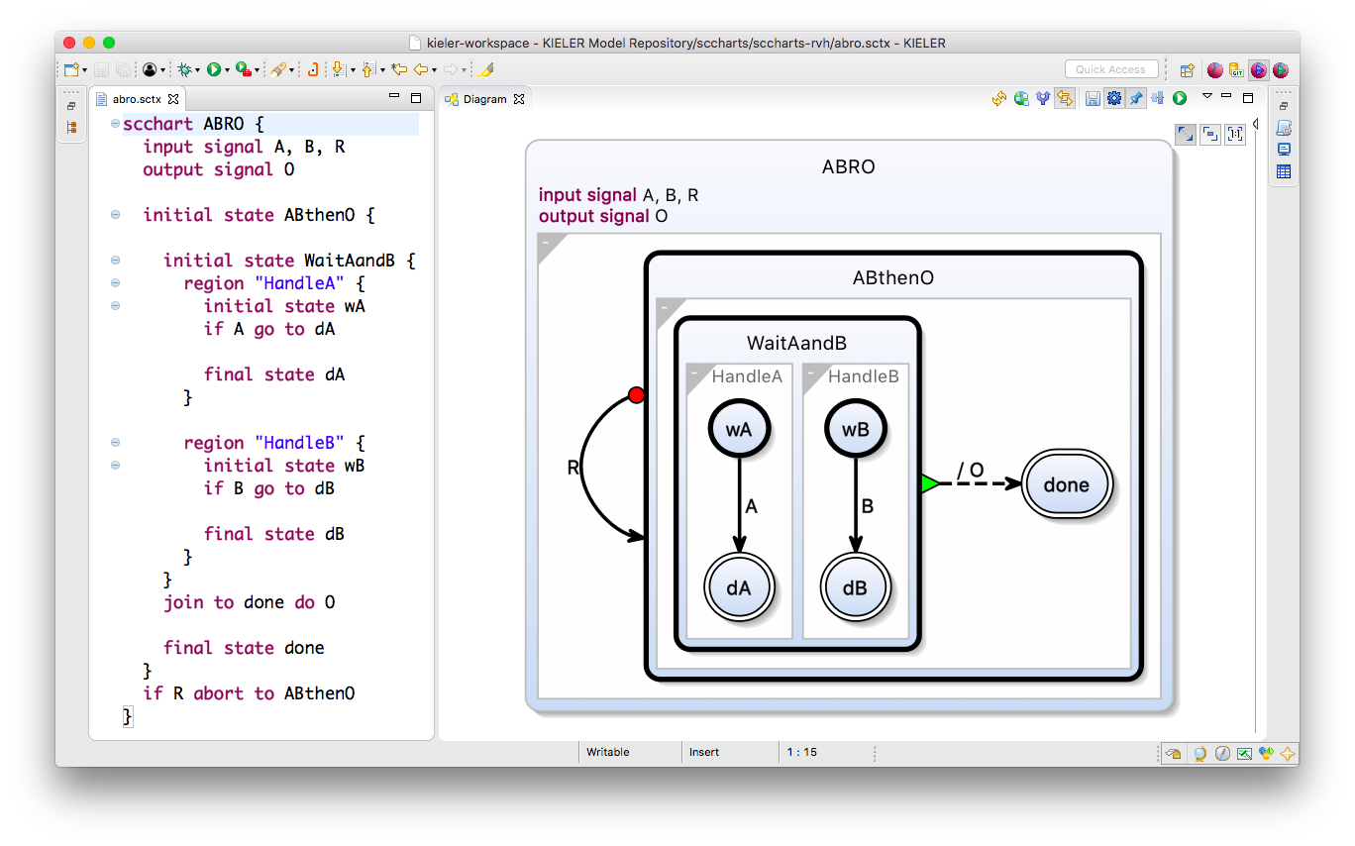
View Synthesis

Slide 56
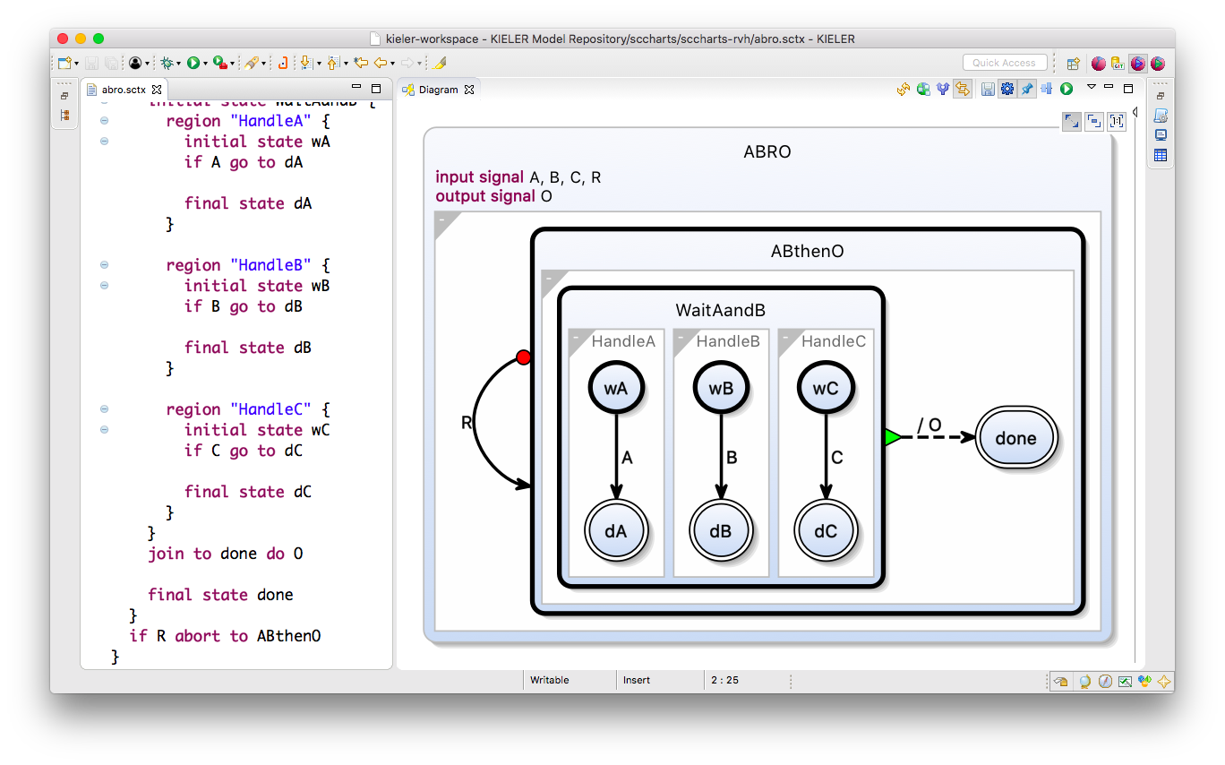
Adding Region “HandleC”

Slide 57
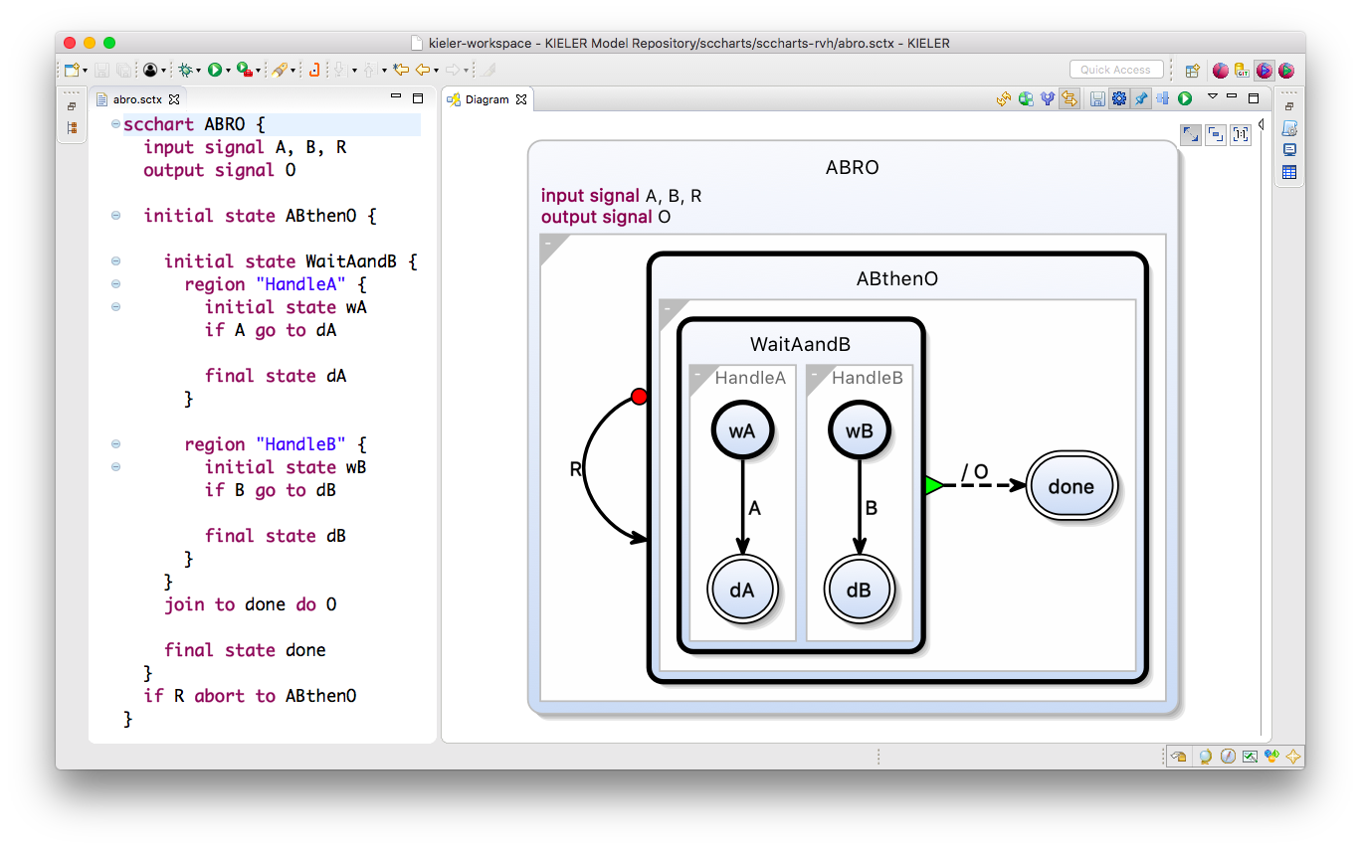
Back to Original ABRO

Slide 58
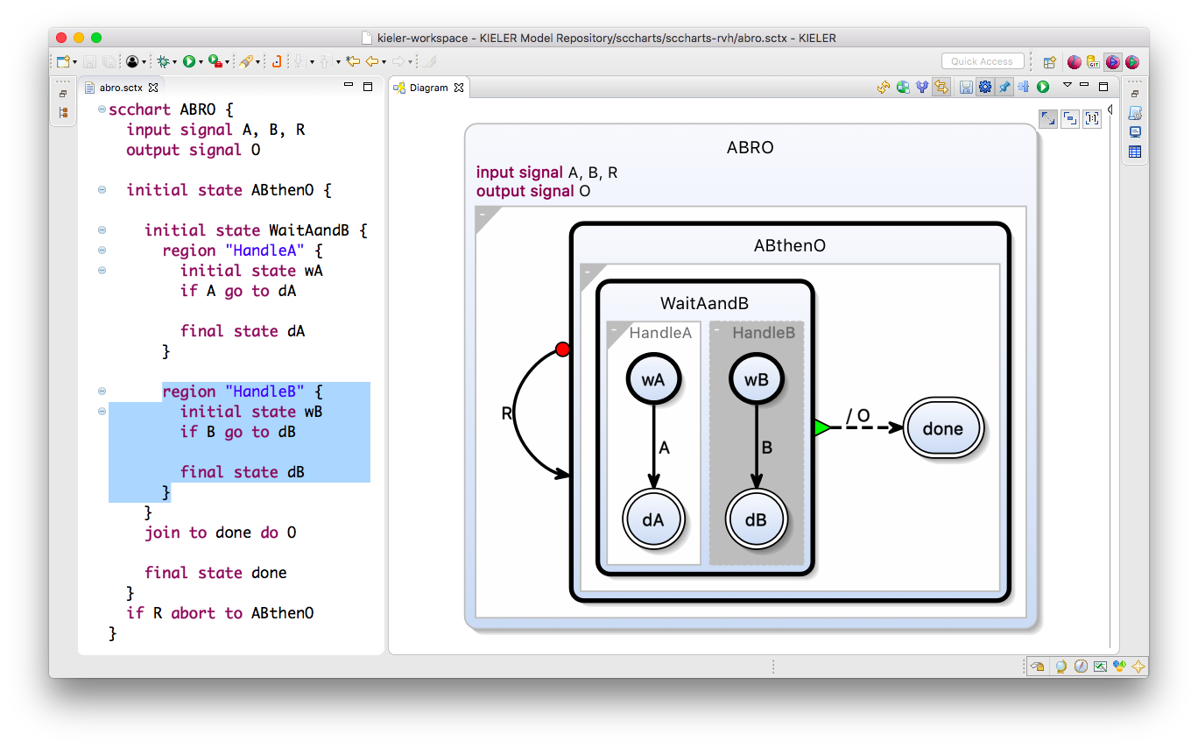
Graphics-to-Text Navigation:
Select Region

Slide 59
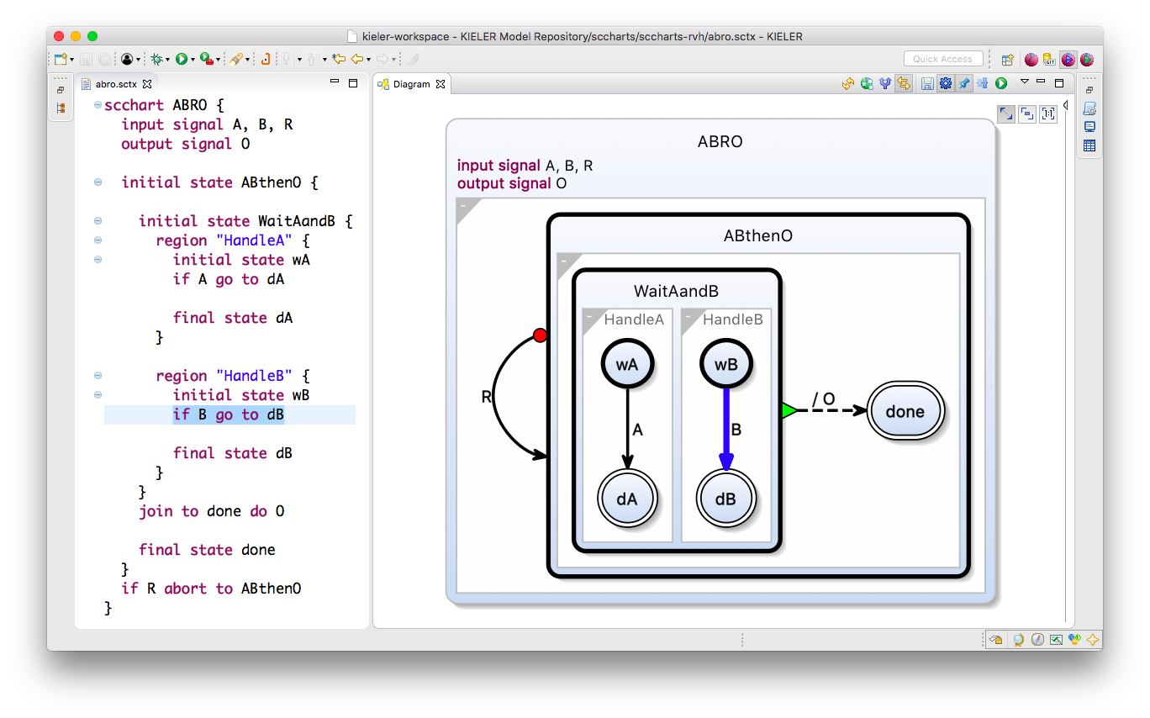
Graphics-to-Text Navigation:
Select Transition

Slide 60
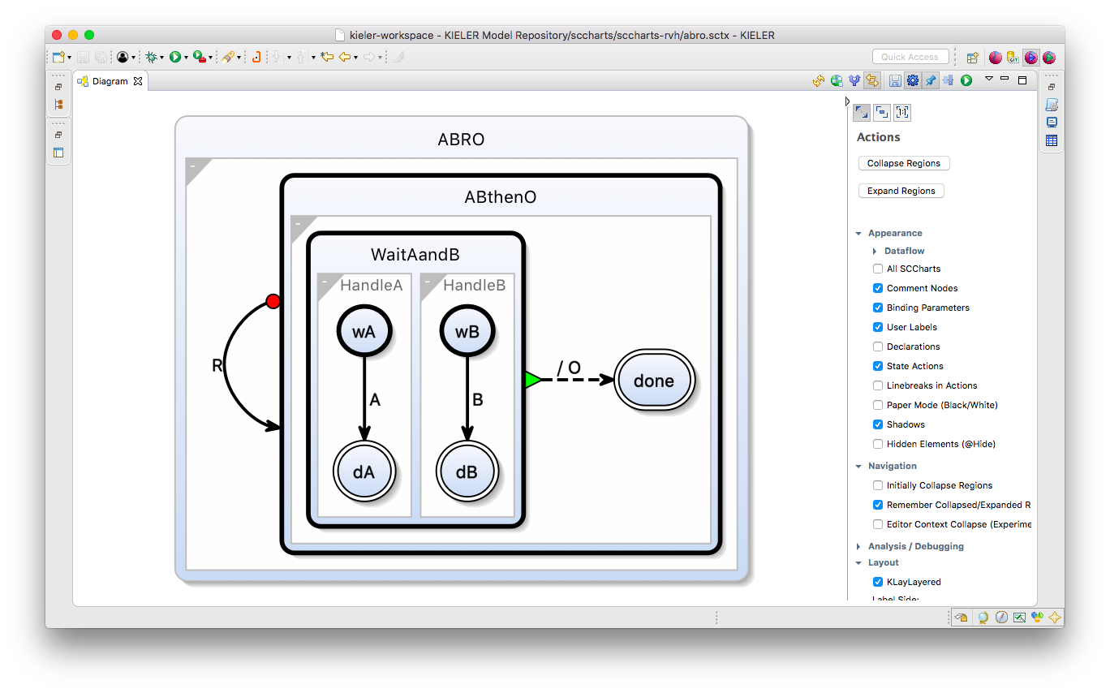
View Filtering: Hide Declarations

Slide 61
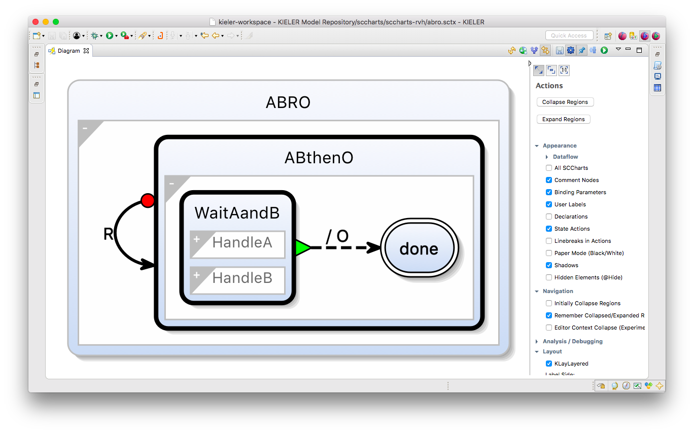
View Filtering: Collapse Regions

Slide 62
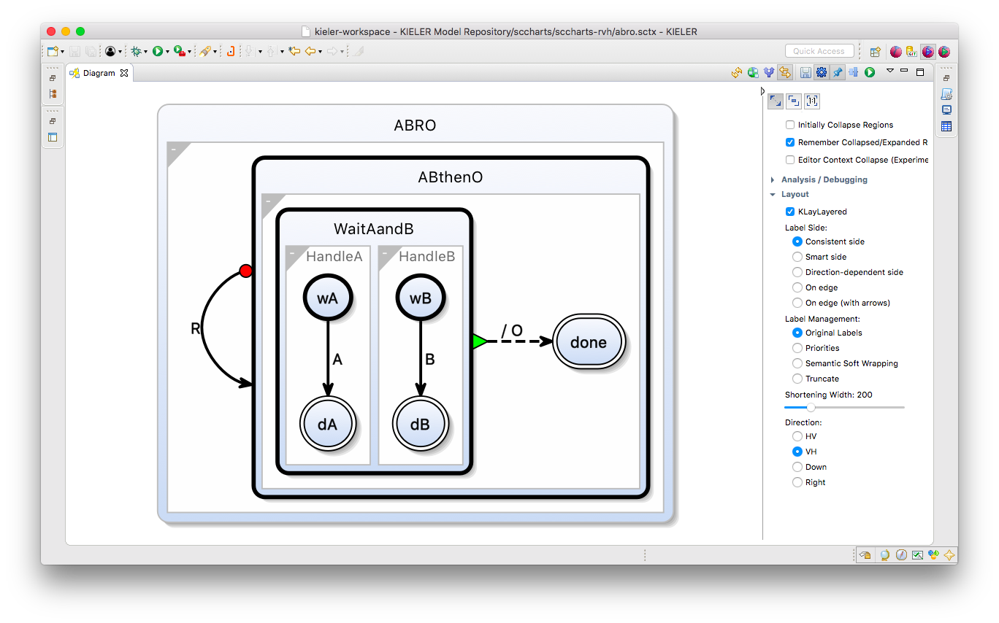
Direction VH (Vertical-Horizontal)

Slide 63
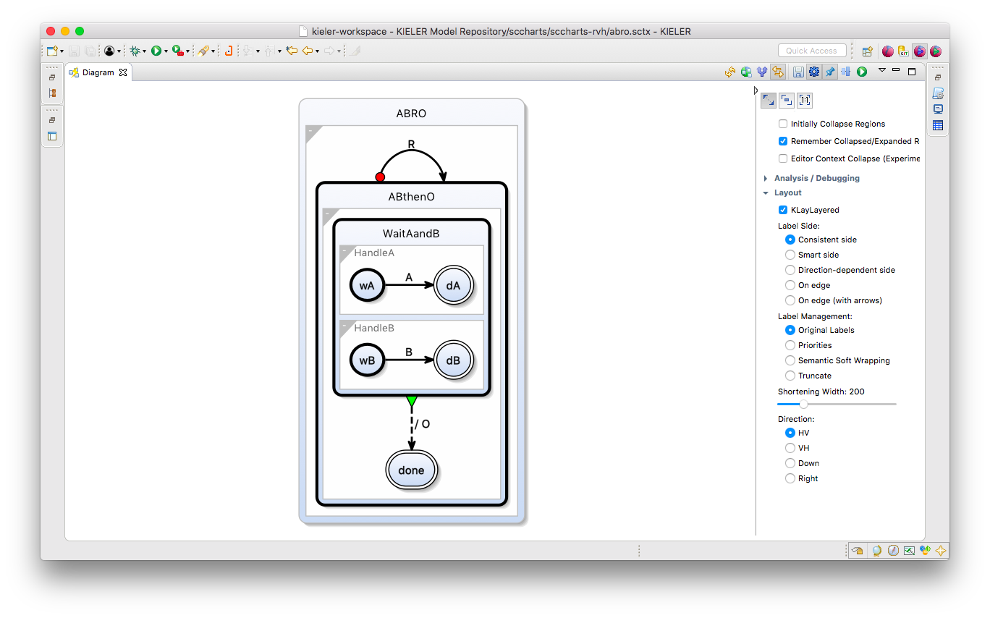
Change Layout: Direction HV

Slide 64
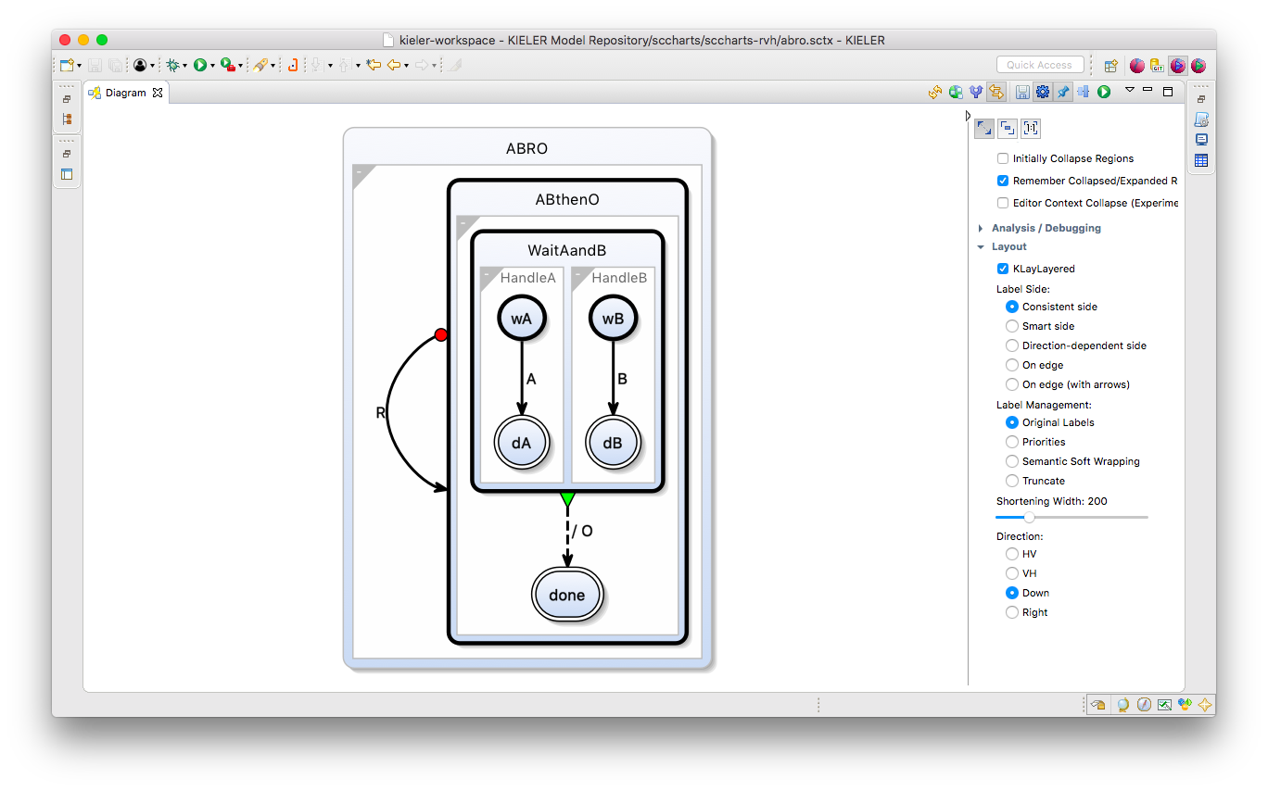
Change Layout: Direction Down

Slide 65
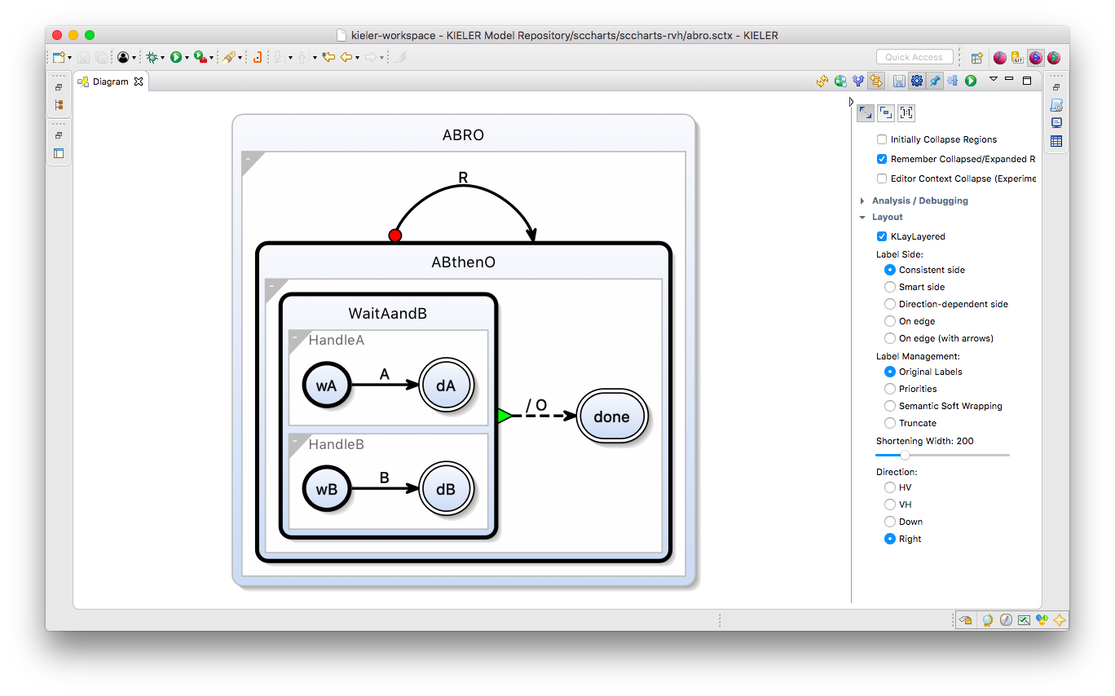
Change Layout: Direction Right

Slide 66
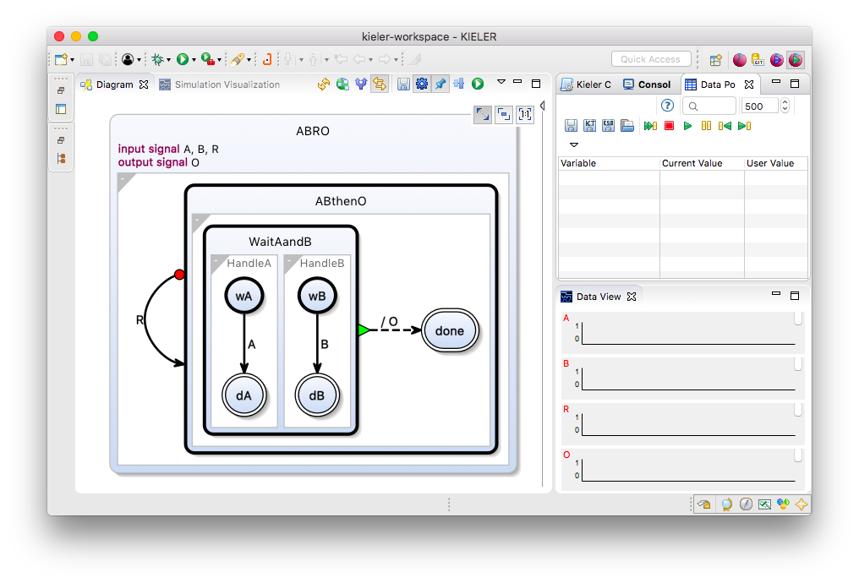
Simulation – Initialization

Slide 67
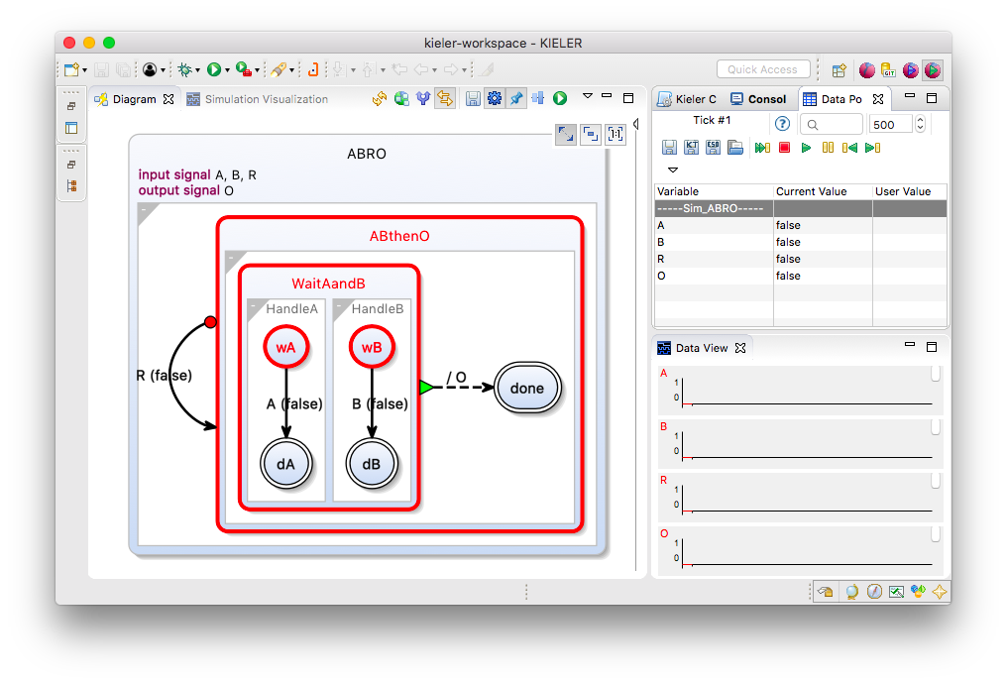
Simulation – Tick 1

Slide 68
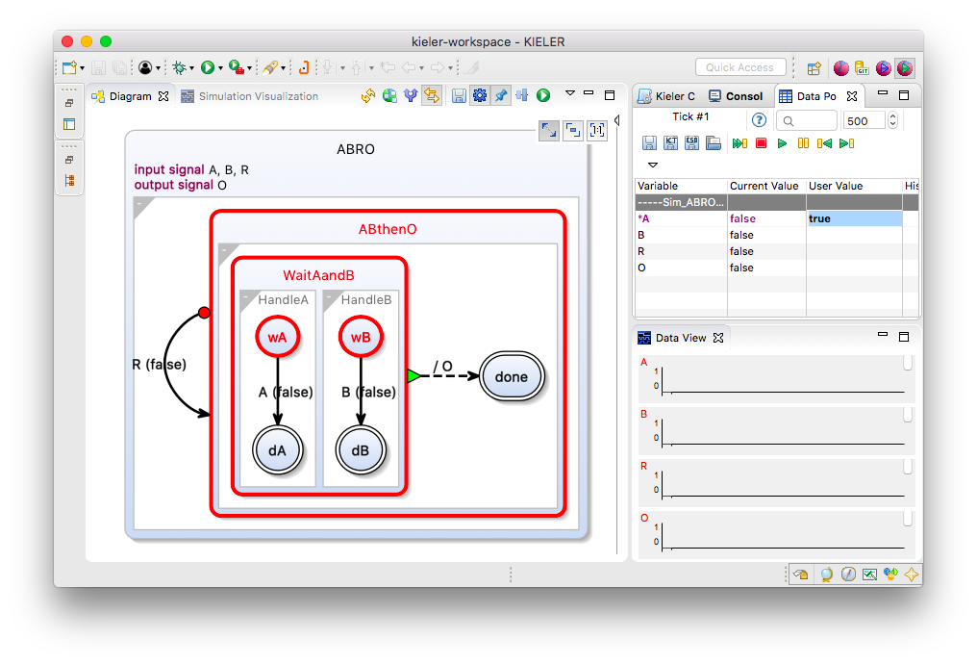
Simulation – Tick 1

Slide 69
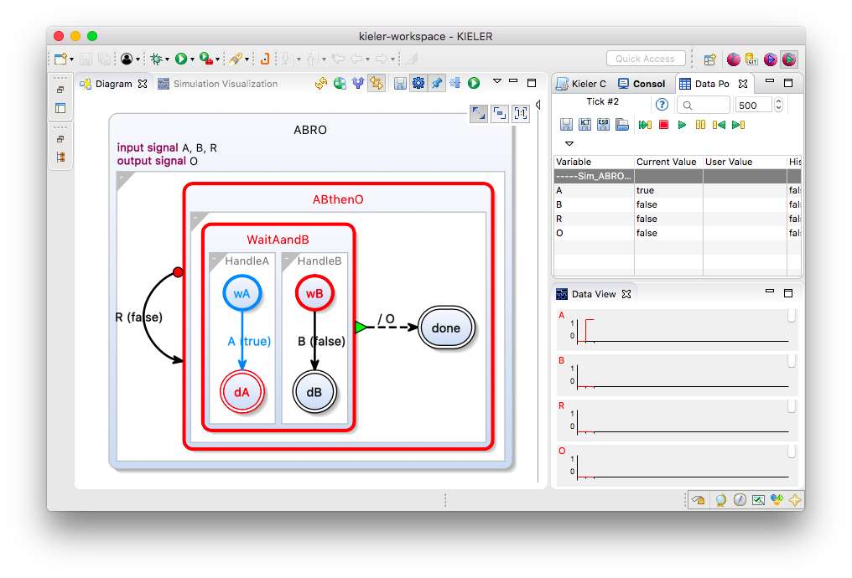
Simulation – Tick 2

Slide 70
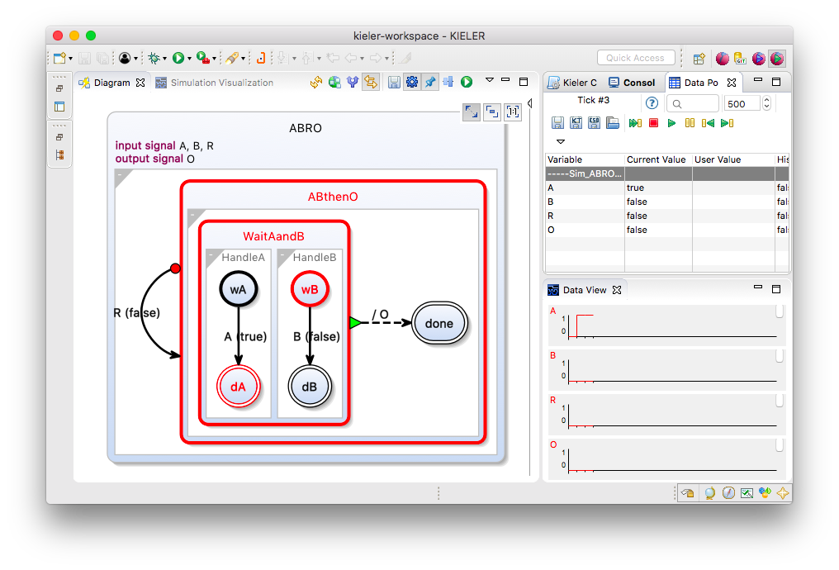
Simulation – Tick 3

Slide 71
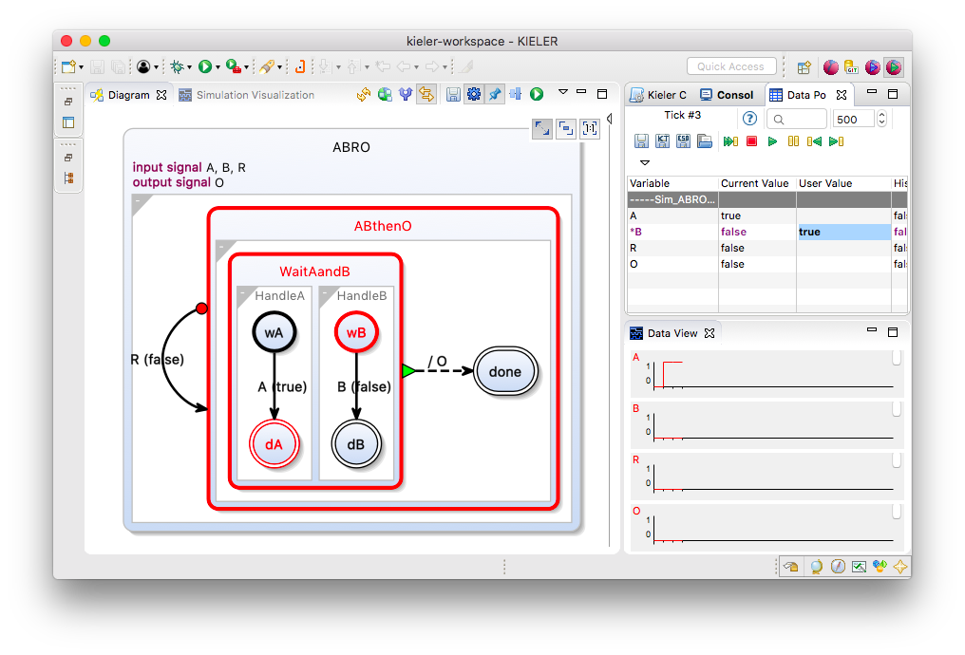
Simulation – Tick 3

Slide 72
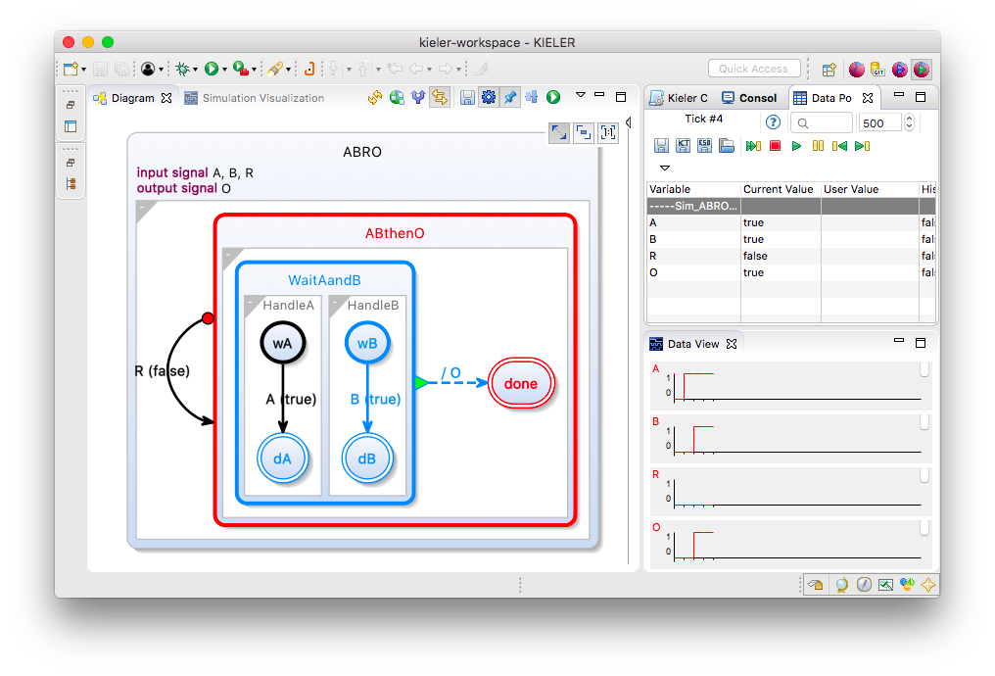
Simulation – Tick 4

Slide 73
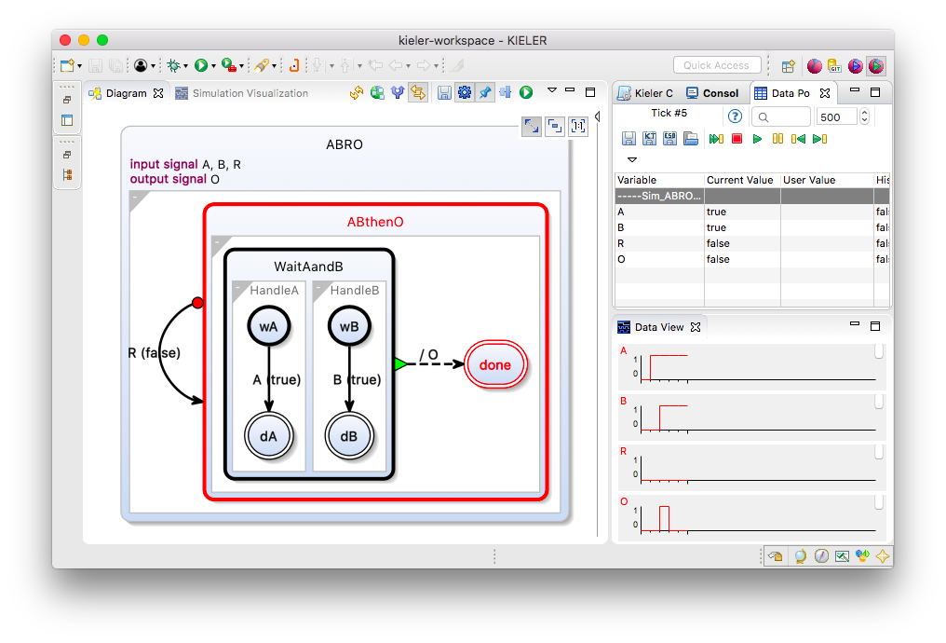
Simulation – Tick 5

Slide 74
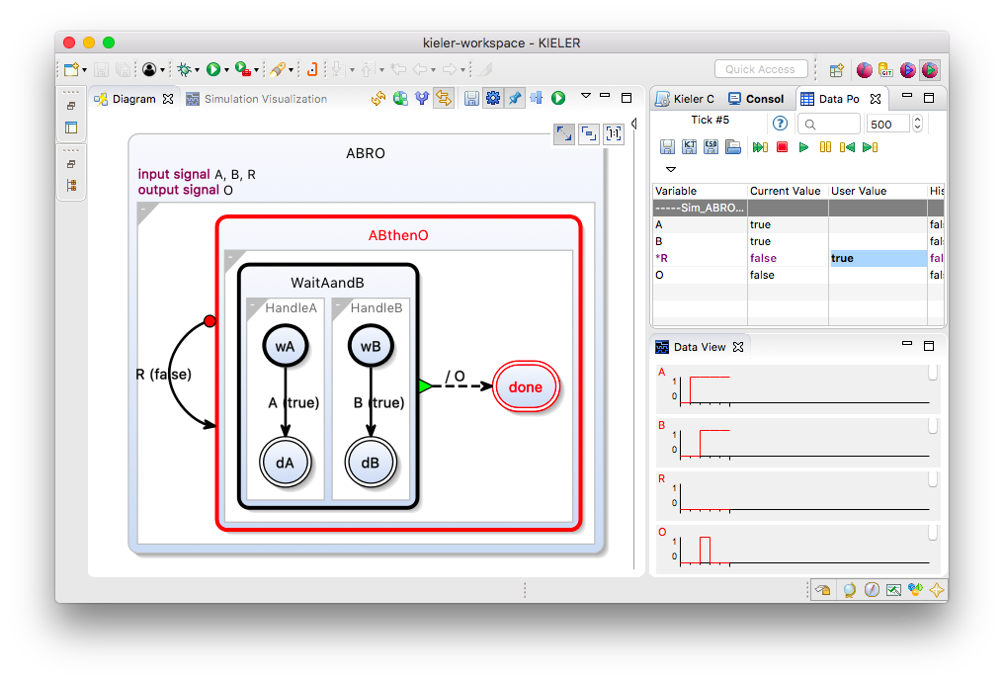
Simulation – Tick 5

Slide 75
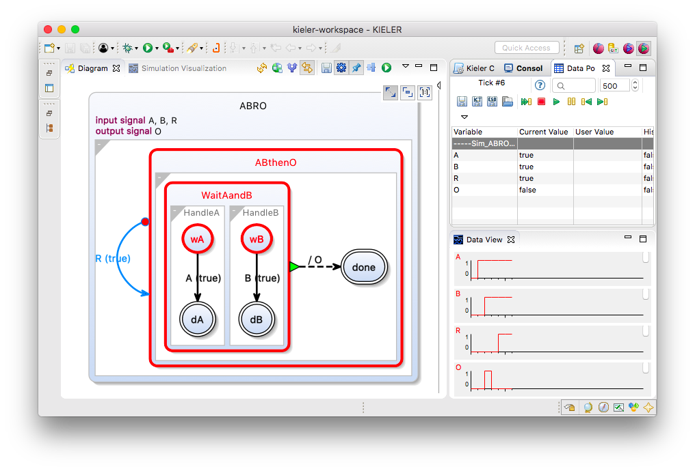
Simulation – Tick 6

Slide 76
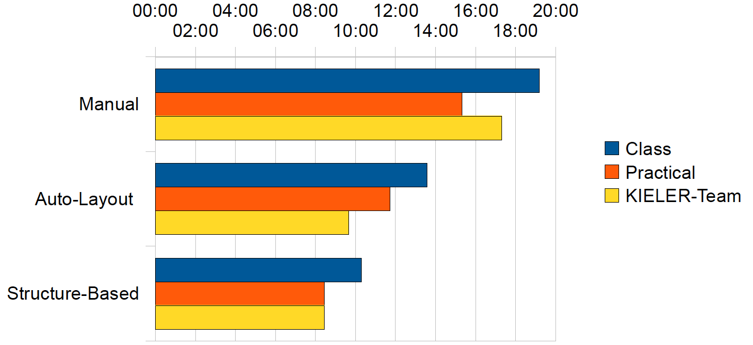

Editing Efficiency: An Experiment
Task: Create diagram from textual specification
Fuhrmann, v. Hanxleden
Taming Graphical Modeling
MODELS’10

Slide 77
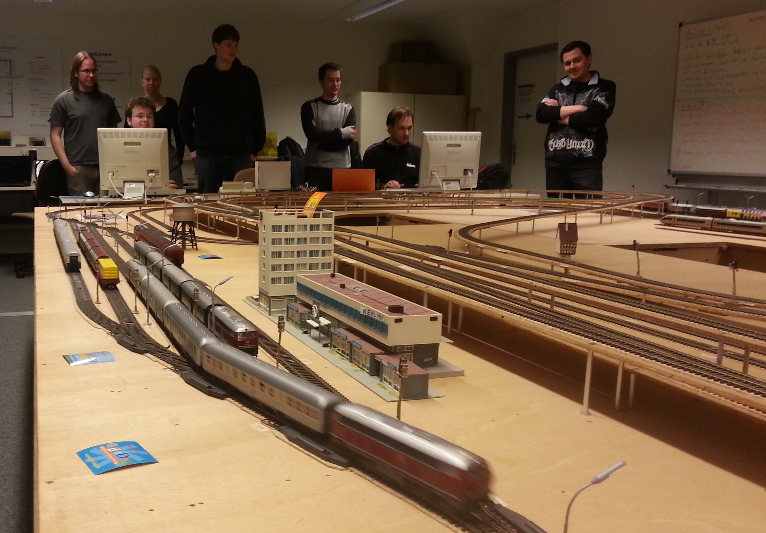
SCCharts – Classroom-Tested

Slide 78
SCCharts – Classroom-Tested
10.000 / 135.000 SCChart nodes
before/after normalization
650.000 lines of C-code
Compiles in about 2 min’s
2 ms reaction time

Slide 79
SCCharts – Modeling Dataflow

Slide 80
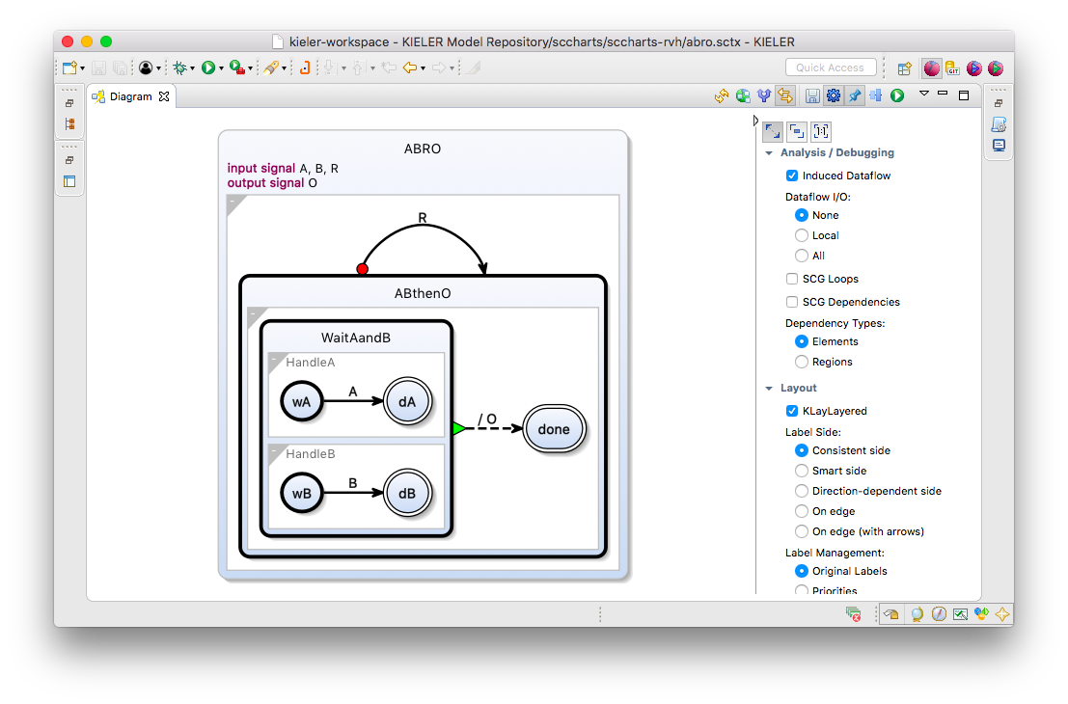
Dataflow View in ABRO

Slide 81
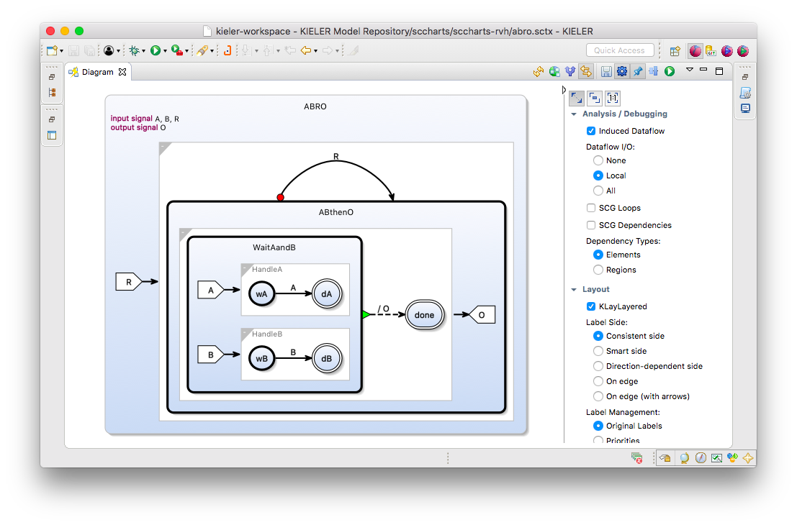
Dataflow View in ABRO

Slide 82

Dataflow View in ABRO

Slide 83

Dataflow View, with Communication
[Wechselberg, Schulz-Rosengarten, Smyth, von Hanxleden
Augmenting State Models with Data Flow
Principles of Modeling – LNCS Festschrift on Edward Lee's 60th Birthday (to appear)]

Slide 84

Dataflow View, with Communication
[Wechselberg, Schulz-Rosengarten, Smyth, von Hanxleden
Augmenting State Models with Data Flow
Principles of Modeling – LNCS Festschrift on Edward Lee's 60th Birthday (to appear)]

Slide 85

Dataflow View, with Communication
[Wechselberg, Schulz-Rosengarten, Smyth, von Hanxleden
Augmenting State Models with Data Flow
Principles of Modeling – LNCS Festschrift on Edward Lee's 60th Birthday (to appear)]

Slide 86

Dataflow View, with Communication
[Wechselberg, Schulz-Rosengarten, Smyth, von Hanxleden
Augmenting State Models with Data Flow
Principles of Modeling – LNCS Festschrift on Edward Lee's 60th Birthday (to appear)]

Slide 87
[Colaço, Pagano, Pouzet,
A Conservative Extension of Synchronous Dataflow with State Machines,
EMSOFT'05]

Slide 88

[Clement Pascutto (ENS), Internship project at Kiel]

Slide 89

[Clement Pascutto (ENS), Internship project at Kiel]

Slide 90


Slide 91
From C to SCCharts

Slide 92
Extracting Visual Models from C
[Smyth, Lenga, von Hanxleden,
Model Extraction of Legacy C Code in SCCharts, ISoLA DS 2016]

Slide 98

SCCharts Wrap-Up
Language
5 core constructs
Smörgåsboard of extensions
Model of Computation
Relaxed synchrony
Still determinate
Can model C programs
Compilation
M2M transformations
Stress-tested in KIELER
Still plenty of things to do: Variants on SC MoC, optimize code generation, pragmatics improvements for schedulability analysis, …

Slide 99
Code Generation

Slide 100
Downstream Compilation
So far, two alternative compilation strategies from SCL/SCG to C/VHDL
 | Dataflow | Priority
Accepts instantaneous loops | – | +
Can synthesize hardware | + | –
Can synthesize software | + | +
Size scales well (linear in size of SCChart) | + | +
Speed scales well (execute only active parts) | – | +
Instruction-cache friendly (good locality) | + | –
Pipeline friendly (little/no branching) | + | –
WCRT predictable (simple control flow) | + | +/–
Low execution time jitter (simple/fixed flow) | + | –
[von Hanxleden, Duderstadt, Motika, et al.,
SCCharts: Sequentially Constructive Statecharts for Safety-Critical Applications,
PLDI'14]

Slide 101

Compilation Option 1: Dataflow

Slide 102

Dataflow SCG

Slide 103

Compilation Option 2: Priority-Based

Slide 104


Compilation Option 2: Priority-Based

Slide 105
Priority-Based C Code
int tick() {
tickstart(7);
fork1(_region_0,_region_1, 3) {
_region_0:
O = 0;
pause;
goto _region_0;
} par {
_region_1:
fork1(_region_2,_region_3, 2) {
_region_2:
prio(6);
pause;
if(R){
} else {
prio(3);
goto _region_2;
}
} par {
_region_3:
fork1(HandleB,HandleA, 1) {
HandleB:
prio(5);
pause;
if(R){
} else {
if(B){
} else {
prio(2);
goto HandleB;
}
}
} par {
HandleA:
prio(4);
pause;
if(R){
} else {
if(A){
} else {
prio(1);
goto HandleA;
}
}
} join2(2, 5);
if(R){
} else {
O |= 1;
}
} join2(3, 6);
prio(3);
goto _region_1;
} join1(7);
tickreturn();
}

Slide 106
SCCharts and Time
Synchrony Hypothesis:
Outputs are synchronous with inputs
Computation "does not take time"
Actual computation time does not influence result
Sequence of outputs determined by inputs

Slide 107
Synchronous Execution
[Benveniste et al., The Synchronous Languages Twelve Years Later, Proc. IEEE, 2003]

Slide 108
Multiform Notion of Time
Only the simultaneity and precedence of events are considered.
This means that the physical time does not play any special role.
This is called multiform notion of time.
[https://en.wikipedia.org/wiki/Esterel]

Slide 109
Packaging Physical Time as Events
[Timothy Bourke, SYNCHRON 2009]
Event "HMS": 100 μsec have passed since last HMS
Event "TMS": 1000 μsec have passed since last TMS

Slide 110
A Problem With That ...
[Timothy Bourke, SYNCHRON 2009]

Slide 111
Dynamic Ticks
Recall logical time:
Physical time,
time-triggered:
Physical time,
dynamic ticks:
[von Hanxleden, Bourke, Girault,
Real-Time Ticks for Synchronous Programming, FDL'17]

Slide 112
Eclipse Layout Kernel
Official Eclipse project
Some users:
  Bosch/ETAS (EHANDBOOK)
  Embraer (in-house Simulink autolayout)
  itemis (Franca project)
  Papyrus (Sequence Diagram Editor)
  UC Berkeley (Ptolemy)
  Sigasi (Sigasi Studio)

Slide 113
In our experience over many years my colleagues and I concluded that textual modeling is the only practical way,
but that a graphical view of the models is a must-have as well.
Your technology closes exactly that gap.
Dr. Andreas Seibel, BSH Hausgeräte GmbH
E-Mail from Oct. 6, 2017

Slide 114
SCCharts Textual Representation
/** Controller for stepper motor
*/
scchart MOTOR {
output int currentUsec = 0; // [usec] Current simulated time;
// when deployed, this should be input
output int wakeUsec; // [usec] Time for next wake-up
input bool accel, decel; // Increase/decrease speed
input bool stop; // Emergency stop - sets (angular) speeds to 0
output bool motor = false; // Motor pulse
output float v; // [cm/sec] Robot speed
output int pMotorUsec; // [usec] Half period for motor
int pSetSpeedsMaxUsec = 500000; // [usec] Maximum period of speed control loop
int pSetSpeedsMinUsec = 400000; // [usec] Minimum period of speed control loop
output int pUsec; // [usec] Previous period (delta of wake-up times)
output int pMinUsec = pSetSpeedsMaxUsec; // [usec] Minimum period
float dV = 2; // [cm/sec] Delta v applied during one speed
// control loop cycle
float vMax = 20; // [cm/sec] Max speed of left/right motor
float cmPerHalfPeriod = 1; // [cm] Distance traveled by motor per half period
// (duration of true or false)
// ===================================================================================
region SetSpeeds:
initial state SetSpeeds "" {
// Possible syntax, to replace the clk flag and the GenClk region,
// and not having to condition delayed triggers with "clk &":
// clock type = soft, min = pSetSpeedsMinUsec, max = pSetSpeedsMaxUsec
bool clk; // Local clock
// ===================================================================================
region ProcessInputs:
initial state Init
--> Running immediate;
state Running {
entry / v = 0;
// ===================================================================================
region CalcV:
initial state Pause
--> Accel with clk & accel & !decel
--> Decel with clk & decel & !accel;
state Accel
--> CheckMax immediate with / v += dV;
state Decel
--> CheckMin immediate with / v -= dV;
state CheckMax
--> SetPeriod immediate with v <= vMax
--> SetPeriod immediate with / v = vMax;
state CheckMin
--> SetPeriod immediate with v >= - vMax
--> SetPeriod immediate with / v = - vMax;
state SetPeriod
--> Pause immediate with v == 0 / pMotorUsec = 0
--> Pause immediate with / pMotorUsec =
'(int) (1000000 * cmPerHalfPeriod / v)';
}
o-> Running with clk & stop / pMotorUsec = 0;
// ===================================================================================
region GenClk:
initial state GenClkState {
int myWakeMinUsec, myWakeMaxUsec;
initial state Init
--> AssertWakeTime immediate with / clk = true;
myWakeMinUsec = currentUsec + pSetSpeedsMinUsec;
myWakeMaxUsec = currentUsec + pSetSpeedsMaxUsec;
connector state AssertWakeTime
--> Pause immediate with / wakeUsec = myWakeMaxUsec; // Initialize wakeUsec
@layout[layerConstraint] LAST
state Pause
--> AssertWakeTime with currentUsec < myWakeMinUsec / clk = false
--> Init;
};
};
// ===================================================================================
region CtrlMotor:
initial state CtrlMotor "" {
// Possible syntax, to replace the clk flag and the GenClk region,
// and not having to condition delayed triggers with "clk &":
// clock type = hard, min = 1000000 * cmPerHalfPeriod / vMax // = 50000
bool clk; // Local clock
// ===================================================================================
region GenClk:
initial state GenClkState "" {
int myWakeUsec;
initial state Stopped
--> AssertWakeTime immediate with pMotorUsec > 0 / myWakeUsec = currentUsec +
pMotorUsec; clk = true;
connector state AssertWakeTime
--> Running immediate with / wakeUsec min= myWakeUsec; // Initialize wakeUsec
@layout[layerConstraint] LAST
state Running
--> ResetClock with / clk = false;
connector state ResetClock
--> AssertWakeTime immediate with pMotorUsec > 0 & currentUsec < myWakeUsec
--> Stopped immediate;
};
// ===================================================================================
region Motor:
initial state Low
--> High with clk / motor = true;
state High
--> Low with clk / motor = false;
};
// ===================================================================================
region SimTime:
initial state SimTimeState "" {
during / pUsec = currentUsec;
currentUsec = pre(wakeUsec);
pUsec = currentUsec - pUsec;
pMinUsec min= pUsec;
};
}

Slide 115
Now use KIELER to synthesize graphical SCChart with ELK and simulate ...
/** Controller for stepper motor
*/
scchart MOTOR {
output int currentUsec = 0; // [usec] Current simulated time; when deployed, this should be input
output int wakeUsec; // [usec] Time for next wake-up
input bool accel, decel; // Increase/decrease speed
input bool stop; // Emergency stop - sets (angular) speeds to 0
output bool motor = false; // Motor pulse
output float v; // [cm/sec] Robot speed
output int pMotorUsec; // [usec] Half period for motor
int pSetSpeedsMaxUsec = 500000; // [usec] Maximum period of speed control loop
int pSetSpeedsMinUsec = 400000; // [usec] Minimum period of speed control loop
output int pUsec; // [usec] Previous period (delta of wake-up times)
output int pMinUsec = pSetSpeedsMaxUsec; // [usec] Minimum period
float dV = 2; // [cm/sec] Delta v applied during one speed control loop cycle
float vMax = 20; // [cm/sec] Max speed of left/right motor
float cmPerHalfPeriod = 1; // [cm] Distance traveled by motor per half period (duration of true or false)
// ===================================================================================
region SetSpeeds:
initial state SetSpeeds "" {
// Possible syntax, to replace the clk flag and the GenClk region,
// and not having to condition delayed triggers with "clk &":
// clock type = soft, min = pSetSpeedsMinUsec, max = pSetSpeedsMaxUsec
bool clk; // Local clock
// ===================================================================================
region ProcessInputs:
initial state Init
--> Running immediate;
state Running {
entry / v = 0;
// ===================================================================================
region CalcV:
initial state Pause
--> Accel with clk & accel & !decel
--> Decel with clk & decel & !accel;
state Accel
--> CheckMax immediate with / v += dV;
state Decel
--> CheckMin immediate with / v -= dV;
state CheckMax
--> SetPeriod immediate with v <= vMax
--> SetPeriod immediate with / v = vMax;
state CheckMin
--> SetPeriod immediate with v >= - vMax
--> SetPeriod immediate with / v = - vMax;
state SetPeriod
--> Pause immediate with v == 0 / pMotorUsec = 0
--> Pause immediate with / pMotorUsec =
'(int) (1000000 * cmPerHalfPeriod / v)';
}
o-> Running with clk & stop / pMotorUsec = 0;
// ===================================================================================
region GenClk:
initial state GenClkState {
int myWakeMinUsec, myWakeMaxUsec;
initial state Init
--> AssertWakeTime immediate with / clk = true;
myWakeMinUsec = currentUsec + pSetSpeedsMinUsec;
myWakeMaxUsec = currentUsec + pSetSpeedsMaxUsec;
connector state AssertWakeTime
--> Pause immediate with / wakeUsec = myWakeMaxUsec; // Initialize wakeUsec
@layout[layerConstraint] LAST
state Pause
--> AssertWakeTime with currentUsec < myWakeMinUsec / clk = false
--> Init;
};
};
// ===================================================================================
region CtrlMotor:
initial state CtrlMotor "" {
// Possible syntax, to replace the clk flag and the GenClk region,
// and not having to condition delayed triggers with "clk &":
// clock type = hard, min = 1000000 * cmPerHalfPeriod / vMax // = 50000
bool clk; // Local clock
// ===================================================================================
region GenClk:
initial state GenClkState "" {
int myWakeUsec;
initial state Stopped
--> AssertWakeTime immediate with pMotorUsec > 0 / myWakeUsec = currentUsec +
pMotorUsec; clk = true;
connector state AssertWakeTime
--> Running immediate with / wakeUsec min= myWakeUsec; // Initialize wakeUsec
@layout[layerConstraint] LAST
state Running
--> ResetClock with / clk = false;
connector state ResetClock
--> AssertWakeTime immediate with pMotorUsec > 0 & currentUsec < myWakeUsec
--> Stopped immediate;
};
// ===================================================================================
region Motor:
initial state Low
--> High with clk / motor = true;
state High
--> Low with clk / motor = false;
};
// ===================================================================================
region SimTime:
initial state SimTimeState "" {
during / pUsec = currentUsec;
currentUsec = pre(wakeUsec);
pUsec = currentUsec - pUsec;
pMinUsec min= pUsec;
};
}

Slide 116


Slide 117

[Wechselberg, Schulz-Rosengarten, Smyth, von Hanxleden
Augmenting State Models with Data Flow
Principles of Modeling – LNCS Festschrift on Edward Lee's 60th Birthday (to appear)]

Slide 118
Modeling Pragmatics
Goal: Better use of 1) designer’s time, 2) screen real estate
State of Practice:
  Modeler draws view of a model
  (manual place & route – tedious!)
  Tool infers model
Our approach:
  Modeler constructs model
  Tool continuously updates view of a model,
  with automatic layout and filtering

Slide 119
Pragmatics Wrap-Up
The Problem: Lots of productivity wasted with drawing diagrams manually
Our Approach: Pragmatics-aware modeling
  Let designer concentrate on model,
  automatically synthesize views
  Employ filtering to synthesize views
  customized to user stories
  Key enabler: automatic layout

